Slide 1
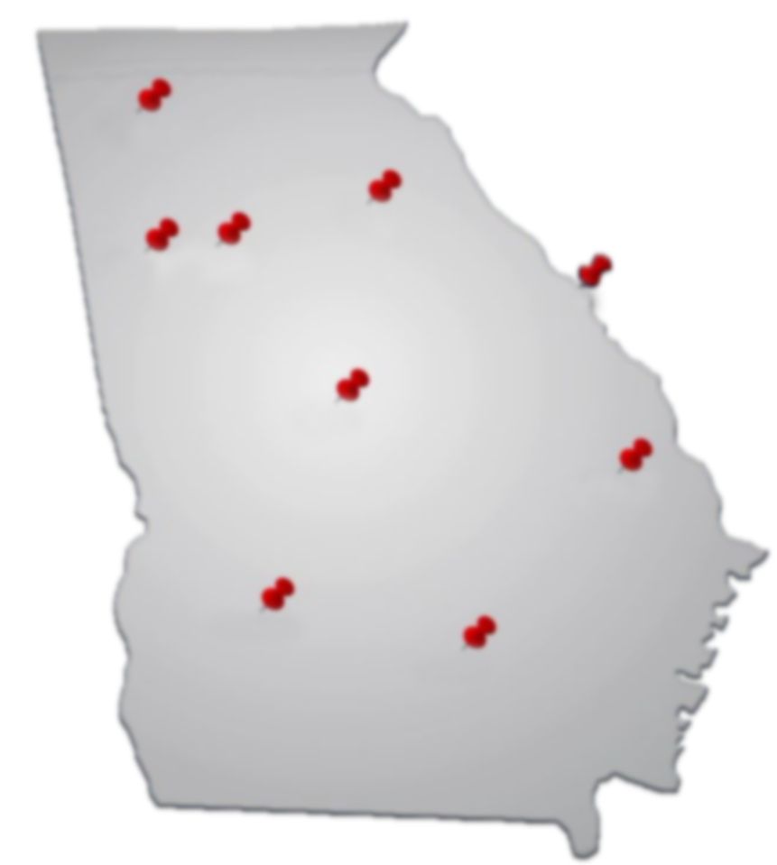
GEORGIA DEPARTMENT OF AUDITS AND ACCOUNTS
Annual Updates
and
Tips for Preparing for a
Successful Single Audit
September 19, 2021
Professional People with Purpose

Slide 2
Objectives
Provide basic DOAA updates
Year in Review
Technology Advances
Robotic Process Automation (RPA)
Post-Pandemic Workplace Strategy
Tips for Preparing for a Successful Single Audit
What, Why, Who and How
Everchanging Landscape
Preparations
More Tips
Innovation Hub
Client Portal
New Website

Slide 3
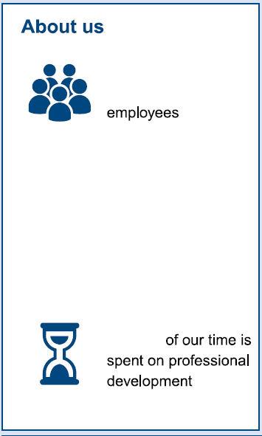
Year in Review
We Audited
State government entities
Local school districts
252 employees
Managing $64 Billion in funds
70
entities
Employing over 74,000 people
128 staff with adv. degrees or certifications
Educating over 1.7 million students
Receiving a portion of $11.3 Billion in state QBE funds
140
entities
4.8% of available work hours spent on training
We also…
X%
Performed 1,258 Reviews of Local Governments and Non-Profit Organizations
Managed Immigration Compliance Reporting for 2,421 entities
$33 Million annual budget
315
financial audit reports
16
performance audit reports
129
fiscal notes & retirement certs
2,990
property appraisals

Slide 7
Technology Advances
Robotic Process Automation
Innovation Hub
Client Portal
New Website

Slide 8
Robotic Process Automation (RPA)
Automated Processes to retrieve Audit Data from Various Public Websites
Automated Process to Publish Audit Reports
Automated Processes to create standard letters and reports
Freeing up time to focus on improving the audit experience, client needs, and delivering quality services.

Slide 9
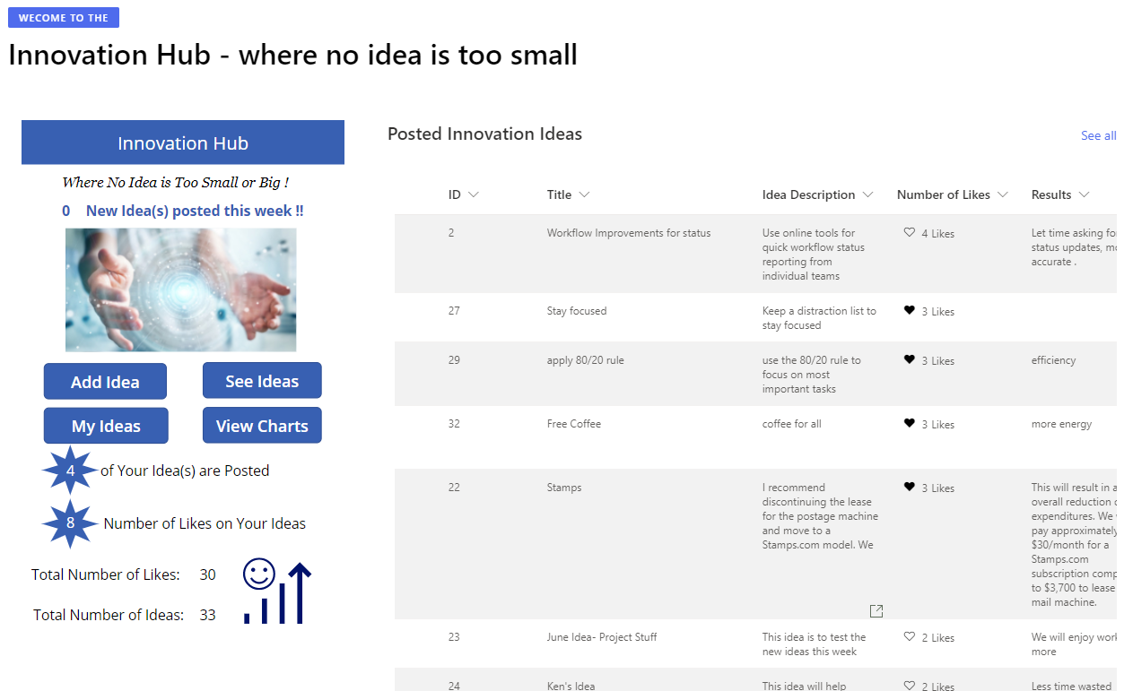
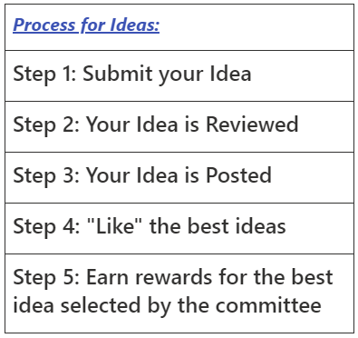
Innovation Hub

Slide 10
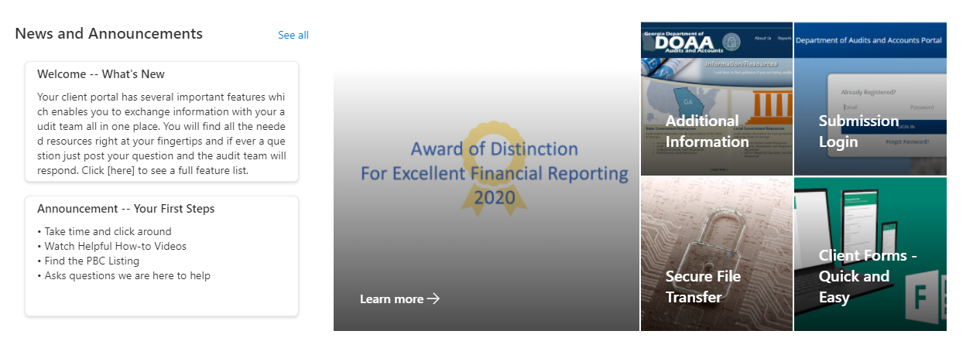
Client Portal – Information at Your Fingertips

Slide 11
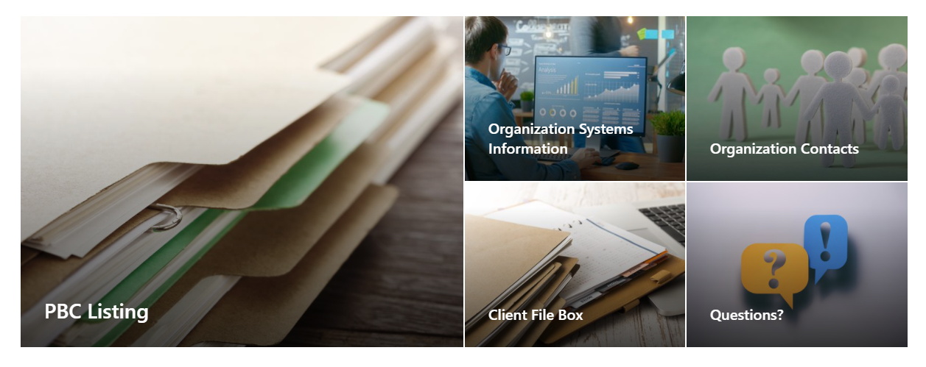
Client Portal – Information at Your Fingertips
Current Deadlines and Issues
Prepared by Client Listing
Manage Systems Information
Manage Contact Information
Upload and Retrieve Files
Submit Questions
Complete Forms

Slide 12
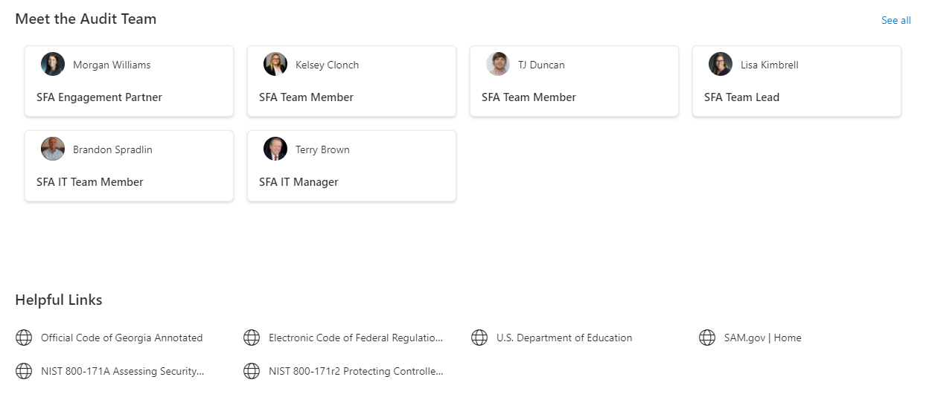
Client Portal – Information at Your Fingertips
Meet the Audit Team

Slide 13
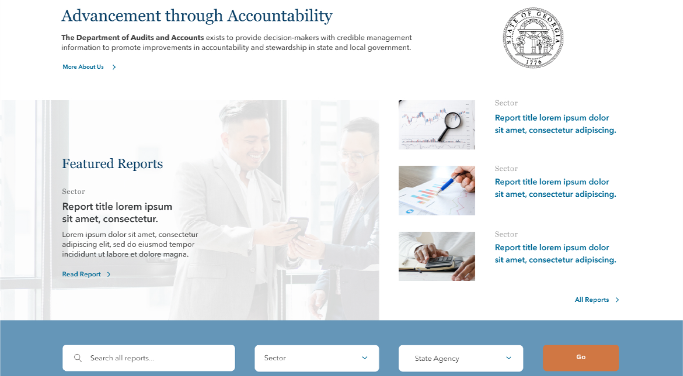

Slide 14
Searchability
Better search functionality to save time
What’s New?
Resources
Easier access to exactly what you need
Readability
Shorter, scannable content for easy reading

Slide 15
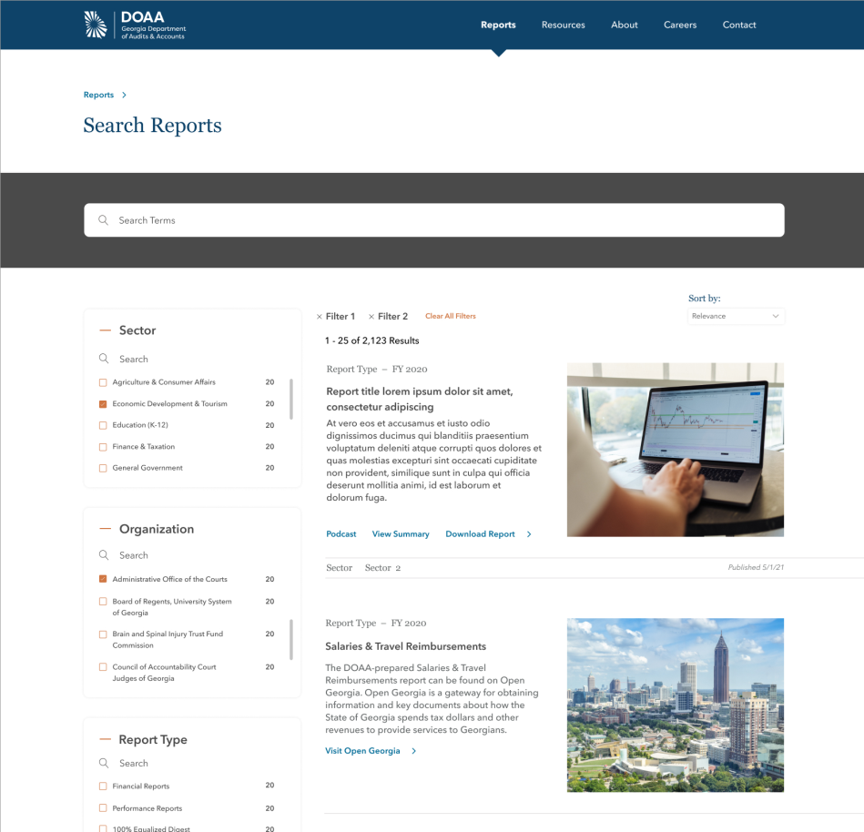
Improved Report Search
Key Filters
Sector
Organization
Report Type
Fiscal Year

Slide 16
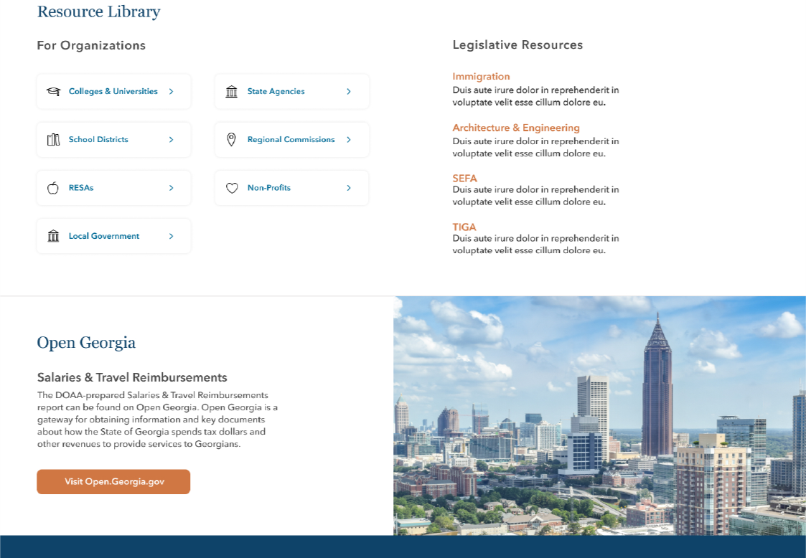

Slide 17
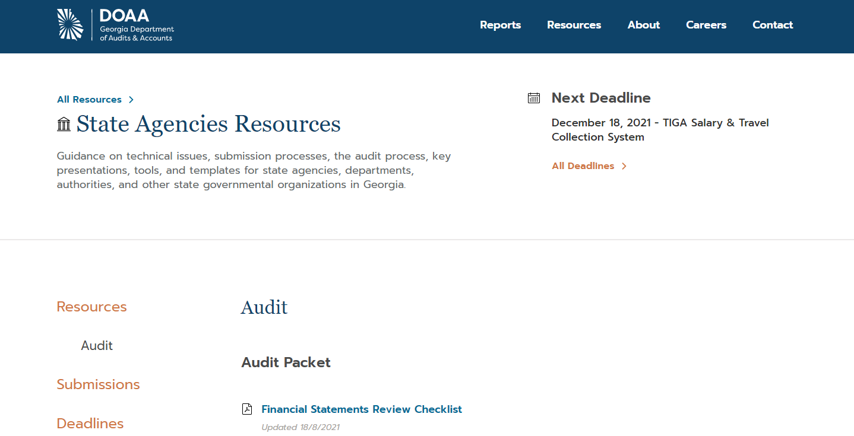

Slide 18
The DOAA Workplace…

Slide 19
Three Models Considered
Pre-Pandemic
Fully Remote
Hybrid Model

Slide 20
The Hybrid Model
Allows more opportunities for remote work than the pre-pandemic model
Values collaboration, innovation, knowledge transfer along with productivity
Balances the needs of the organization with the work-life balance gains we made during the pandemic

Slide 21
DOAA Guiding Principles for Workplace Location
Client
Team
Type of Work
Individual Preferences

Slide 22
Hybrid Model – Performing Audits
Most auditors are performing audit procedures remotely:
Using MS Teams for video conferencing for meetings and collaborations
Secure File Transfer or email for sending and receiving communications and documentation
DocuSign for communications requiring signatures

Slide 23
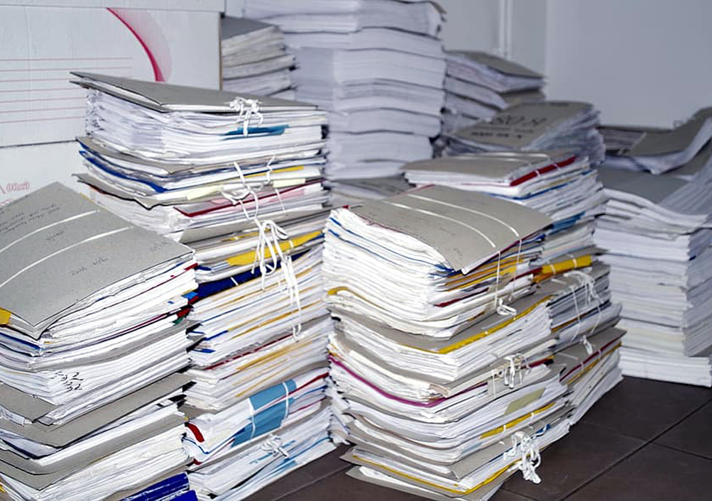
Hybrid Model – Performing Audits
Audit procedures and meetings held on-site when it is most beneficial and efficient for your audit.
When hard copies of audit evidence needs to be reviewed
Various meetings and client consultations
When on-site auditors are taking necessary precautions to reduce
exposure.
Wearing masks
Maintaining social distancing requirements
Obtaining as much electronic audit evidence as possible

Slide 24
Tips for Preparing for a Successful Single Audit

Slide 25
Single Audit: What, Why, Who, and How?

Slide 26
What? – Single Audit
A Single Audit must be completed for entities that expend $750,000 or more of federal awards in the fiscal year under review.
Incudes an audit of the entities financial statements, Schedule of Expenditures of Federal Awards (SEFA) and Major programs (federal awards)
Single Audits are authorized under the Single Audit Act.
The Single Audit Act provisions are located in Uniform Guidance at Title 2 U.S. Code of Federal Regulations (CFR) Part 200, subpart F – Audit Requirements (200.500) www.ecfr.gov

Slide 27
Why?
Required to be eligible to receive federal funds.
Provides assurance to the US federal government.
Enacted to streamline and improve the effectiveness of audits of federal awards and reduce the audit burden on nonfederal entities.

Slide 28
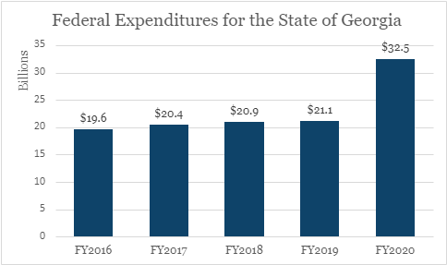
Who? – State of Georgia
The Statewide Single Audit is the largest audit of public funds in the State of Georgia.
Source: State of Georgia Single Audit Reports

Slide 29
How? – Objectives
Audit of the financial statements and reporting on the Schedule of Expenditures of Federal Awards (SEFA):
Determine whether the financial statements are presented fairly, in all material respects, in accordance with Generally Accepted Accounting Principles (GAAP).
Determine whether the SEFA is stated fairly in all material respects in relation to the financial statements.

Slide 30
How? – Objectives
Compliance audit of federal awards:
Obtain an understanding, plan, and test internal controls over major program compliance requirements.
Determine whether the auditee has complied with federal statutes, regulations, and the terms and conditions of federal awards.

Slide 31
Everchanging Landscape
Tip 1. Stay Up-to-Date on Changes to Accounting Standards and Compliance Requirements

Slide 32
GASB Effective Dates (after GASB 95)
2022
June 30: Fiscal Year 2022
Statement 87 – Leases
Statement 89 – Construction-period Interest
Statement 92 – Omnibus 2020 (mult. effective dates)
Statement 93 – LIBOR removal and lease modifications
Statement 97 – Certain component unit criteria and Section 457 plans
IG 2019-3 – Leases
IG 2020-1 – Update (except 4.6–4.17 and 4.19–4.21)
2023
June 30: Fiscal Year 2023
Statement 91 – Conduit Debt Obligation
Statement 94 – Public-Private Partnerships
Statement 96 – Subscription-Based Information Technology Arrangements (SBITA)
IG 2020-1 – Update (4.6–4.17 and 4.19–4.21)

Slide 33
Pandemic Response Accountability Committee (PRAC) – www.pandemicoversight.gov

Slide 34
Annual Changes to the Compliance Supplement
Suggested Audit steps for federal programs are reflected in the Compliance Supplement.
The Compliance Supplement was issued in August.
There will be at least one addendum to the Compliance Supplement that will address additional programs associated with COVID-19.
“Pick-Six” Initiative is still being used:
Each grantor organization selected six compliance requirements for testing.
Note: Activities Allowed or Unallowed and Allowable Costs/Cost Principles compliance areas are counted as one compliance requirement.
Compliance Supplement
Link:
2021 Compliance Supplement Addendum_ Final (whitehouse.gov)

Slide 35
The Uniform Guidance (UG) was revised effective November 13, 2020.
Some agencies adopted the revisions as of that date, but some agencies adopted the revisions later.
Check the award’s terms and conditions to determine if UG revisions are applicable.
Assistance Listing number is the new name for CFDA number.
All UG changes are reflected in Part 3 of the 2021 Compliance Supplement.
Revisions include higher procurement thresholds for:
Micro-purchases ($10,000)
Simple acquisitions ($250,000)
Uniform Guidance
Link:
2021 Compliance Supplement Addendum_ Final (whitehouse.gov)

Slide 36
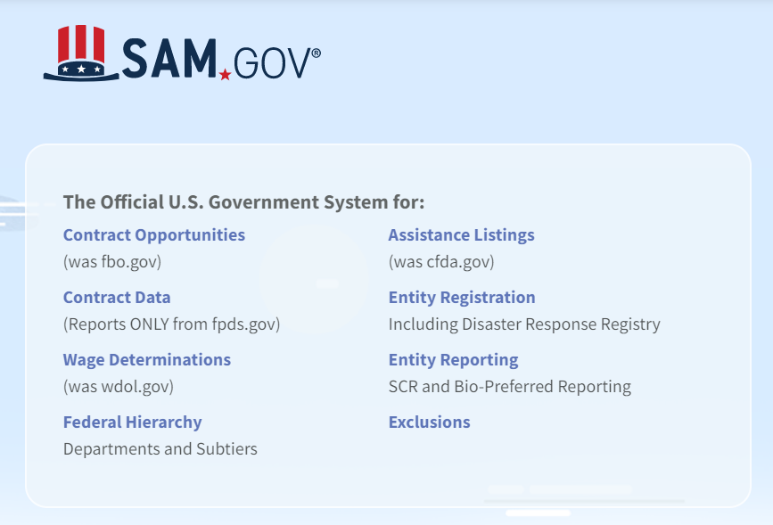
SAM.gov now includes assistance listings, exclusions (suspension and debarment) and more.
Website Changes

Slide 37
Preparation
Tip 2. Be Prepared!

Slide 38
Preparation
Know the Requirements: Review applicable federal and state statutes and regulations, state policies and award documents.
Become very familiar with requirements related to federal awards.
Code of Federal Regulations www.ecfr.gov
Discover U.S. Government Information www.govinfo.gov
Understand the requirements reflected in the UG. www.ecfr.gov
Explore the OMB Compliance Supplement.
Suggested audit steps are reflected in the Compliance Supplement. www.whitehouse.gov

Slide 39
Preparation - Changes
Identify Significant Changes:
Changes in Key Personnel or Organizational Structure.
New or Significant Upgrades/Mods to Existing Systems.
New Laws, Regulations, Executive Orders affecting your Entity.
Changes in Standards and Compliance Requirements.

Slide 40
Preparation - Changes
Identify Significant Changes:
New or Redesigned Services or Activities Implemented.
Significant Contracts or Significant Amendments to Existing Contracts.
State or Federal Program Transfers between your Entity and Another.

Slide 41
Preparation – Changes Determine the Impact of Changes to:
Accounting
Reporting
Policy and procedures
Controls
Compliance

Slide 42
Preparation - Changes
Plan to Address Change:
Assign financial, budget, program and information technology (IT) key personnel to cooperatively work together:
To address the impact of the changes.
Put a plan in place to successfully address impacted areas.
Know who on the team is responsible for each piece of the plan.

Slide 43
Preparation
Training
Onboarding, continuous updates training, videos or specific training to address higher risk areas.
Ask Questions
Federal Awarding Agency
State Accounting Office
Department of Audits and Accounts

Slide 44
Preparation
Clear, written policies and procedures for significant business transactions, information system, and applicable compliance requirements.
Simplify policies as much as possible while ensuring that they contain all federal and state requirements.
Periodically review and update policies.
Approved policies and procedures should be implemented.

Slide 45
Preparation
Maintain Documentation Throughout the Year
To support financial transactions
To evidence controls (e.g. document independent reviews and approval, segregation of duties)
To evidence compliance activities performed
Approvals from federal awarding agencies providing waivers to requirements

Slide 46
Audit Observations More Tips
Tip 3. Learn from Audit Observations

Slide 47
Financial Reporting
Review period 998 Journal Entries (JEs) and Post-Closing Adjustments (PCAs)
Determine why are they occurring.
Create a listing of 998 JEs and PCAs you expect to make each year.
Can anything be put in place to reduce the number of 998 JEs/PCAs?
Can a process be put in place throughout the year to record transactions when they occur rather than performing 998 JEs/PCAs?

Slide 48
Financial Reporting
Federal Revenue Reconciliations
Are reconciliations being performed monthly?
Reconcile Federal Expenditures to Federal Revenue
Federal Receivable
Last year EB + Federal Revenue – Drawdowns = Current Year Receivable
Inter-Organization Transfers
Agencies transferring money to each other should touch base with each other and verify the amounts they are reporting to SAO on the Inter-Organization Form are in sync. Due To and Due From should Equal.

Slide 49
Financial Reporting
Bank Reconciliation
Timely manner
Address outstanding items
Make sure outstanding items are addressed within a reasonable time period
Circle back – Ensure outstanding items are resolved

Slide 50
Federal
Eligibility
Make sure the system captures the compliance requirements.
Spot check transactions to make sure the configurations in the system are working correctly.
Reconcile your eligibility payments to TeamWorks throughout the year.
Review your processes and make sure they are meeting or exceeding the Federal Requirements.

Slide 51
Federal
Eligibility
Eligibility Requirements - All applicable program staff (e.g. intake staff, managers, etc.) should know the eligibility requirements
Training
Checklists
Ensure eligibility redeterminations are done timely
If possible, set systems to flag redeterminations as they become due
Generate Ad hoc reports to report upcoming redeterminations
Oversee that the redeterminations occur

Slide 52
IT General Controls (ITGC)
Inappropriate Segregation of Duties (SoD) and Access
Review system roles periodically to remove inappropriate permissions to allow proper segregation of duties within the role.
Review user access and privileged IT access periodically in the system, database, and operating system to determine access is based on least privilege and appropriate segregation of duties exist.

Slide 53
IT General Controls (ITGC)
Inappropriate Segregation of Duties (SoD) and Access
New user access requests reviewed to determine access is based on need and does not allow improper segregation of duties.
Terminated or transferred employee access removed in a timely manner from the system, database, and operating system.

Slide 54
Thank you
Kristina Turner, Deputy State Auditor
404.657.4352 | turnerka@audits.ga.gov
Jessica Parent, Director
404.463.0173 | parent@audits.ga.gov

