Slide 1
Understanding the Independence Implications of the New State and Local Government Client Affiliates Ethics Interpretation

Slide 2
What we will cover
Overview of the new ethics Interpretation, State and Local Government Client Affiliates
State and local government affiliate determination
Conceptual framework application
Implementation considerations

Slide 3
Overview

Slide 4
“State and Local Government Client Affiliates” supersedes “Entities included in State and Local Government Financial Statements” as ET* 1.224.020
Conceptually consistent with the “Client Affiliates” interpretation (ET* 1.224.010)
Guidance not applicable to compliance audit (current projects)
Current guidance only requires auditor to be independent of entity being audited
* AICPA Code of Professional Conduct section
Notes:
Adopted at May PEEC meeting
Fairly significant changes
Original SLG affiliate was adopted in 2001, which is when GASB 34 was being implemented (reason for SLG affiliate interpretation)
Affiliate interp today is easy – look to FSAC and entities within the reporting entity not referred to by another auditor
Talk about how much more challenging it is than the commercial environment – looking upstream (parent companies), looking sister entities, and look down;
in current SLG interp, just looking down – which is staying the same in the new interp
Not applicable to single audits – the TF has 2 more projects on agenda (1-single audits and 2-federal audits) – shouldn’t take as long as SLG has taken (almost 4 years)
When looking at SLG interp, we wanted to be generally consistent with the commercial affiliates guidance which was effective in 2014, much later than current SLG interp so we wanted to update SLG to be consistent with those principals where possible, but environment and reporting structure is so different in SLG so some circumstances didn’t make sense – for example, control and significant influence used in commercial didn’t make sense for SLG so they weren’t used

Slide 5
State and Local Government Client Affiliates (ET 1.224.020)
Effective for years beginning after December 15, 2021
Who is an affiliate of a state and local government?
The “Independence Rule” and related interpretations must be applied
Exceptions – more on this later
Notes:
Independence rules apply unless there are exceptions, which we’ll get into later
Effective date – one year delayed effective date
done very deliberately, primarily due to conference schedules – wanted to get through this season and next season conference schedule so that practitioners understand what is required.
Who is an affiliate: [Look down from the reporting entity]
Entities that the applicable financial reporting framework requires to be included in the client’s financial statements, whether they are included or not; and
Certain investments

Slide 6
Understanding the effective date
Interpretation effective for periods beginning after 12/15/21 (date reflects a one-year delay due to the pandemic)
Independence is assessed from the beginning of the audit period. Take steps now!
Need to consider the new requirements before 1/1/2022, for clients with a 12/31/2022 year-end
Need to consider the new requirements before 10/1/2022, for clients with a 9/30/23 year-end
Need to consider the new requirements before 7/1/2022, for clients with a 6/30/2023 year-end

Slide 7
Determination of Affiliates

Slide 8
Who is an affiliate of a state and local government?
Type I - Paragraph .03ai (current guidance)
Entity included in client’s financial statements
No reference to other auditor’s report
Type II - Paragraph .03aii (new guidance)
Entity included in the client’s financial statements
Reference to other auditor’s report
Material to the client
Client has more than minimal influence
Type III - Paragraph .03aiii (new guidance)
Excluded from client’s financial statements
Material to the client
Client has more than minimal influence
Type IV - Paragraph .03aiv (new guidance)
Investments held by an investor
Investor has control (unless investment is trivial or inconsequential) or
Investor has significant influence and investment is material to client
Notes:
High level overview – Don’t get into too much detail;
Type I extant; II and III new – .03aii included in FS, .03aiii excluded; important points: material to FSAC FS as a whole (not at opinion unit), MTMI
More than minimal influence over the accounting or financial reporting process of entity – get into MTMI later
Type IV – investments that could be affiliates

Slide 9
What is considered an entity?
An entity is intended to be broadly defined and can include:
Funds
Component Units
Departments
Agencies
Programs
Organizational Units
Fiduciary Activities
Custodial Activities
Employee Benefit Plans
Suborganizational Units of the proceeding entities

Slide 10
Who is Not an Affiliate
Auditors should consider the conceptual framework if you identify threats to independence – More on this later!
Applicable financial reporting framework doesn’t require inclusion
Not all investments
Upstream entities
Notes:
Who is not an affiliate -
Entities not required to be included in the financial reporting entity under applicable framework
Notes: In commercial environment, you can have affiliates that are not included in financial statements
Emphasis that we refer to “under applicable framework” because in certain states that have regulatory frameworks that exclude component units – so if you’re working under that reg reporting framework and that component unit is excluded from that framework, you wouldn’t have to worry about that (i.e. wouldn’t have to evaluate to determine whether it’s an affiliate)
Originally proposed and exposed looking upstream but met with opposition to say that the least, in such that we pulled back away from that. We going to talk about conceptual framework later – there’s some reminders in there, but you still don’t have to look upstream to determine entities that you have be independence of, unless you identify or come across a significant threat.
Investments that are held by type ii, iii, and iv affiliates (explains that you don’t have to dig down into investments of these entities)
Simplified –
“under applicable framework” because in certain states that have regulatory frameworks that exclude component units – so if you’re working under that reg reporting framework and that component unit is excluded from that framework, you wouldn’t have to worry determine whether it’s an affiliate
Originally proposed and exposed looking upstream but had some pushback from a variety of stakeholders, so the final interpretation only requires you to look down from the FRE
Investments: Only evaluate the investments of your client or an affiliate under par. .03ai (Type I)
Still have to think about CF… if you identify a threat and it’s not addressed, you’ll still need to follow the CF

Slide 11
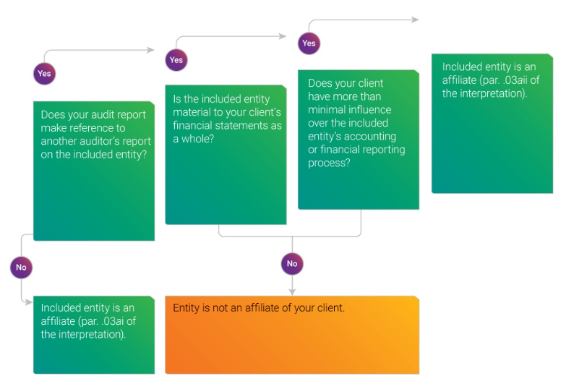
Determining affiliates – Inclusion pathway
Don’t forget that other circumstances or relationships with this entity may create threats that would require you to consult the conceptual framework.
Notes:
Identify the entities that the applicable financial reporting framework requires to be included in your client’s financial statements.
--- Key point: materiality, we’re thinking that in most instances you’re probably not going to trigger affiliates in those circumstance, but you are still going to have to walk through the exercise to determine whether independence is required

Slide 12
Determining affiliates – Exclusion pathway
Don’t forget that other circumstances or relationships with this entity may create threats that would require you to consult the conceptual framework.
Notes:
What if the applicable the applicable financial reporting framework requires the entity to be included in your client’s financial statements, but it’s NOT included? Could you still have affiliates of your client that you would need to evaluate? Yes!
Just like the inclusion pathway we’ve just looked at the exclusion pathway requires you to evaluate materiality and more than minimal influence.
So even if the entity is excluded if it’s material to your client’s financial statements and your client has MTMI over the entity’s accounting or financial reporting process, the entity is an affiliate under par. .03aiii of the interpretation.
If not, then that excluded entity is NOT an affiliate.
Two examples of where this has been done in practice – 1) deliberately, FS only done for single audit purposes so they exclude funds or components that don’t hold grant funding and they don’t want them audited – carved out and would have GAAP departure 2) typically would be component entity that doesn’t have audited financial statement available, timing issues or problems with books/records

Slide 13
Panel discussion – What are some other circumstances or relationships that may create threats that would require you to consult the conceptual framework?
Notes:
Will be covered a little later in the presentation, but a couple of examples would be the following:
A partner’s immediate family member (for example, his son) holds a key position (finance director) with a City ( the nonaffiliate). The City includes the Water District, (which is the financial statement attest client) in its financial statements. Also, the City provides accounting staff and establishes internal controls over financial reporting for the Water District (the financial statement attest client). This would create at threat to independence that you would need to consult the conceptual framework.
Another example might be, the member or member’s firm is considering providing financial information system design services to the in which the same financial information system would also be used by the Water District ( the financial statement attest client).

Slide 14
Materiality
Professional judgement
Applied at the reporting entity level
Consider qualitative and quantitative factors
The materiality criteria will likely exclude many entities from inclusion as an affiliate.
Notes:
Whether the entity is included or not, materiality is a key component in the decision-making process.
Materiality should be considered in relation to the financial statement attest client reporting entity and not in relation to materiality as determined at the individual opinion unit
Discussion on Qualitative Factors

Slide 15
More than minimal influence
Level of involvement your client has in preparing the financial statements of the entity
Does your client and the entity have the same
accounting or finance staff?
accounting systems?
internal control over financial reporting systems?
Note: Analysis is only applied to the accounting and financial reporting process of the entity.
Notes:
*** note there are 3 slides on MTMI
More Than Minimal Influence Over Accounting and Financial Reporting Process
.09
The overall facts and circumstances should be considered when evaluating the level of influence the financial statement attest client has over the accounting or financial reporting process of an entity in the financial statement attest client’s financial statements. The targeted analysis is applied solely to the accounting and financial reporting process of the entity as opposed to the analysis of what entities are included in the financial statement attest client’s financial statements. Factors such as the following may assist members with this evaluation:
a. The extent of involvement the financial statement attest client has in preparing the financial statements of the entity
b. The extent of operational control the financial statement attest client has over the entity
c. The extent to which both the financial statement attest client and the entity have the same
i. accounting or finance staff;
ii. accounting systems; and
iii. internal control over financial reporting systems
d. The extent to which the financial statement attest client
i. can direct the behaviors or actions of the governing board of the entity;
ii. can add or remove members of the governing board of the entity;
iii. issues or pays for the entity’s debt;
iv. finances the entity’s deficits; and
v. uses or takes the entity’s financial resources

Slide 16
More than minimal influence
What is the extent of operational control your client has over the entity?
Can your client…
direct the behaviors or actions of the governing board of the entity?
add or remove members of the governing board of the entity?
issue or pay for the entity’s debt?
finance the entity’s deficits?
use or take the entity’s financial resources?
Note: There is a rebuttable presumption that when the entity is a fund or a blended component unit the financial statement attest client has more than minimal influence.
Notes:
[Highlight rebuttable presumption]

Slide 17
More than minimal influence considerations
Take a substance over form approach to evaluating the factors
Requires professional judgement
Some factors may indicate influence, others may indicate little to no influence
Some factors may be weighted differently

Slide 18
Discussion – Can you explain what it means to take a substantive approach when considering factors to determine if a client has more than minimal influence over the accounting and financial reporting process?
Notes:
As mentioned in the previous slides, the factors in paragraph .09 will help you access the actual level of influence. Those should be evaluated based on the facts and circumstances of your client. An example of a substantive consideration would be although the financial statement attest client has the ability to influence or direct the governing board actions or has the ability to issue debt for the entity, the financial statement attest client hasn’t done in the past and does not intend to in the future.

Slide 19
Affiliate determination – Scenario 1
Scenario 1:
Firm A audits Anytown, USA
Firm B audits Utility District
Utility District
Included in the Anytown, USA’s financial statements
Firm A does not make reference to Firm B’s audit report

Slide 20
Affiliate determination – Scenario 1 Questions
Question 1 – Is the Utility District an affiliate of Anytown, USA?
Yes, the Utility District is an affiliate of Anytown, USA as defined in paragraph .03ai (Type I)
Type I - Paragraph .03ai (current guidance)
Entity included in client’s financial statements
No reference to other auditor’s report

Slide 21
Affiliate determination – Scenario 1 Questions
Question 2 – If Firm A references Firm B’s audit report, is the Utility District an affiliate of Anytown, USA?
That depends on the following –
Is the Utility District material to the financial statements of Anytown, USA?
Does Anytown, USA have more than a minimal influence over the Utility District’s accounting or financial reporting process?
If the answer is “yes” to both, then the Utility District is an affiliate of Anytown, USA as defined in paragraph .03aii (Type II).
Type II - Paragraph .03aii (new guidance)
Entity included in the client’s financial statements
Reference to other auditor’s report
Material to the client
Client has more than minimal influence

Slide 22
Exception: Nonattest services
Prohibited nonattest services – services that would impair independence under the “Nonattest Services” subtopic (ET sec. 1.295) of the “Independence Rule”
Nonauthoritative Q&As on Nonattest services are available at - https://www.aicpa.org/InterestAreas/ProfessionalEthics/Resources/Tools/DownloadableDocuments/NonattestServicesFAQs.pdf
Only applies to affiliates under .03aii (Type II) and .03aiii (Type III)
You would not be prohibited from providing these services when the following apply:
The results of the nonattest services will not be subject to financial statement attest procedures
Other threats can
be eliminated or reduced to an acceptable level by applying safeguards
22
Notes:
Paragraph .07 of the interpretation provides an exception for prohibited nonattest services. Prohibited nonattest services are services that would impair independence under the “Nonattest Services” subtopic of the “Independence Rule”.
It’s important to note that you may only apply this exception to affiliates defined in paragraph .03aii and .03aiii of the interpretation.
Under the nonattest services exception, you would not be prohibited from providing such services to these affiliates of your client when:
You can reasonably conclude that the prohibited nonattest service does not create a self-review threat because the results of the nonattest service won’t be subject to financial statement attest procedures.
Safeguards can be applied that eliminate or reduce to an acceptable level any other threats created by the provision of the nonattest service.

Slide 23
Nonattest services exception – Scenario 2
Scenario 2:
Firm Z audits Any County, USA
Firm Z has determined that the County Housing Authority meets the definition of an affiliate under paragraph .03aii (Type II) of the interpretation.
Firm Z determines that the NFP Company meets the definition of an affiliate under paragraph .03aiii (Type III) of the interpretation.

Slide 24
Nonattest services exception – Scenario 2 Questions
Question 1 – County Housing Authority asks Firm Z to provide backup services for its data and records. Under the “Hosting Services” interpretation (ET sec. 1.295.143) of the “Independence Rule,” Firm Z concludes the services are prohibited services.
Does the otherwise prohibited backup services meet the requirements of the nonattest services exception?
That depends on the following –
Can Firm Z conclude that the backup services will not be subject to the financial statement attest procedures?
Are all other threats an acceptable level?
If the answer is “yes” to both, then Firm Z can provide the backup services to County Housing Authority without impairing independence.

Slide 25
Nonattest services exception scenarios - Scenario 2 Questions
Question 2 – NFP Company asks Firm Z to perform financial information systems design services. Under the “Information Systems Design, Implementation, or Integration” interpretation (ET sec. 1.295.145) of the “Independence Rule,” Firm Z concludes that the financial information system design services are prohibited services.
Does the otherwise prohibited financial information system design services meet the requirements of the nonattest services exception?
That depends on the following –
Can Firm Z conclude that the financial information system design services will not be subject to the financial statement attest procedures?
Are all other threats an acceptable level?
If the answer is “yes” to both, then Firm Z can provide the financial information system design services to County Housing Authority without impairing independence.

Slide 26
Investments
A security or other asset that an investor:
holds primarily for the purpose of income or profit, and
has a present service capacity based solely on its ability to generate cash or to be sold to generate cash.
Investments do not include:
Temporary investments
Equity interests in entities that provide governmental services
Includes investments and ownership in equity interest in common stock accounted for using the equity method of accounting
:
26
Notes:
What’s important is what they don’t include –
Temp investments (local govt get bequest of some kind but they have no intention of holding it; they just want to liquidate it, but will take a little time to do that and do that efficiently – we would carve those out).
They also do not include equity investments that are held for providing govt service (public/private partnerships are normally carved out bc there’s normally for providing govt services…but if they aren’t, they may be included in the affiliate evaluation.
Basically includes an asset that is held primarily for purpose of income/profit and has present service capacity based solely on its ability to generate cash or to be sold to generate cash
Wanted to make this a very very narrow application; again, feedback we’ve gotten is that this will primarily affect benefit plans, which was intentional bc this is how you would treat EBPs outside of the SLG environment.

Slide 27
Determining affiliates - investments
An investor includes your client or an affiliate of your client that meets the definition of an affiliate under paragraph .03ai (Type I) of the interpretation
the investor has control and the investment is not trivial or clearly inconsequential to the financial statement attest client
the investor has significant influence; and
the investment is material* to the financial statement attest client
* Emphasis Point - Materiality should be considered in relation to the financial statement attest client reporting entity and not in relation to materiality as determined at the individual opinion unit.
Notes:
Reiterate definition of investor; look at two pathways: control and significant influence
If you look to current indep interp related to commercial entities, this is basically right out of that. There were FAQs developed in 2013 related to the commercial affiliates on EBPs that has good info on how you work through concepts of control or SI.
In Code, the def of control and SI points you to FASB accounting standards, which in SLG environment, it’s not particularly helpful but do get a sense of what those would look like
Practitioners often consider control as ownership %s of 50% or more and SI often being triggered at 20% up to 49.999%. For most practitioners, an ownership calculation will prob be common
Emphasis Point
When it comes to trivial or clearly inconsequential all we can say is that it’s something less than material and that it’s a matter of professional judgement; like materiality, the Code looks to auditing standards for how you would consider what is material

Slide 28
Determining affiliates – Control Investment Inclusion
Don’t forget that other circumstances or relationships with this entity may create threats that would require you to consult the conceptual framework.
Notes:
Identify the entities that the applicable financial reporting framework requires to be included in your client’s financial statements.
Walk through example from guide - .03ai and .03aii
--- Key point: materiality, we’re thinking that in most instances you’re probably not going to trigger affiliates in those circumstance, but you are still going to have to walk through the exercise to determine whether independence is required

Slide 29
Determining affiliates – Significant Influence Investment Inclusion
Don’t forget that other circumstances or relationships with this entity may create threats that would require you to consult the conceptual framework.
Notes:
Identify the entities that the applicable financial reporting framework requires to be included in your client’s financial statements.
Walk through example from guide - .03ai (Type I) and .03aii (Type II)
--- Key point: materiality, we’re thinking that in most instances you’re probably not going to trigger affiliates in those circumstance, but you are still going to have to walk through the exercise to determine whether independence is required

Slide 30
Affiliate determination scenarios – Investments of Public Pension Trust Funds (PTF) – Scenario 3
Scenario 3:
Firm A includes the Pension Trust Fund (PTF) in its audit of Anytown, USA
Firm A concludes it’s an affiliate as defined in paragraph .03ai (Type I).
PTF has two investments:
DEF Company
RST Company

Slide 31
Affiliate determination scenarios – Investments of Public Pension Trust Funds (PTF) – Scenario 3
Scenario 3 (continued):
DEF Company:
PTF is considered an investor, as defined by the interpretation, since affiliate under .03ai (Type I)
PTF has a controlling interest and its investment in DEF is more than trivial and is clearly consequential to XYZ’s financial statements as a whole
Notes:
Using the information in the previous slide, we will now look at DEF Company to determine if it is an affiliate

Slide 32
Affiliate determination scenarios – Investments of Public Pension Trust Funds (PTF) – Scenario 3 Questions
Question 1 – Is DEF Company an affiliate of XYZ City?
Does PTF have control over DEF Company?
Is the investment in DEF Company trivial and clearly inconsequential to XYZ City’s financial statements as a whole?
DEF Company is an affiliate (paragraph .03aiv(1) – Type IV.
Yes
No

Slide 33
Nonattest Services Exception– Investments of Public Pension Trust Funds (PTF) – Scenario 3 Questions
Question 2 – PTF asks Firm A to provide backup services for its data and records. Under the “Hosting Services” interpretation (ET sec. 1.295.143) of the “Independence Rule,” Firm A concludes the services are prohibited services.
Can Firm A use the nonattest services exception?
No. PTF is an affiliate as defined by .03ai (Type I), which the nonattest services exception does not apply.
Type I - Paragraph .03ai (current guidance)
Entity included in client’s financial statements
No reference to other auditor’s report

Slide 34
Affiliate determination scenarios – Investments of Public Pension Trust Funds (PTF) – Scenario 3
Scenario 3:
Firm A includes the Pension Trust Fund (PTF) in its audit of Anytown, USA
Firm A concludes it’s an affiliate as defined in paragraph .03ai (Type I).
PTF has two investments:
DEF Company
RST Company
Notes:
Using the same basic scenario
Firm A includes the Pension Trust Fund (PTF) in its audit of Anytown, USA
Firm A concludes it’s an affiliate as defined in paragraph .03ai (Type I).

Slide 35
Affiliate determination scenarios – Investments of Public Pension Trust Funds (PTF) – Scenario 3
Scenario 3 (continued):
RST Company:
PTF is considered an investor, as defined by the interpretation, since affiliate under .03ai (Type I)
PTF has an interest that gives it significant influence over RST
The investment in RST is material to XYZ’s financial statements as a whole
Notes:
We will now look at RST Company to determine if it is an affiliate

Slide 36
Affiliate determination scenarios – Investments of Public Pension Trust Funds (PTF) – Scenario 3 Questions
Question 3 – Is RST Company an affiliate of XYZ City?
Does PTF have significant influence over RST Company?
Is the investment in RST Company material to XYZ City’s financial statements as a whole?
RST Company is an affiliate (paragraph .03aiv(2).
Yes
Yes

Slide 37
Best efforts to obtain information
Firms must expend their “best efforts” to obtain information to identify affiliates. How are threats reduced to an acceptable level and ensure independence would not be impaired when you are unable to obtain the information?
Discuss the matter, the potential impact on independence, with those charged with governance
Document the results of the discussion
Obtain written assurances from the client that they are unable to provide the information to identify affiliates
Document the efforts to obtain the information to identify affiliates

Slide 38
Conceptual framework application

Slide 39
Applying the conceptual framework for independence
In the absence of an interpretation of the “Independence Rule” [1.200.001] that addresses a particular relationship or circumstance, a member should apply the “Conceptual Framework for Independence” interpretation [1.210.010].
Identify and apply safeguards
Identify and evaluate threats
39
Notes:
You’ve evaluated entities that might be considered your client’s affiliates and determined that they don’t meet any of the definitions of affiliates as outlined in the interpretation.
But paragraph .06 of the interp highlights that you still might have relationships or circumstances where you would want to consider the conceptual framework…
Just b/c it doesn’t meet affiliate, doesn’t mean you’re done with your evaluation, in particularly when you may be performing certain types of services for an upstream entity

Slide 40
Examples of relationships/circumstances where the conceptual framework could be applicable
1
Your immediate family member is in a key position with a nonaffiliate that includes your client in its financial statements. The nonaffiliate provides accounting staff, shares financial information systems, or establishes internal controls over financial reporting for your client.
2
Your firm is considering providing financial information system design services to a nonaffiliate in which the same financial information system would also be your client.
3
You have a financial interest in a nonaffiliate that includes your client in its financial statements, and the nonaffiliate prepares the financial statements for your client.
40
Notes:
[Highlight an example]
Emphasize that if you have a situation in the examples, it doesn’t necessarily mean there’s significant threats. Just examples of when you might consider concept framework (brick analogy)
Caution – when you look at independence, need to look at fact and in appearance…and in appearance often gives you most trouble. Believes that the financial interest is example in interp that would present some threats to independence in appearance. Very subjective, which is why concept framework presents some challenges

Slide 41
Examples of relationships/circumstances where the conceptual framework could be applicable
4
Your client participates in a PPP or joint venture that doesn’t meet the definition of an investment in par. 03c and your immediate family member has a financial interest in an organization that is also involved with the PPP or joint venture.
5
You own utility bonds issued by a nonaffiliate and your client is responsible for payment of the utility bond debt service.
6
You own conduit debt issued by your client on behalf of a nonaffiliate, the debt is not included in your client’s financial statements, and the debt service is paid by the nonaffiliate.
41

Slide 42
Employment relationship where the conceptual framework would be applicable – Scenario 4
Scenario 4:
Utility District, a blended component unit of Any City, USA asks Firm A to perform its audit
Firm A does not audit Any City, USA
Partner 1 and Partner 2 are partners in Firm A
Partner 2 will be the audit partner on Utility District
Partner 1’s wife is the Finance Director for Any City, USA. She also prepares the Annual Comprehensive Financial Report (ACFR) and oversees the accounting functions for Utility District

Slide 43
Employment relationship where the conceptual framework would be applicable – Scenario 4 Question
Question – Does Partner 1’s wife position create threats to Firm A’s independence in Utility District’s audit?
Yes, it creates a threat to independence, due to the following:
Partner 1’s wife is an immediate family member in a key position
She prepares the Annual Comprehensive Financial Report (ACFR) and oversees the accounting function for the Utility District

Slide 44
Discussion – In the previous slide we determined that there would be threats to independence. Does that mean a firm’s independence will be impaired?
Notes:
That depends. You should consider threats to independence. If threats are not at an acceptable level, you will need to apply safeguards sufficient to eliminate threats or reduce them to an acceptable level. If you cannot sufficiently mitigate any significant threats and chooses to perform the engagement anyway, your independence would be impaired.

Slide 45
Employment relationship where the conceptual framework would be applicable – Scenario 5
Scenario 5:
Utility District, a blended component unit of Any City, USA asks Firm A to perform its audit
Firm A does not audit Any City, USA
Any City, USA issued Utility Bonds and Utility District is responsible for the debt service payments
Partner 1 and Partner 2 are partners in Firm A
Partner 2 will be the audit partner on Utility District
Partner 1 owns Utility Bonds issued by Any City, USA

Slide 46
Employment relationship where the conceptual framework would be applicable – Scenario 5 Question
Question – Does Partner 1’s ownership of the Utility Bonds issued by Any City, USA create threats to Firm A’s independence in Utility District’s audit?
Yes, it creates a threat to independence, but the threats are at an acceptable level due to the following:
Partner 1 will not be serving on the engagement team which reduces the self-interest threat. Firm A has numerous partners and professional employees, and Partner 1 will have no influence over the proposed audit.
Partner 1 will not provide any professional services to the Utility District or Any City, USA
Partner 1’s financial interest are not in the Utility District or in its affiliates
Notes:
Discussion if partner in same office/different office

Slide 47
SLG Client Affiliates Interpretation Resources

Slide 48
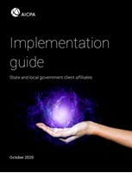
AICPA Ethics—SLG Client Affiliates
Access Official Release
Implementation Guide recently issued that includes three tools as follows:
An affiliates survey tool for identifying which entities are affiliates.
An investments survey tool for identifying whether an investment is an affiliate.
An excel tool that is intended to allow you to evaluate multiple entities or investments.
Don’t Wait to Begin Considering the Provisions of this Interpretation!
Notes:
Implementation Guide
Includes decision tree, description of pathways, illustrative exhibits and examples, guidance for understanding MTMI, description of nonattest services exception, examples of circumstances and relationships where you might need to consult the Conceptual Framework for Independence
Go into tools more on subsequent slides

Slide 49
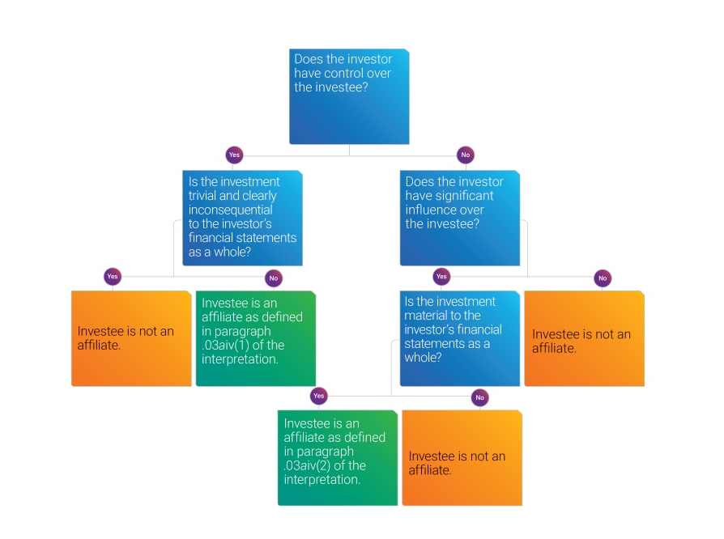
Application guidance
Implementation guide
Decision trees
Examples
Tools
Evaluate affiliates
Provide documentation
Notes:
Implementation guide
Decision trees; examples… how non-attest services exception might be applied; where the CF might come into play and what it would look like
Tools
Affiliate evaluator – two tools – entity/investment – one example and walk through analysis
Interactive matrix – excel tool - ability to evaluate multiple units or entities in one centralized location
DOCUMENTATION

Slide 50
Let’s try it out…
Entity affiliate evaluator
Investment affiliate evaluator
Interactive matrix
50
Notes:
Demo each of the tools

Slide 51
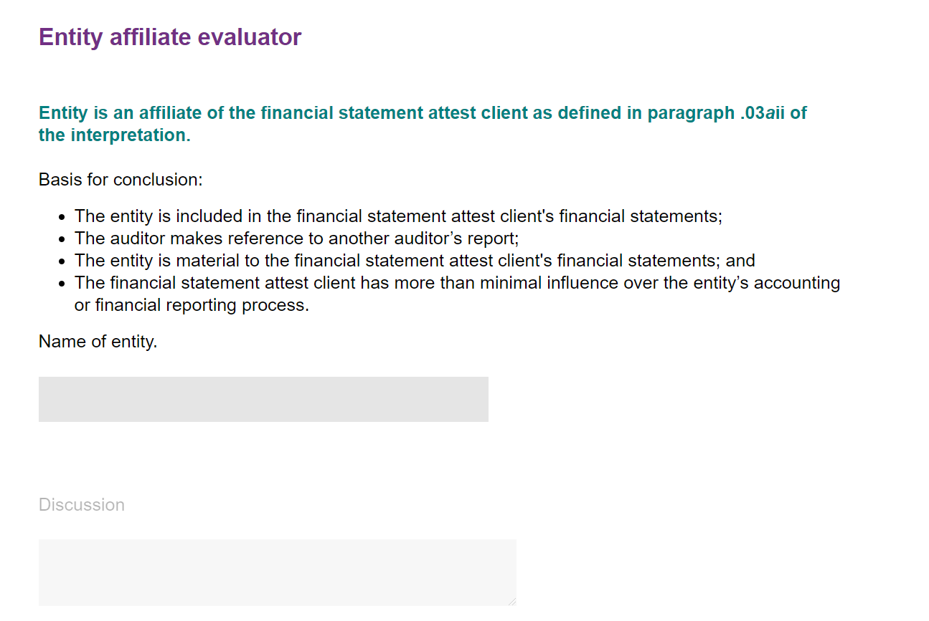
Entity affiliate calculator
Walks you through a step-by-step analysis of whether an entity is an affiliate of your FSAC under paragraph .03ai–iii of the interpretation
User answers yes or no to each question
Provides a summary page with results.
Allows you to document the name of the entity you’re evaluating as well as any discussion points.
Notes:
How do we arrive at this conclusion? The next few screen shots show how the entity affiliate evaluator looks as the questions are answered.

Slide 52
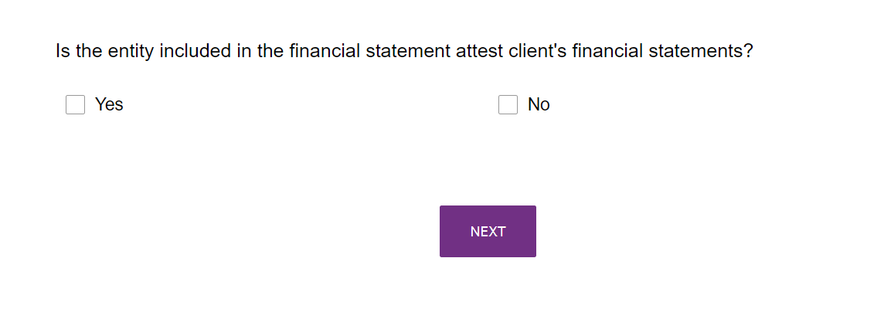
Entity affiliate calculator
Notes:
Let’s walk through some screen shots of the Entity affiliate calculator…
Once you click on the “Entity affiliate calculator” link, this is the first screen you arrive at. For purposes of this presentation, assume the auditor answers this question “yes”. The next slide shows the next question.
Highlight that members should print or save the last page of “calculator” with conclusion as once you navigate away from page the tool will close.
Links below in case clicking icon doesn’t work – Also Excel tool will need to be demo’d by opening file attached (no “home” for this yet)
(Note that for the entity tool the AICPA logo has a glitch and you’ll need to scroll down until the tool is updated)
https://www.surveymonkey.co.uk/r/entitydecisiontree
https://www.surveymonkey.co.uk/r/investmentdecisiontree

Slide 53
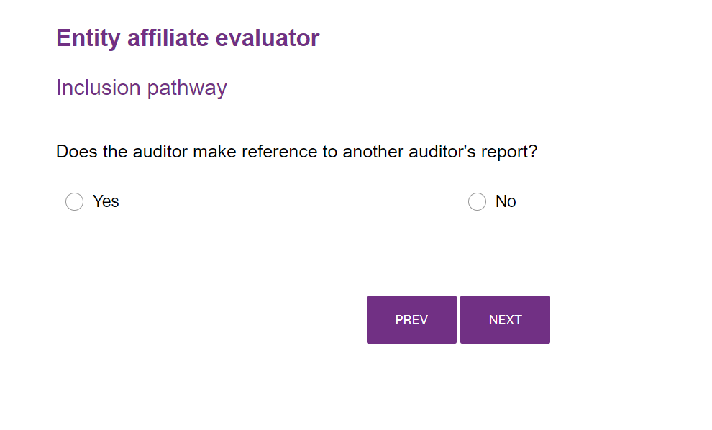
Entity affiliate calculator
Notes:
Once you’ve answered the previous question ‘yes’ the audit answers whether or not the auditor is making reference to another auditor’s report. For purposes of this presentation, assume the auditor answers this question “yes”. The next slide shows the next question.
Highlight that members should print or save the last page of “calculator” with conclusion as once you navigate away from page the tool will close.
Links below in case clicking icon doesn’t work – Also Excel tool will need to be demo’d by opening file attached (no “home” for this yet)
(Note that for the entity tool the AICPA logo has a glitch and you’ll need to scroll down until the tool is updated)
https://www.surveymonkey.co.uk/r/entitydecisiontree
https://www.surveymonkey.co.uk/r/investmentdecisiontree

Slide 54
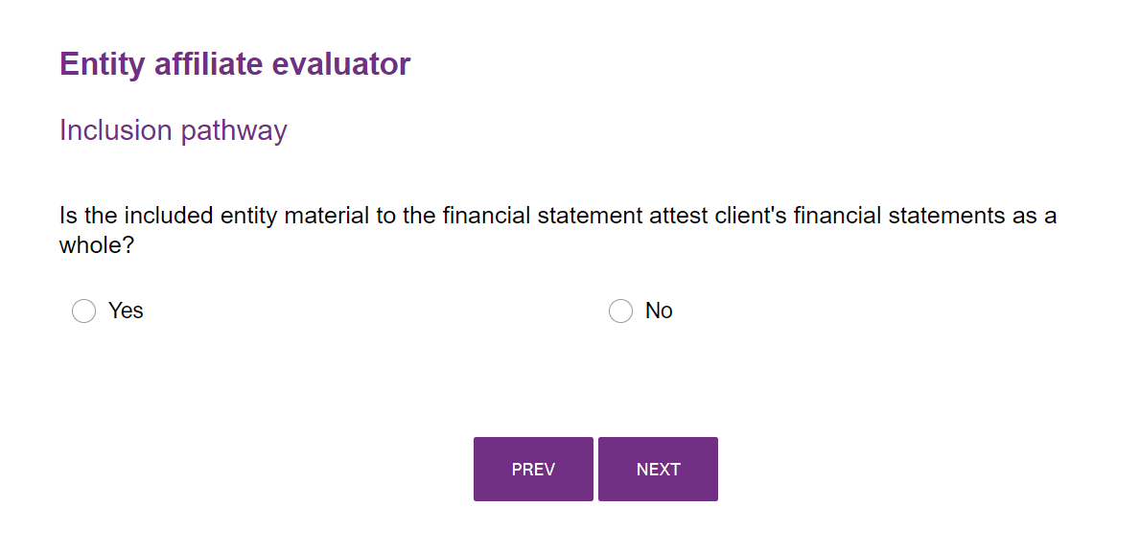
Entity affiliate evaluator
Notes:
Once you’ve answered the previous question ‘yes’ the auditor answers whether or not the entity is material to the FSAC’s FS as a whole. For purposes of this presentation, assume the auditor answers this question “yes”. The next slide shows the next question.
Highlight that members should print or save the last page of “calculator” with conclusion as once you navigate away from page the tool will close.
Links below in case clicking icon doesn’t work – Also Excel tool will need to be demo’d by opening file attached (no “home” for this yet)
(Note that for the entity tool the AICPA logo has a glitch and you’ll need to scroll down until the tool is updated)
https://www.surveymonkey.co.uk/r/entitydecisiontree
https://www.surveymonkey.co.uk/r/investmentdecisiontree

Slide 55
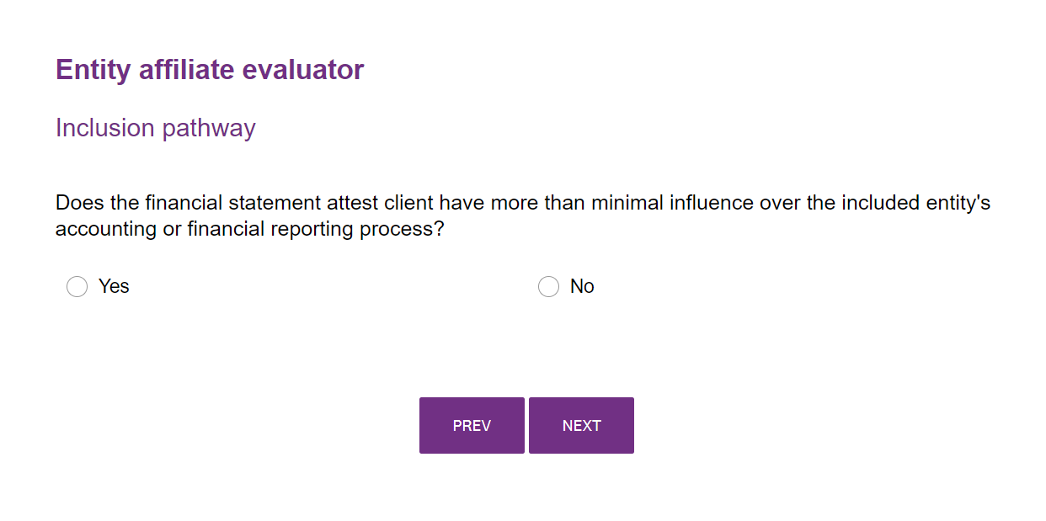
Entity affiliate evaluator
Notes:
Once you’ve answered the previous question ‘yes’ the audit answers whether or not the auditor is making reference to another auditor’s report. For purposes of this presentation, assume the auditor answers this question “yes”. The next slide shows the next question.
Highlight that members should print or save the last page of “calculator” with conclusion as once you navigate away from page the tool will close.
Links below in case clicking icon doesn’t work – Also Excel tool will need to be demo’d by opening file attached (no “home” for this yet)
(Note that for the entity tool the AICPA logo has a glitch and you’ll need to scroll down until the tool is updated)
https://www.surveymonkey.co.uk/r/entitydecisiontree
https://www.surveymonkey.co.uk/r/investmentdecisiontree

Slide 56
AICPA Ethics – SLG Client Affiliates: Investment Survey Tool
Walks you through a step-by-step analysis of whether an investee is an affiliate of your FSAC under paragraph .03aiv(1)–(2) of the interpretation
User answers yes or no to each question
Provides a summary page with results.
Allows you to document the name of the entity you’re evaluating as well as any discussion points.

Slide 57
AICPA Ethics – SLG Client Affiliates: Excel Tool
Allows you to capture all potential affiliates and consider the individual criteria required to make your affiliate determinations
User choose from drop-down options to make determinations
Provides applicable references to the interpretation

Slide 58
Implementation Is Here – What do we do?

Slide 59
Implementation Tips!
Read the Official Release of the Interpretation, the Implementation Guide, and use the tools provided by the AICPA
Begin having conversations with your clients now – you may need help in performing evaluations and determining potential affiliates
Firms should take an “inventory” of their relationships, including the following:
Who are you doing business with?
Which entity is related to which entity?
Determine whether you have new affiliates requiring independence
Evaluate circumstances and relationships that require action to remain independent
Consider the conceptual framework for other circumstances and relationships
Document your affiliate evaluations and determinations

Slide 60
Key impacts of interpretation
More evaluation
Potentially more inclusive
Impact financial interests
Certain material entities when making reference to another auditor’s report
Material excluded entities
Investments
Notes:
High level summary of what’s new

Slide 61
Discussion – What are the most significant take-aways from today’s discussion?
Notes:
Members should determine now/very soon whether they will have any new affiliates that require independence realizing it may take time to work through considerations like materiality and MTMI and trivial and clearly inconsequential and to gather the data needed to evaluate any potential investment affiliates and determine whether those are impactful and require action to remain independent-(financial interests and employment relationships especially). Members want to ask if there are any circumstances or relationships with affiliates or non-affiliates that they are aware of that would require the consideration of the conceptual framework.
- The SLG Affiliate Interpretation is effective for periods beginning after December 15, 2021 so the audit firm needs to consider this new requirement before January 1, 2022.
- Firms should take an 'inventory' of their relationships now, including who they are doing business with and what entities are related to other entities.

Slide 62
Questions?

