Slide 1
Audit Requirements for
State & Federal Grants Administered by
DCA

Slide 2
Purpose of Today’s Presentation
Outline the audit requirements associated with applying for and closing out State and Federal projects
Detail how to avoid application delays or denials
This Photo by Unknown Author is licensed under CC BY-SA

Slide 3
Community Finance Division Overview
Appalachian Regional Commission
Support of community and economic development in Georgia’s 37 county Appalachian region
Community Development Block Grant – Small Cities and Counties
Viable Communities
Low to Moderate Income Benefit
Community Development Block Grant – Economic Development
Jobs and Private Investment
OneGeorgia Authority – Equity
Rural Economic Development
Capacity-building
State Incentive Programs – REBA and EDGE
Economic Development
High Profile Projects – Rivian, Hyundai, KIA, Amazon
Job Tax Credit Program
Credit Against Company’s Income Tax
Downtown Development Revolving Loan Fund
Building Great Downtowns
State Small Business Credit Initiative
Reducing the bank’s risk to lend funds to small businesses

Slide 4
Application Phase
Application
Implementation
Closeout
Compliance with the Local Government Audit Act (OCGA 36-81-1 et seq)
Local Government Audit
Financial Statements
Failure to meet the audit requirements will result in delay in application review or denial for non-compliance depending on the grant program.

Slide 5
Implementation Phase
Application
Implementation
Closeout
Annual Audit
Source and Use Statement
Project Cost Schedule

Slide 6
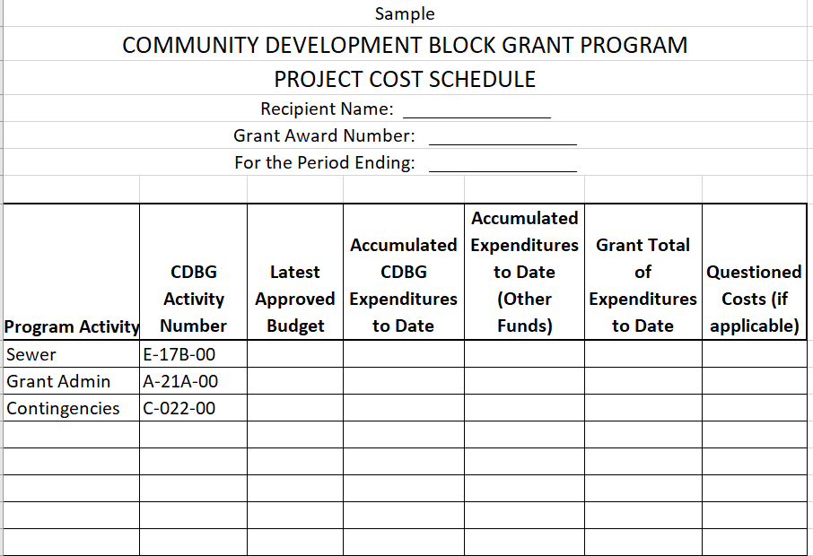
Sample Project Cost Schedule

Slide 7
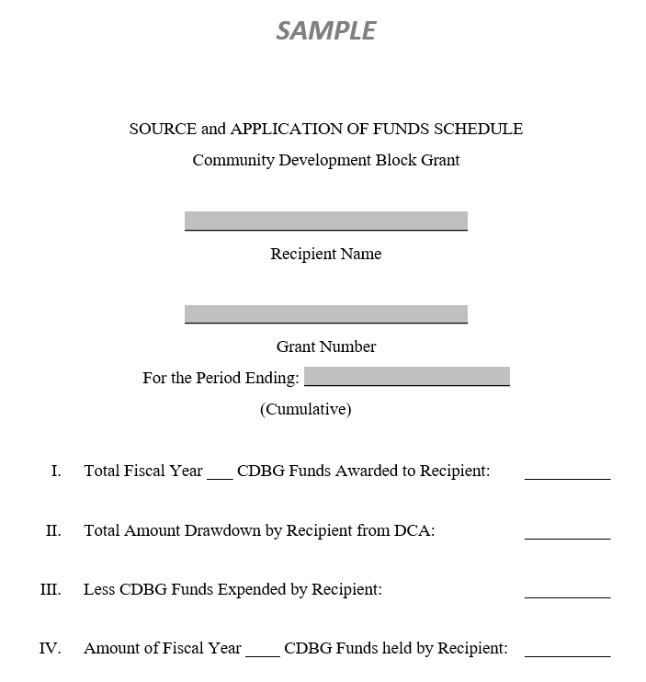
Sample Source and Application of Funds Schedule

Slide 8
Closeout Phase
Application
Implementation
Closeout
Final accounting of all draw expenditures
Audit findings will be addressed
Evidence of compliance with any recommended corrective action(s) may be requested
Notes:
For every fiscal year in which funds are drawn, audit must be submitted to DCA for review
Electronic copy preferred
Must include (notify your auditor):
Source and Application of Funds
CDBG Project Cost Schedule
Grant Conditionally Closed until all audits reviewed along with meeting other conditions.
Formally closed after all audits received and issues resolved

Slide 9
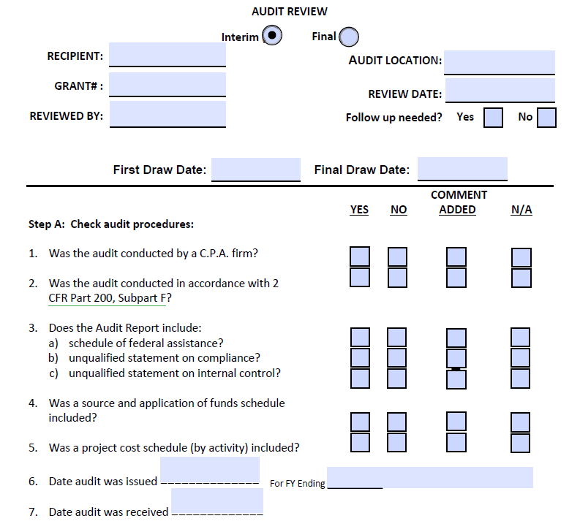
Audit Review

Slide 10
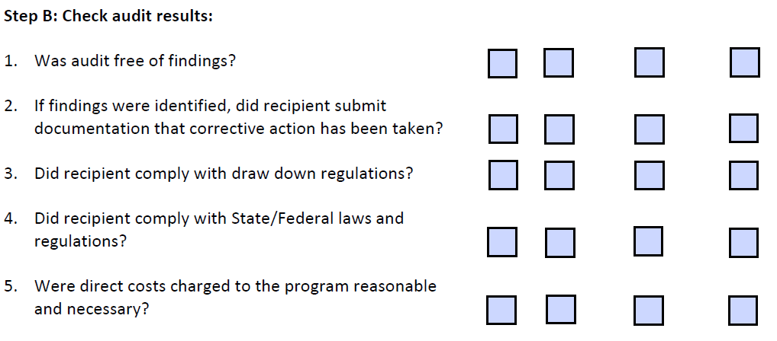
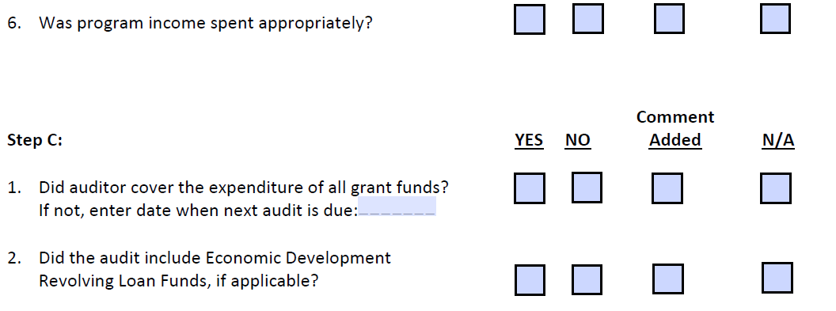
Audit Review

Slide 11
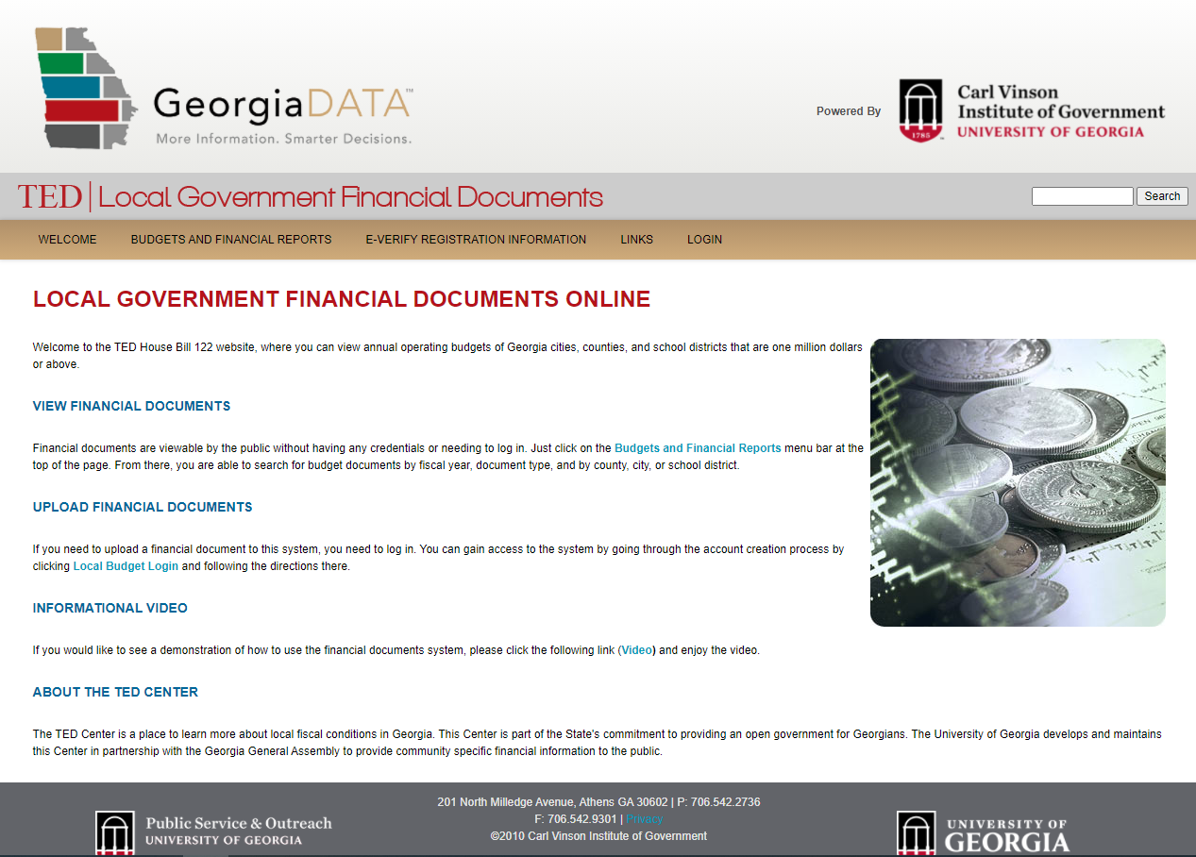
Audits
Send all audits to GA Department of Audits and Accounts
Future federal grant applications not eligible if audits are delinquent
Send to TED / Carl Vinson Institute of Government,
Local Government Finance Documents
Web site maintaining audits for cities, counties, others
https://ted.cviog.uga.edu/financial-documents/

Slide 12
Contact Info:
Kimberly N. Carter, EDFP
Division Director, Community Finance
Georgia Department of Community Affairs
kim.carter@dca.ga.gov
Kathleen Vaughn
Director, Office of Community Development
Georgia Department of Community Affairs
kathleen.vaughn@dca.ga.gov

Slide 13
Thanks!
Any questions or comments?

