Slide 1
PROPOSED FINANCIAL REPORTING MODEL
Oklahoma Society of CPAs Governmental
Accounting and Auditing Conference
Lisa R. Parker, CPA, CGMA, Senior Project Manager, GASB
Frank Crawford, CPA, President, Crawford & Associates, P.C.
Ms. Parker and Mr. Crawford.

Slide 2
What We will Cover
Conceptual Framework Recognition Exposure Draft
Financial Statement Model Improvements Exposure Draft
Examples
Notes:
Misty

Slide 3
Conceptual Framework: Recognition

Slide 4
Exposure Draft: Recognition of Elements of Financial Statements
What?
Why?
When?
The Board issued an Exposure Draft of a Concepts Statement on recognition of financial statement elements
Recognition concepts are one of the components needed to complete the conceptual framework
A final Concepts Statement is scheduled to be considered for issuance in Q2 2023

Slide 5
Recognition Concepts
The measurement focus of a specific financial statement determines what items should be reported as elements of that financial statement.
The related basis of accounting determines when those items should be reported.

Slide 6
Tentative Decisions: Recognition Hierarchy
Follow a specific order when evaluating an item for recognition:
Does it meet the definition of an asset or liability?
Yes: Recognize asset or liability
No: go to next step
Does it meet the definition of a deferred outflow of resources or a deferred inflow of resources?
Yes: Recognize deferral
No: go to next step
Does it meet the definition of an outflow of resources or an inflow of resources?
Yes: Recognize inflow/outflow
No: Do not recognize the item

Slide 7
Tentative Decision: Recognition Framework
Two Measurement Focuses
Economic Resources
(applied in government-wide, proprietary fund, and fiduciary fund financial statements)
Short-Term Financial Resources
(would replace current financial resources in the governmental funds)
Notes:
Subject to the limitations of financial reporting described in Concepts Statement 1.

Slide 8
Tentative Decisions: Recognition Framework (continued)
Item meets definition of an element under the measurement focus
Measurement of item sufficiently reflects qualitative characteristics
Recognize the item in financial statement
Notes:
Qualitative characteristics of information in financial reports per Concepts Statement 1.
Financial statements presented applying the short-term financial resources measurement focus would reflect the amount of fund balance at period-end that is available for spending in the next period, which may or may not be restricted for specific purposes, as well as fund balance that is legally or contractually required to be maintained intact.
This is subject to the limitations of financial reporting described in Concepts Statement 1.

Slide 9
Project Timeline
Preliminary Views Issued | September 2018
Redeliberations Began | June 2019
Exposure Draft Approved | June 2020
Redeliberations Began | May 2021
Final Concepts Statement Scheduled to Be Considered for Issuance | December 2023

Slide 10
Financial Reporting Model Reexamination

Slide 11
Financial Reporting Model Improvements
What?
Why?
When?
The Board proposed improvements to the financial reporting model― Statements 34, 35, 37, 41, and 46, and Interpretation 6
A review of those standards found that they generally were effective, but that there were aspects that could be significantly improved
A final Statement is scheduled to be considered for issuance in Q2 2023

Slide 12
Project Activities
Pre-agenda research
Roundtables
Surveys
Literature review
Archival
Interviews
Invitation to Comment, Financial Reporting Model Improvements—Governmental Funds, issued December 2016
Preliminary Views, Financial Reporting Model Improvements, issued September 2018
Exposure Draft, Financial Reporting Model Improvements, issued June 2020
Public hearings and user forums, March – April 2021
Notes:
DRB suggests that we spend a little time presenting about the pre-agenda research. He wants those that are new to the project understand how much time and effort we have put in.
Here is the detail:
During 2013 the following activities were conducted:
11 research roundtables in 8 cities
Focusing on either general purpose or special-purpose governments
Mix of financial statement preparers, auditors, and users
Primary purpose was to identify any major, overarching issues that have arisen since Statement 34 was implemented
During 2014 the following activities were conducted:
Broad surveys of
Preparers
Auditors
Users
Survey of preparers using the modified approach for reporting infrastructure
Archival research with annual financial reports
Literature review
Primary purpose was to identify how Statement 34 has been implemented in practice and to explore further the issues raised in the roundtables
During 2015 the following activities were conducted
148 interviews with preparers, auditors, and users narrowing in on areas of concern raised in prior research
Roundtables: # to get a variety of views, geographic variety, different size
governments/firms, too
recognize that issues may be different for GP government and special purpose governments
selected a mix of constituents
asked broad, open-ended Q’s to identify issues with the reporting model
Surveys: different surveys designed for different type of constituents
outreach to get as many responses to surveys as possible, respondents are self-selected
Purpose to explore further issues raised in the roundtables, and also to ask broad Q’s,
Q’s about value of different components, as well as they reasons why
Archival: CAFR reviews, selecting a large sample, broad variety of types and sizes of governments
Purpose to see how Statement 34 has been implemented in practice
Interviews: Again, a carefully selected group to reflect different geographical areas,
types of governments, sizes of governments, and stakeholders
Now focused more on the issues raised in the earlier research,
looking for confirmation on whether and how to address issues

Slide 13
Overview of the Proposals
Measurement focus and basis of accounting for the governmental funds
Format of governmental funds financial statements
Clarification of operating and nonoperating in proprietary funds
Presentation of proprietary funds statement of revenues, expenses, and changes in fund net position
Management’s discussion and analysis
Budgetary comparisons
Major component unit presentations
Unusual or infrequent items

Slide 14
Concerns with Governmental Fund Financial Statements
Lack of effectiveness of governmental fund information
Lack of conceptual consistency
Lack of guidance for complex transactions
Lack of consistency in applying the current financial resources measurement focus and modified accrual basis of accounting

Slide 15
Key Factors in Recognition
Key Recognition Factors
Recognition Terms The applicable payment terms of the transaction or other event that are used in recognition
Recognition Method How transactions will be recognized; begins with determining whether a transaction or other event is short term or long term
Recognition Period Period associated with the recognized assets and liabilities

Slide 16
Tentative Decisions: Key Factors in Recognition for the Short-Term Financial Resources Measurement Focus and Modified Accrual Basis of Accounting
Key Recognition Factors
Recognition Terms Binding arrangement—The terms of the binding arrangement or estimated payments if there is no binding arrangement or the binding arrangement does not include specific payment terms.
Recognition Method Items arising from short-term transactions or other events—recognize when incurred Items arising from long-term transactions or other events—recognize when due Based on the inception date of the transaction
Recognition Period One-year—Will be converted to or generate cash (or other financial assets) or require the use of cash (or other financial assets) within one-year from the inception of the transaction or other event

Slide 17
Tentative Decisions: Recognition in Governmental Funds
Short-term financial resources measurement focus and modified accrual basis of accounting
Elements from short-term transactions or other events recognized as the underlying transaction or other event occurs
Elements from long-term transactions and other events recognized when payments are due
Financial assets: cash, assets that are available to be converted to cash, and assets that are consumable in lieu of cash
Financial liabilities: ALL liabilities

Slide 18
Tentative Decisions: Recognition in Governmental Funds (cont.)
Short-Term Transactions
Period from inception to conclusion is one year or less
Long-Term Transactions
Period from inception to conclusion is more than one year
Inception
generally is when a party to the transaction takes an action that results in the initial recognition of an asset or liability
Conclusion
generally is when the final payment of cash or other financial assets is due according to the terms of the binding arrangement (or estimated payments)

Slide 19
Recognition in Governmental Funds
Assets:
Assets include those from short-term transactions as they occur
Assets arising from long-term transactions are recognized when payments are due
Includes:
Investments
Prepaid items
Inventory
Liabilities:
Liabilities arising from short-term transactions that are payable at year end as they occur
Liabilities arising from long-term transactions are recognized when payments become due
Except for long-term FINANCINGS issued for short-term purposes, which is recognized as a short-term transaction
Notes:
Long-term debt otherwise would be recognized as a l/t transaction—when payments are due. As a short-term transactions,
It would be recognized as a fund liability
Feedback the fund balance would be overstated if these items are not reported as fund liabilities
Adding the exception retain current reporting for TANS/RANS
Would now also pick up other items, such as the issuance of 5 year notes issued for operating purposes

Slide 20
Recognition in Governmental Funds
Inflows of Resources:
Inflows of resources from short-term transactions (such as tax levies, grants, and changes in fair value of investments) as the transactions occur
Inflows of resources from long-term transactions as payments are due except for long-term debt issued for short-term purposes
Includes on-behalf payments for fringe benefits and salaries and direct vendor financing (leases), except for those that are for short-term purposes, which would be reported as fund liabilities
Outflows of Resources:
Outflows of resources from short-term transactions (such as use of goods and services and acquisition of capital assets) as the transactions occur
Outflows of resources from long-term transactions are recognized when payments become due except for long-term debt issued for short-term purposes
Includes on-behalf payments for fringe benefits and salaries and direct vendor financing (leases), except for those that are for short-term purposes, which would be reported as fund liabilities

Slide 21
Recognition in Governmental Funds
Deferred Outflows of Resources and Deferred Inflows of Resources:
Recognized for both short-term and long-term transactions and other events when the outflow (or inflow) of resources is applicable to a future reporting period
Limited to circumstances identified by the GASB
Example: a tax imposed for a subsequent reporting period

Slide 22
Recognition Example – Investments in Permanent Fund
Jan 1, 20XX balance: $18,400,000 No maturities or purchases of investments Change in fair value of $100,000 Dec 31, 20XX balance: $18,500,000
Recognition Approach | Balance Sheet | Resource Flows Statement
Current financial resources | Investments of $18,500,000 | Inflows of resources of $100,000
Short-term financial resources | Investments of $18,500,000 | Inflows of resources of $100,000
Notes:
Investments are always a short-term transaction.
Changes in FV are an example of an other event.

Slide 23
Recognition Example – Property Taxes
Jan 1, 20XX balance: $5,000 $10,500,00 of property taxes are imposed Jan 1, half due Feb 1, half due Aug $10,485,000 collected during the year Dec 31, 20XX balance: $20,000
Recognition Approach | Balance Sheet | Resource Flows Statement
Current financial resources | Taxes receivable of $20,000 | Inflows of resources of $10,500,000
Short-term financial resources | Taxes receivable of $20,000 | Inflows of resources of $10,500,000
Notes:
Short-term transaction.
Inception is when taxes are imposed.
Conclusion is when final payment is due-Aug 1.

Slide 24
Recognition Example – Income Taxes
Jan 1, 20XX receivable balances: $5,000 due Jan 15, $8,000 due Apr 15 $400,000 of income taxes collected during the year Dec 31, 20XX receivable balances: $7,000 due Jan 15, $10,000 due Apr 15
Recognition Approach | Balance Sheet | Resource Flows Statement
Current financial resources: period of availability of 60 days | Taxes receivable of $17,000; Deferred inflow of resources $10,000 | Inflows of resources of $402,000 ($400,000 - $5,000 + $7,000)
Short-term financial resources | Taxes receivable of $17,000 | Inflows of resources of $404,000 ($400,000 - $5,000 - $8,000 +$7,000 + $10,000)
Notes:
Short-term transaction.
Inception is when taxes arise—taxable income is earned.
Conclusion is when payment is due-income tax payment due dates.

Slide 25
Recognition Example – Prepaid Items
Jan 1, 20XX balance: $5,800 Spending on prepaid items during year: $60,000 Dec 31, 20XX balance: $13,800
Recognition Approach | Balance Sheet | Resource Flows Statement
Current financial resources | Prepaid item and nonspendable fund balance of $13,800 | Outflows of resources of $52,000
Short-term financial resources | Prepaid item of $13,800 | Outflows of resources of $52,000
Notes:
Note i short-term financial resources, this is no longer nonspendable fund balance.
Prepaid items are financial assets—consumed in lieu of other financial assets
Is a short-term term transaction because it is a one-year policy.

Slide 26
Recognition Example – Notes Receivable Related to Lending
Jan 1, 20XX balance: $4,387,776 Collected/matured during year: $645,000 Dec 31, 20XX balance: $3,742,776
Recognition Approach | Balance Sheet | Resource Flows Statement
Current financial resources | Notes receivable and nonspendable fund balance of $3,742,776 | No amounts recognized
Short-term financial resources | No amounts recognized | Inflow of resources of $645,000
Existing guidance does not address how to report notes receivables related to lending. This example assumes a choice to report an asset, rather than an outflow of resources, was made.
Notes:
Long-term transaction. Inception is when loan was funded in a prior year. Conclusion
Is when final payment is due.
Recognize when payments are due.

Slide 27
Recognition Example – Accrued Interest on Long-Term Debt
Jan 1, 20XX balance: $899,750 Accrued during in the current year: $2,394,534 Paid during the current year: $2,448,950 Dec 31, 20XX balance: $845,334
Recognition Approach | Balance Sheet | Resource Flows Statement
Current financial resources | No amounts recognized | Debt service expenditures of $2,448,950
Short-term financial resources | No amounts recognized | Outflows of resources of $2,448,950
Notes:
Long-term transaction. The binding arrangement is the loan or bond document that requires period interest
Payments. The inception of the transaction is when the debt was funded in a prior year. Conclusion is when
The final payment is made.

Slide 28
Recognition Example – Tax Anticipation Notes Payable
Jan 1, 20XX balance: $4,000,000 Repayments during in the current year: $4,000,000 Borrowings during the current year: $4,400,000 Dec 31, 20XX balance: $4,400,000
Recognition Approach | Balance Sheet | Resource Flows Statement
Current financial resources | Tax anticipation note payable of $4,400,000 | No amounts recognized.
Short-term financial resources | Tax anticipation note payable of $4,400,000 | No amounts recognized.
Notes:
Doesn’t matter if the TAN is for 13 months or not. Exception for long-term debt issued for short-term purposes.

Slide 29
Recognition Example – Postemployment Benefits
Pension plan is funded. Net pension liability is $826,333 at Dec 31, 20XX. OPEB plan is pay-as-you-go. Net OPEB liability is $42,785,037 at Dec 31, 20XX.
Recognition Approach | Pension | OPEB
Current financial resources | No liability. No amount normally expected to be liquidated with available expendable resources. | No liability. No amount normally expected to be liquidated with available expendable resources.
Short-term financial resources | No liability. No amounts due. | No liability. No amounts due.
Notes:
OPEB are long-term transactions. Inception is when the employee begins earning the benefit. Conclusion is
When the benefits end. Report when payments become due.

Slide 30
Recognition Example – Bonds Payable
Jan 1, 20XX balance: $33,414,493 Principal paid during the current year: $8,331,457 Dec 31, 20XX balance: $25,083,036
Recognition Approach | Balance Sheet | Resource Flows Statement
Current financial resources | No amounts recognized | Expenditures of $8,331,457
Short-term financial resources | No amounts recognized | Outflows of resources of $8,331,457

Slide 31
Tentative Decisions: Presentation of Governmental Funds
Financial statements presented in
current and noncurrent activity
format
Current activity—
all other
Noncurrent activity—related to purchase and disposition of capital
assets and issuance and repayment of long-term debt

Slide 32
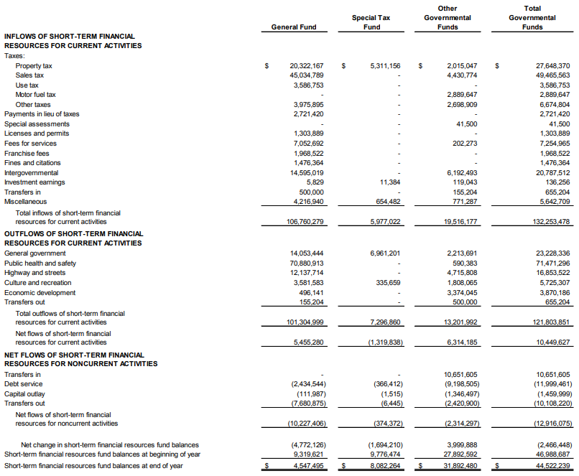
Tentative Decisions: Proposed Statement of Short-Term Financial Resource Flows
Current and Noncurrent Activity Format
Notes:
This is the lower half

Slide 33
Proposals: Management’s discussion and analysis
PREPARERS:
Remember Users are Different
Continue to provide objective and readable explanations and interpretations that users can understand.
Users have different levels of knowledge and sophistication.

Slide 34
Proposals: Management’s discussion and analysis (continued)
Telling Your Story
Focus on the primary government.
Discuss comparative results of current year and prior year, focusing on current year
Avoid unnecessary duplication and “boilerplate” discussions.

Slide 35
Proposals: Management’s discussion and analysis (continued)
Do Some House-Keeping
Move budgetary analysis and discussion of infrastructure assets modified approach (if applicable) to the relevant parts of RSI
Use five required sections -
Introduction
Financial summary
Detailed analysis
Significant capital assets and long-term debt activity
Currently known facts, decisions, or conditions

Slide 36
Proposals: Management’s discussion and analysis (continued)
EXAMPLES
Currently known facts, decisions, or conditions
Trends in relevant economic and demographic data
Information about certain actions the government has taken after the end of the reporting period
Information related to actions other parties have taken that will affect the government
Information related to the subsequent year’s budget

Slide 37
Other Proposals
If it is not feasible to present major component unit financial statements in separate columns in the reporting entity’s financial statements, the financial statements of the major component units would be presented in the reporting entity’s basic financial statements as combining financial statements
Major component unit presentations
Notes:
The Board has tentatively decided to carry forward the major component unit proposals to the ED.

Slide 38
Other Proposals (continued)
Unusual or Infrequent Items
Disclose additional information about those inflows and outflows, including the programs, functions, or identifiable activities to which they are related and whether they are within the control of management
Separately present inflows and outflows of resources that are unusual in nature and/or infrequent in occurrence (replacing extraordinary and special items)

Slide 39
Proposals: Proprietary Funds
Statement of Revenues, Expenses, and Changes in Fund Net Position
Continue separate presentation of operating and nonoperating revenues and expenses
AND
New definition/description proposed for operating and nonoperating revenues and expenses to increase comparability in reporting

Slide 40
Proposals: Proprietary Funds
Separate presentation of operating and nonoperating revenues and expenses
Operating
Activities other than nonoperating activities
Nonoperating
Subsidies received and provided
Revenues and expenses of financing
Resources from the disposal of capital assets and inventory
Investment income and expenses

Slide 41
Proposals: Proprietary Funds (cont.)
Subsidies
Resources received from another party or fund to keep rates lower than otherwise would be necessary to support the level of goods and services to be provided
Resources provided to another party or fund that results in higher rates than otherwise would be established for the level of goods and services to be provided
Add a new subtotal for operating income (loss) and noncapital subsidies

Slide 42
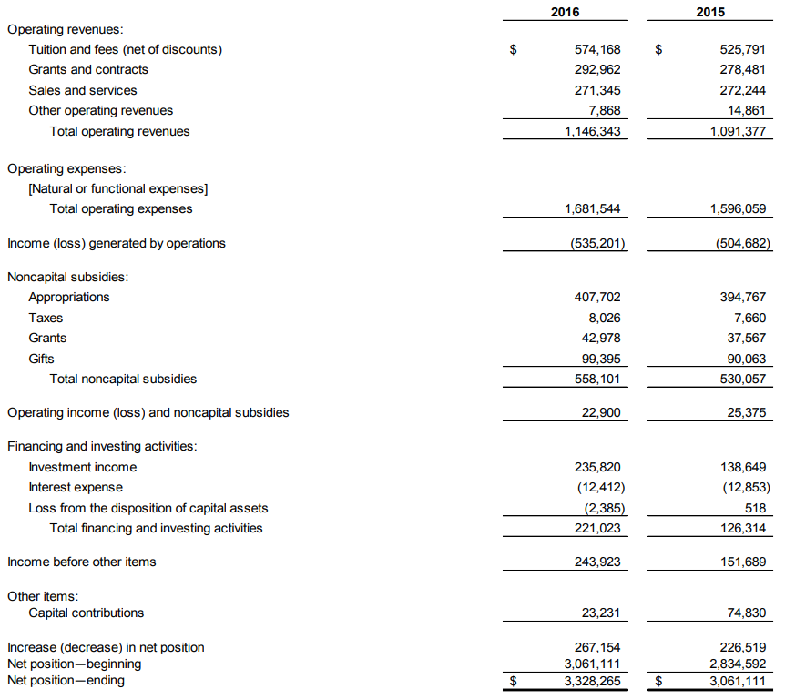

Slide 43
Proposals: Budgetary Comparison Information
Budgetary Comparisons
Would be presented as required supplementary information (no option for basic statements)
Required variances would be final-budget-to-actual and original-budget-to-final-budget
Notes:
The Board has tentatively decided to carry forward the major component unit proposals to the ED.

Slide 44
Proposed Effective Dates
Based on total annual revenues in fiscal year beginning after June 15, 2022
$75 million or more
Apply in fiscal years beginning after June 15, 2024
Less than $75 million
Apply in fiscal years beginning after June 15, 2025

Slide 45
Total Annual Revenues
Include
Extraordinary and special items
Exclude
All governmental activity revenues
All business-type activity revenues
Governments engaged only in fiduciary activities should use total annual additions.
Component units should implement in the same year as their primary government.
Notes:
The Board has tentatively decided to carry forward the major component unit proposals to the ED.

Slide 46
Proposals: Transition Provisions
Retroactively, by restating financial statements, if practicable, for all prior periods presented
Disclose the nature of the restatement and its effect
If not practicable
Restate beginning fund balance for the earliest period presented for the cumulative effect of application, if any
Disclose reason for not restating
Not required to
Restate prior periods for purposes of comparative data for MD&A
Encouraged to
Provide comparative analysis of key elements of activities (governmental and business-type) in MD&A
Statistical section provisions—may be applied prospectively
Notes:
Subject to the limitations of financial reporting described in Concepts Statement 1.

Slide 47
Project Timeline
Pre-Agenda Research Started | April 2013
Added to Current Technical Agenda | September 2015
Invitation to Comment Issued | December 2016
Preliminary Views Issued | September 2018
Exposure Draft Approved | June 2020
Redeliberations Began | May 2021
Final Statement Scheduled to Be Considered for Issuance | December 2023

