Slide 1


Collection and Use of 911 Fees
Aleisha Rucker-Wright
Deputy Executive Director

Slide 2
Topics for Discussion
Review the provisions of the Georgia Emergency Telephone Number 9-1-1 Service Act.
Review statutory requirements for expenditures of 9-1-1 funds.
Review the statutory requirements for 9-1-1 fee collection and disbursement.
Discuss the process for fee disbursement from the state to local 9-1-1 centers and the related reporting documentation.
Discuss the Federal Communications Commission's (FCC) annual reporting requirements.

Slide 3
Georgia Emergency Telephone Number 9-1-1 Service Act of 1977
46-5-120. Short title.
Establishes the name of the Act
46-5-121. Legislative intent.
Designates 911 as the 3-digit emergency number
Identifies land line and wireless phones as covered under this Act
Establishes that, as technology evolves, other types of 911 users fall under the act
Declares that the safety and well-being of the citizens of Georgia is of the utmost importance, and it is in the public interest to provide the highest level of emergency response service on a local, regional, and state-wide basis
Moves the collection of existing 9-1-1 charges on prepaid wireless service to the retail point of sale
46-5-122. Definitions.
46-5-124. Guidelines for implementing state-wide emergency 9-1-1 system;
training and equipment standards.

Slide 4
Georgia Emergency Telephone Number 9-1-1 Service Act of 1977
Continued
46-5-124.1. Service suppliers or Voice over Internet Protocol service suppliers must register certain information with the authority; updating information; compliance; notices of deficiency or noncompliance.
  Any service provider or VoIP service supplier doing business in Georgia shall register with the Authority by January 1, 2019
  Requires same suppliers to keep information up-to-date
  Dictates penalties for failure to register to include:
    Ineligible for cost recovery
    Subject to fines of $1,000 per day not in compliance
    Not be subject to the three-year audit limit
    Only applies if the deficiency or noncompliance is “uncured.”
    Allows the Authority to share the registry with the Georgia Department of Revenue
46-5-125. Formation of multijurisdictional and regional 9-1-1 systems.
46-5-126. Cooperation by commission and telephone industry.

Slide 5
Georgia Emergency Telephone Number 9-1-1 Service Act of 1977
Continued
46-5-127. Approval of 9-1-1 systems by agency; written confirmation by authority required for 9-1-1 systems established on or after January 1, 2019.
46-5-128. Cooperation by public agencies.
46-5-129. Use of "9-1-1" emblem.
46-5-130. Federal assistance.
The Authority may apply for and accept federal funding assistance in the development and implementation of a state-wide emergency 9-1-1 system.
46-5-131. Exemptions from liability in operation of "9-1-1" system.
No local government of the State of Georgia shall be required to release, indemnify, defend, or hold harmless any emergency 9-1-1 system provider from any loss, claim, demand, suit, or other action or any liability whatsoever which arises out of subsection (a) of this O.C.G.A., unless the local government agrees or has agreed to assume such obligations.

Slide 6
Georgia Emergency Telephone Number 9-1-1 Service Act of 1977
Continued
46-5-132. Fees by service supplier.
It shall be unlawful for any service supplier to assess or charge any fee for an emergency call placed on an emergency 9-1-1 system. The prohibition provided for in this Code section shall only apply to actual emergency calls made on such system and shall not apply to nor prohibit any fee assessed or charged for the implementation or enhancement of such system.
46-5-133. Authority of local government to adopt resolution to impose monthly 9-1-1 charge.
  Authorizes local governments to adopt resolutions concerning the collection of 911 fees under certain conditions.
  Section (c) requires: On and after January 1, 1999, no monthly 9-1-1 charge provided for in this Code section shall be imposed or continue to be imposed unless each public safety answering point funded in whole or in part from such charges is in compliance with Code Section 36-60-19, relating to required TDD training for communications officers.

Slide 7
Georgia Emergency Telephone Number 9-1-1 Service Act of 1977
Continued
46-5-134. Billing of subscribers; liability of subscriber for service charge; taxes on service; establishment of Emergency Telephone System Fund; cost recovery fee; records; use of funds
  Billing of Subscribers;
  Liability of Subscriber for Service Charge;
  Taxes on Service;
  Establishment of Emergency Telephone System Fund;
  Records;
  Use of Federal, State, Municipal, or Private Funds.
46-5-134.1. Counties where the governing bodies of more than one local government have adopted a resolution to impose an enhanced 9-1-1 charge.
46-5-134.2. Prepaid wireless 9-1-1 charge; definitions; imposition of fee by localities; collection and remission of charges; distribution of funds
46-5-135. Liability of service supplier in civil action

Slide 8
Georgia Emergency Telephone Number 9-1-1 Service Act of 1977
Continued
46-5-136. Authority of local government to create advisory board.
46-5-137. Powers of Public Service Commission not affected.
46-5-138. Joint authorities.
46-5-138.1. Guidelines pertaining to additional charges involving contracts between two or more counties.
46-5-138.2. “Director” defined; training and instruction.

Slide 9
Statutory Requirements for 911 Fee Expenditures - Eligible Expenditures under O.C.G.A. § 46-5-134
Actual cost of insurance purchased to insure against the risks and liability in the operation and maintenance of the emergency 9-1-1 system
Actual cost of salaries and employee benefits for employees hired solely for the operation and maintenance of the emergency 9-1-1 system
Actual cost of training employees hired for the operation and maintenance of the emergency 9-1-1 system
Allocation of indirect costs associated with supporting the 9-1-1 system center and operations
Cost of leasing or purchasing a building used as a public safety answering point
Lease, purchase, or maintenance of a mobile communications vehicle and equipment, if the primary purpose and designation of such vehicle is to function as a backup 9-1-1 system center
Lease, purchase, or maintenance of computer hardware and software used at a public safety answering point

Slide 10
Statutory Requirements for 911 Fee Expenditures - Eligible Expenditures under O.C.G.A. § 46-5-134 Continued
Lease, purchase, or maintenance of emergency telephone equipment used at a public safety answering point
Lease, purchase, or maintenance of logging recorders used at a public safety answering point
Lease, purchase, or maintenance of mobile public safety voice and data equipment, geo-targeted text messaging alert systems, or towers necessary to carry out the function of 9-1-1 system operations
Lease, purchase, or maintenance of public safety voice and data communications systems located in the 9-1-1 system facility
Any office supplies of the public safety answering points used directly in providing emergency 9-1-1 system services
Rates associated with the service supplier’s 9-1-1 service and other service supplier’s recurring charges
Other supplies directly related to providing emergency 9-1-1 system services

Slide 11
Statutory Requirements for 911 Fee Collection and Disbursement
38-3-185. Remission of 9-1-1 and enhanced 9-1-1 charges.
Beginning January 1, 2019, all 9-1-1 charges and all wireless enhanced 9-1-1 charges imposed shall be remitted monthly by each service supplier to the authority no later than the twentieth day of the month following the month in which the charges were collected.
Each service supplier collecting and remitting charges to the authority shall submit a report identifying the amount of the charges being collected and remitted from telephone subscribers attributable to each county or municipality that operate a PSAP.
For purposes of the required monthly report, the service supplier shall attempt to use enhanced ZIP codes. If an enhanced ZIP code is not available for an address or if the service supplier is unable to determine the applicable enhanced ZIP code after exercising due diligence, the service supplier may apply the five-digit ZIP code to that address.
38-3-186. Contracting with Department of Revenue.

Slide 12
Statutory Requirements for 911 Fee Collection and Disbursement Continued
38-3-188. Retention of funds by Department of Revenue; payments to local governments.
The Department of Revenue shall retain and remit from the total amount of funds collected an amount equal to 1 percent to the authority and an amount equal to 0.75 percent of the total amount to the Peace Officers’ Annuity and Benefit Fund.
Except for the amounts retained by the authority, Department of Revenue, Peace Officers’ Annuity and Benefit Fund, and service suppliers, the remainder of the charges remitted shall be paid to each local government on a pro rata basis based on the remitted amounts attributable to each local government. Such payments shall be made by the Department of Revenue to local governments no later than 30 days following the date charges must be remitted by service suppliers to the Department of Revenue.
Under no circumstances shall such payments be, or be deemed to be, revenues of the state and such payments shall not be subject to or available for appropriation by the state for any purpose.

Slide 13
Statutory Requirements for 911 Fee Collection and Disbursement Continued
38-3-191. Limitation on use of funds, rights, and privileges.
All funds, distributions, revenues, grants, appropriations, and rights and privileges of value of every nature accruing to the authority shall be used only for the purpose of developing, maintaining, administering, managing, and promoting the authority, state-wide 9-1-1 advancements, and state-wide public safety communications interoperability and may never be appropriated for any other purpose.

Slide 14

Revenue Policy Bulletin
Non-prepaid 911 Charge and Prepaid Wireless 911 Charge (FET-2018-1)
Purpose
…provides guidance on Georgia’s non-prepaid 911 charge and prepaid wireless 911 charge and supersedes the guidance entitled Prepaid Wireless 9-1-1 Charge.
Scope
….is intended to provide guidance to the public and to Department personnel. It is a written statement issued to apply principles of law to a specific set of facts or a general category of taxpayers, superseding all conflicting documents and oral directives previously issued by the Department. A Policy Bulletin does not have the force or effect of law and is not binding on the public. It is, however , the Department's position and is binding on agency personnel until superseded or modified by a change in statute, regulation, court decision, or subsequent Policy Bulletin .

Slide 15
Non-Prepaid 911 Fees
How much is the non-prepaid 911 charge?
The non-prepaid 911 charge is a $1.50 monthly charge on non-prepaid wireline, wireless, and voice over internet protocol (VOiP) telephone services. Beginning January 1, 2019, telephone service suppliers are required to report and remit non-prepaid 911 charges to the Georgia Department of Revenue. These fees are no longer reported and remitted directly to PSAPs.
How do service suppliers register to report and remit the charge?
Each service supplier that collects non-prepaid 911 charges must register for a non-prepaid 911 charge account on the Georgia Tax Center (GTC) through which it will report and remit the charges. Each account can be associated with only one federal employer identification number (FEIN). A service supplier must register for a sales tax number before it can apply for a non-prepaid 911 charge account. Account registration on GTC will be available after January 1, 2019.

Slide 16
Non-Prepaid 911 Fees Continued
How do service suppliers report and remit the non-prepaid 911 charge?
Telephone service suppliers report and remit non-prepaid 911 charges to the Department of Revenue through GTC. The returns and collected charges are due on 20th day of each month following the month of collection. For example, fees collected in February must be submitted to the DOR by March 20th.
Telephone service suppliers are required to report the amount of charges collected for each telephone service type (i.e., wireline, wireless, or VOiP) attributable to each county or municipality that operates a PSAP.
Are any telephone services exempt from the non-prepaid 911 charge?
All telephone services billed to federal, state, or local governments are exempt.
Are telephone service suppliers required to report exempt telephone services?
Yes

Slide 17
Non-Prepaid 911 Fees Continued
Are telephone service suppliers allowed vendor's compensation?
If the return is filed timely and the charge is remitted timely, the service suppliers' compensation is 1 % of the charge remitted.
Are telephone service suppliers allowed to charge a cost recovery fee?
A service supplier may recover its costs expended on the implementation and provision of 911 services to subscribers by imposing a cost recovery fee not to exceed 45 cents per month or including such costs in existing cost recovery or regulatory recovery fees billed to the subscriber. Telephone service suppliers are prohibited from deducting the cost recovery fee from non-prepaid 911 charges or prepaid wireless 911 charges.
Are telephone service suppliers allowed vendor's compensation?
If the return is filed timely and the charge is remitted timely, the service suppliers' compensation is 1 % of the charge remitted.

Slide 18
Non-Prepaid 911 Fees Continued
How will the Department disburse the charges?
Every month, the Department of Revenue will pay .25 % of the remitted charges to the general fund of the state treasury, .75 % of the remitted fees to the Peace Officer Benefit and Annuity Fund, and 1 % of the remitted charges to the GECA. The Department will then disburse the remaining charges every month to qualifying counties and cities that operate or contract for the operation of a PSAP. The Department will disburse directly to each jurisdiction the amount of non-prepaid 911 charges reported by service suppliers as designated to that jurisdiction. The counties and cities are required to deposit the charges in a separate restricted fund known as the Emergency Telephone System Fund.

Slide 19
Prepaid 911 Fees
What is the prepaid wireless 911 charge?
The prepaid wireless 911 charge is a charge on the retail sale of prepaid wireless telephone service. All retail sellers of prepaid wireless telephone service must collect the charge and report and remit the charge through GTC.
What is prepaid wireless telephone service?
“Prepaid wireless telephone service" is a wireless telecommunications connection that the customer pays for in advance. Examples include:
  calling or usage privileges, based on a set dollar amount, minutes or units of air time, included with the purchase of a cellular phone;
  recharging a reusable cellular phone with additional minutes or units of air time;
  cellular phone calling cards that are preloaded with a set dollar amount, minutes, or units of air time; and
  recharging a reusable cellular phone calling card.

Slide 20
Prepaid 911 Fees Continued
How much is the prepaid wireless 911 charge?
The prepaid wireless 911 is $1.50 per wireless telephone service. The Department of Revenue will disburse these charges to local governments on a monthly, instead of an annual basis.
How do sellers register to collect and remit this charge?
Sellers of prepaid wireless telephone service at retail must register for a prepaid wireless 911 charge account on GTC through which they will report and remit the charges. Sellers must register for a sales tax number before they can apply for a prepaid wireless 911 charge account.
How do sellers report and remit the charge?
Sellers will report and remit prepaid wireless 911 charges to the Department through GTC.
The filing frequency is the same as the filing frequency for the seller's master sales and use tax account, if the seller has a master account. If the seller has more than one location but no master account, then the filing frequency is the same as that of the seller's location that files most frequently. For most filers, the prepaid wireless 911 returns and collected charges will be due on the 20th day of each month following the month of collection.

Slide 21
Prepaid 911 Fees Continued
Are sellers allowed vendor's compensation?
If the return is filed timely and the charge is remitted timely, the vendor's compensation is 3% of the charge remitted.
Are any prepaid wireless transactions not subject to the charge?
If the prepaid wireless service is less than 10 minutes or $5.00 and is sold with a prepaid wireless device for a single, non-itemized price, then the seller may elect not to apply the charge to the transaction.
In addition, if the prepaid wireless service is less than 10 minutes or $5.00 and is separately priced and sold as part of a single retail transaction that does not contain a prepaid wireless device or another prepaid wireless service, then the seller may elect not to apply the charge to the transaction.
Further, in the case of transactions where prepaid wireless services are provided to qualifying low-income subscribers free of charge, there is no retail transaction between a seller and a consumer, such transactions are not subject to the charge.

Slide 22
Prepaid 911 Fees Continued
How will the Department of Revenue disburse the charges?
Every month, the Department or Revenue will pay .25 % of the remitted charges to the general fund of the state treasury, .75 % of the remitted fees to the Peace Officer Benefit and Annuity Fund, and 1 % of the remitted charges to GECA. The Department will then disburse the remaining charges every month to qualifying counties and cities that operate or contract for the operation of a PSAP according to the population of each county and city. The Georgia Office of Planning and Budget will annually certify the population data to the Department.
The counties and cities are required to deposit the charges in a separate restricted fund known as the Emergency Telephone System Fund.

Slide 23

911 Fee Disbursement Reports
The Georgia Emergency Communications Authority will send each eligible PSAP fee disbursement reports. A detailed report is emailed to those responsible for PSAP finances. A publicly available report with aggregated amounts is emailed to each PSAP and published on GECA’s website.
To receive these reports, you must complete and submit a non-disclosure agreement to GECA.
The non-disclosure agreement establishes a confidential relationship about the disclosure of certain proprietary and confidential information received from the Georgia Emergency Communications Authority. This agreement outlines access to information, so you can assess the accuracy of 911 fee collections and remittances.

Slide 24
911 Fee Disbursement Reports Continued
Both Non-Prepaid Charge (NPC) and Prepaid Wireless Fee (PWF) Distribution Reports include:
Total allocation amount
Distribution date
Payment allocation date range
Number of distribution accounts
Disbursement jurisdiction
Disbursement amount

Slide 25
Non-Prepaid Charge Distribution Report (NPC)

Slide 26
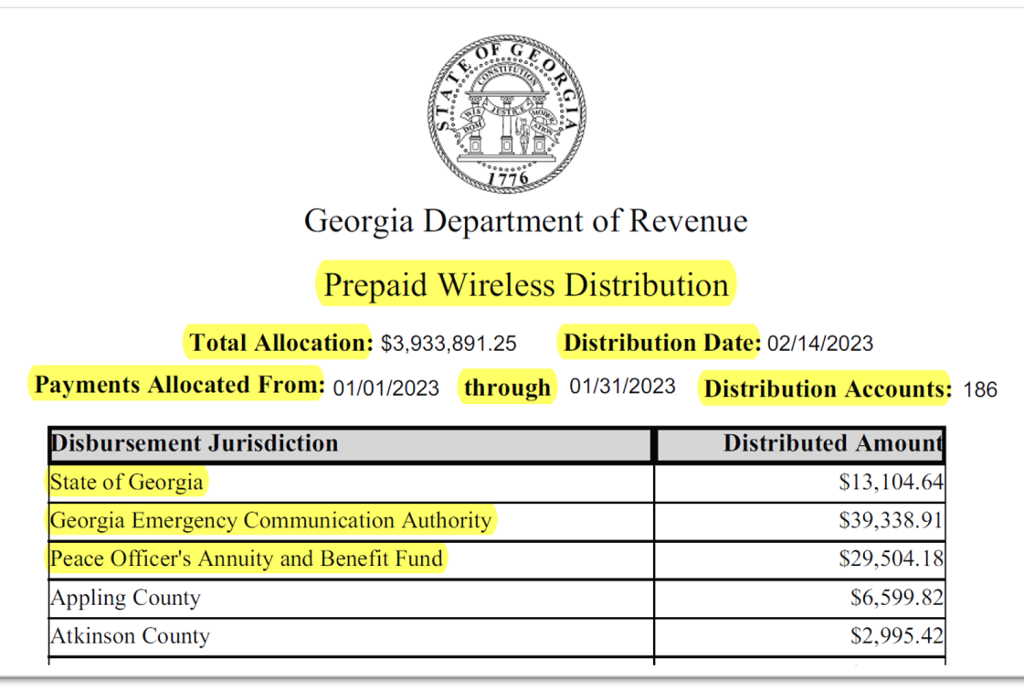
Prepaid Wireless Distribution Report (PWF)

Slide 27
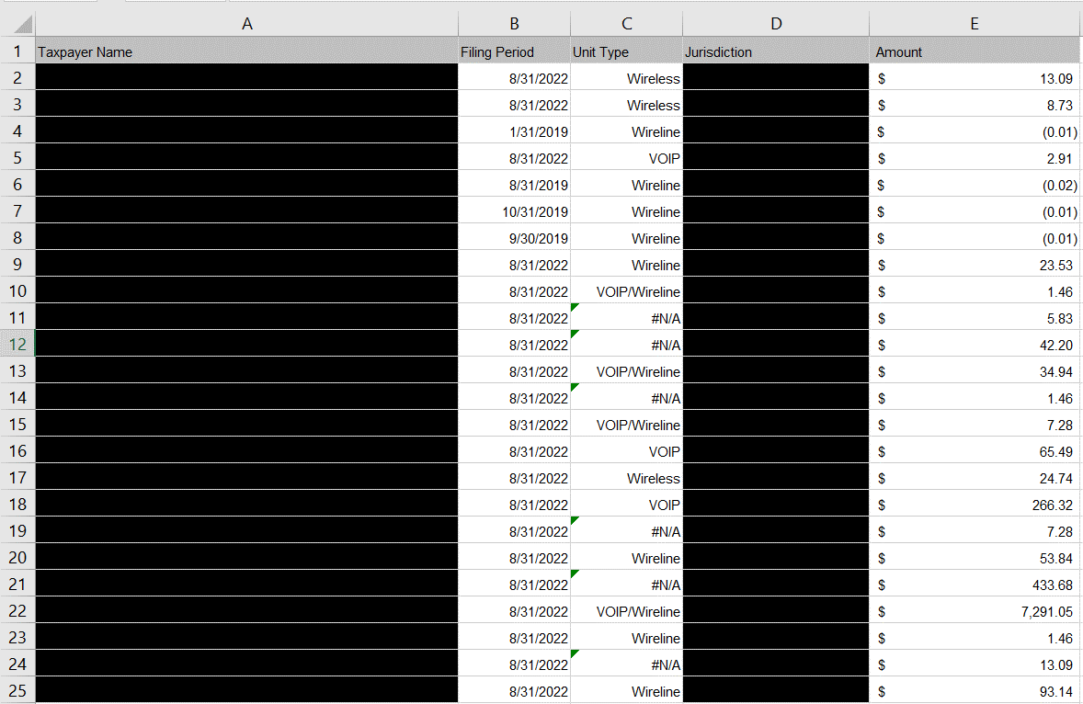
Detailed Distribution Report by County – These reports are confidential and not publicly available.

Slide 28

Georgia Law on Certification of 9-1-1 Expenditures
House Bill 470 (2005)
Local governments collecting or expending any 9-1-1 charges or wireless enhanced charges must file an annual report of its collections and expenditures in conjunction with the annual audit required under O.C.G.A. 36-81-7
Requires certification by the recipient local government and by the local government auditor that funds were expended in compliance with the expenditure requirements
House Bill 280 (2011): Rewrote O.C.G.A. Section 46-5-134 that details the allowable uses of funds in the Emergency Telephone System Fund
Senate Bill 156 (2011): Modified the reporting requirements of 9-1-1 funds
Certification of 9-1-1 Expenditures should be submitted with the annual audit report submitted to the Department of Audits and Accounts in accordance with O.C.G.A. Section 36-81-7
Requires local governments to document the amount of funds collected and expended from 9-1-1 charges and wireless enhanced 9-1-1 charges
Reporting of the amounts of these charges is not required on the Certificate of 9-1-1 Expenditures submitted by the local government
No requirement to submit local government auditor certification that
funds were expended in compliance with the expenditure requirements
https://www.audits2.ga.gov/

Slide 29
  Uniform Chart of Accounts
  Code 3800: E-911
    3810: E-911 Emergency Dispatch
    3820: E-911 Non-Emergency Dispatch
  Fund 215: Emergency 911 Telephone Fund

Slide 30

FCC Annual Reporting Requirements
Federal Communications Commission collects data on 911 revenues and 911 expenditures for 911 services as required by the New and Emerging Technologies 911 Improvement Act of 2008 (NET 911 Act). https://www.fcc.gov/general/911-fee-reports.

Slide 31

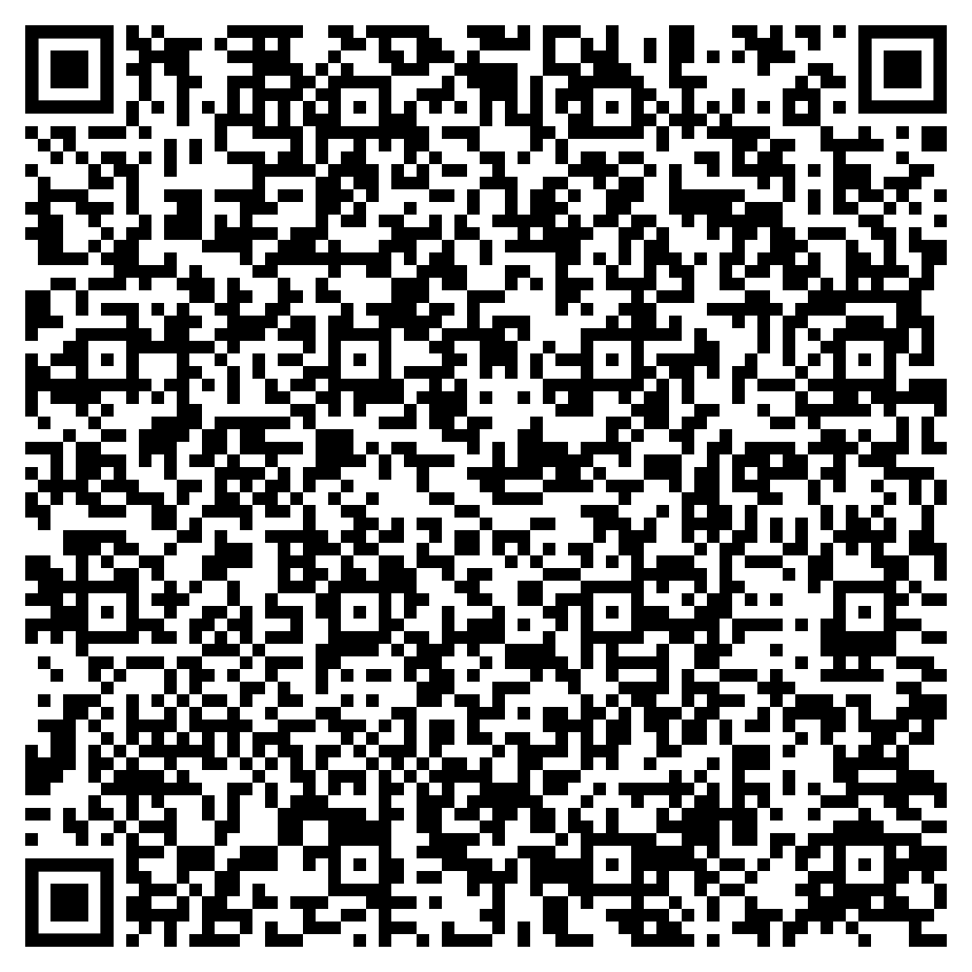
Aleisha Rucker-Wright
Deputy Executive Director
Georgia Emergency Communications Authority
aleisha.rucker-wright@gema.ga.gov
C: 404-358-7194

