Slide 1
GASB UPDATE: Wait, I thought we were getting a break?
Part 2

Slide 2
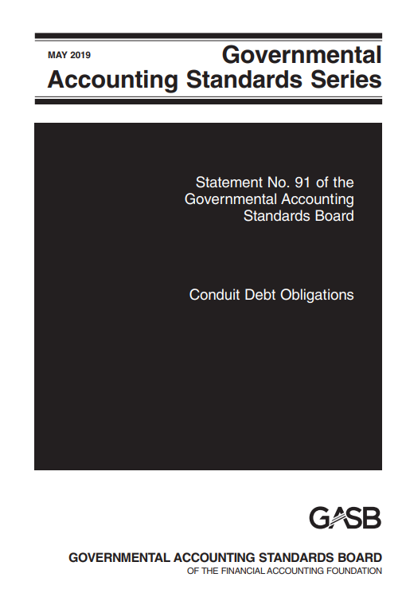
Presentation Overview
Pronouncements being implemented
Projects currently being deliberated by the Board
Pre-agenda research activities
Post-implementation review

Slide 3
Effective Dates
Statement 87 – leases
December 31: Fiscal Year 2022
Statement 92 – omnibus 2020 (multiple effective dates)
December 31: Fiscal Year 2023
Statement 94 – public-private partnerships
Statement 93 – LIBOR removal and lease modifications
Statement 91 – conduit debt
Statement 97 – certain component unit criteria and Section 457 plans
IG 2020-1 – update
Statement 96 – SBITAs
IG 2021-1 – update (4.1–4.21, 4.23, 5.2, and 5.4)
IG 2021-1 – update (4.22)
December 31: Fiscal Year 2024
IG 2021-1 – update (5.1)
IG 2019-3 – leases
Statement 100 – accounting changes and error corrections
Statement 101 – compensated absences
Statement 99 – omnibus 2022 (extension of LIBOR, SNAP distributions, nonmonetary transaction disclosures, pledges of future revenues, clarification of provisions in Statement 34, and terminology updates)
Statement 99 – omnibus 2022 (leases, PPPs, and SBITAs)
Statement 99 – omnibus 2022 (financial guarantees and classification of derivatives)

Slide 4
Effective Dates
Statement 91 – conduit debt
June 30: Fiscal Year 2023
Statement 94 – public-private partnerships
Statement 96 – SBITAs
IG 2020-1 – update (4.6–4.17 and 4.19–4.21)
IG 2021-1 – update (4.1–4.21, 4.23, 5.2, and 5.4)
June 30: Fiscal Year 2024
IG 2021-1 – update (5.1)
Statement 99 – omnibus 2022 (leases, PPPs, and SBITAs)
Statement 99 – omnibus 2022 (financial guarantees and classification of derivatives)
Statement 100 – accounting changes and error corrections
June 30: Fiscal Year 2025
Statement 101 – compensated absences

Slide 5
Pronouncements Being Implemented

Slide 6
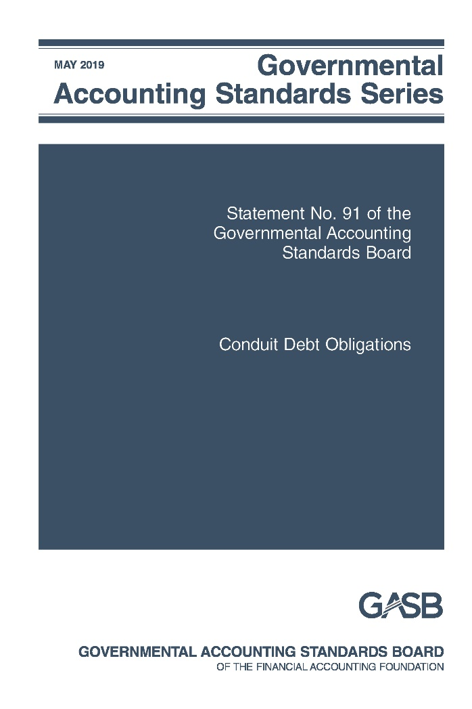
Conduit Debt Obligations
Statement No. 91

Slide 7
Conduit Debt
What?
Why?
When?
The Board improved the standards related to conduit debt obligations by providing a single reporting method for government issuers
Interpretation 2 had been in effect for 20 years before its effectiveness was evaluated; based on GASB research, improvements were needed to eliminate diversity in practice
Effective for periods beginning after December 15, 2021
Earlier application is encouraged

Slide 8
Definition of Conduit Debt
There are at least three parties involved: the government-issuer, the third-party obligor (borrower), and the debt holder or trustee.
The issuer and the third-party obligor are not within the same financial reporting entity.
The debt obligation is not a parity bond of the issuer, nor is it cross-collateralized with other debt of the issuer.
The third-party obligor or its agent, not the issuer, ultimately receives the proceeds from the debt issuance.
The third-party obligor, not the issuer, is primarily obligated for the payment of all amounts associated with the debt obligation.

Slide 9
Limited, Additional & Voluntary Commitments Extended by Issuers
Generally, issuers’ commitments are limited to the resources provided by the third-party obligor.
Occasionally, an issuer may extend an
additional commitment
to support debt service in the event of the third-party obligor’s default.
For example:
Extending an appropriation pledge
Extending a financial guarantee
Pledging its own property, revenue, or other assets as security
Extending a moral obligation pledge
Under a voluntary commitment, issuer voluntarily decides to make a debt service payment or request an appropriation for a payment in the event that the third-party is, or will be, unable to pay.

Slide 10
Recognition by the Issuer
Do not recognize a conduit debt obligation as a liability
May have a related liability arising out of an additional or voluntary commitment
Additional commitment: report a liability when qualitative factors indicate it is more likely than not that the issuer will support debt service payments for a conduit debt obligation
Voluntary commitment: if a certain event or circumstance has occurred, evaluate likelihood, then report a liability if it is more likely than not that the issuer will support debt service payments
Voluntary commitments for which a liability is recognized and all additional commitments: At least annually reevaluate whether recognition criteria are met while conduit debt is outstanding
Notes:
Box 3: The list of qualitative factors in paragraph 13 should be used to assess whether it is more likely than not an issuer will support debt service payments.

Slide 11
Arrangements and Capital Assets
Some conduit debt obligations include
arrangements* that involve capital assets to be used by the third-party obligor but owned by the issuer.
Payment schedule of the arrangement coincides with the debt service repayment schedule.
Capital asset is built or acquired with proceeds of the conduit debt obligation.
Payments from the third-party obligor are to cover debt service payments.
Issuer retains title to the capital asset from the beginning of the arrangement.
*Often characterized as “leases”

Slide 12
Arrangements and Capital Assets (continued)
Accounting by the issuer:
Do not report those arrangements as leases
Do not recognize a liability for the related conduit debt obligations
Do not recognize a receivable for the payments related to those arrangements
If the arrangement meets the definition of a service concession arrangement, follow Statement 60

Slide 13
Arrangements and Capital Assets (continued)
Does title pass to third-party obligor at end of arrangement? | Does the issuer recognize a capital asset? | Does the issuer recognize a deferred inflow of resources?
Yes | No | No
No, and third party has exclusive use of entire capital asset | Yes, when the arrangement ends | No
No, and third party has exclusive use of only portions of the capital asset | Yes, at the inception of the arrangement | Yes, at the inception of the arrangement; deferred inflow recognized as revenue over the term of the arrangement

Slide 14
Disclosures by Type of Commitment
A general description of the issuer’s conduit debt obligations
Description of limited commitments
If the issuer recognizes a related liability
Description of timing of recognition and measurement of the liability
Cumulative payments that have been made
Amounts expected to be recovered, if any, for those payments
Description of additional commitments (legal authority and limits; length; arrangements for recovering payments from third-party obligors, if any)
Aggregate outstanding principal amount
Beginning balances, increases, decreases, ending balances

Slide 15
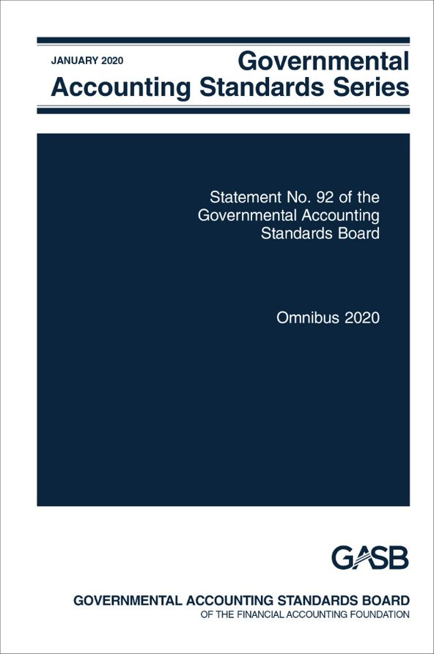
Omnibus 2020
Statement No. 92

Slide 16
Omnibus 2020
What?
Why?
When?
The Board has amended existing standards covering multiple topics
Omnibus projects are used to address issues in multiple pronouncements that, individually, would not justify a separate project
Effective dates vary by topic
Earlier application is encouraged and permitted by topic

Slide 17
Provisions of Statement 92
Leases
Government combinations and disposals of operations
Derivative instruments
Effective date of Statement 87 and Implementation Guide 2019-3 is changed from “reporting periods” to “fiscal years…and all reporting periods thereafter”
Provides an exception to the use of acquisition value in the measurement of an acquired asset retirement obligation
Amends NCGA and GASB pronouncements to standardize the terminology used to refer to derivative instruments

Slide 18
Provisions of Statement 92 (continued)
Application of Statement 84 to Postemployment Benefit Arrangements
Limit the requirements of paragraphs 22 and 25 to defined benefit pension and OPEB plans
Applicability of Statements 73 and 74
Fair value measurements
Amends paragraph 81 of Statement 72 to adjust the example of nonrecurring fair value measurements
Supersedes guidance in Statements 73 and 74 regarding recognition of a liability to employers and NECEs for the excess of assets over liabilities for benefits payments and administrative expenses in custodial funds in circumstances in which assets are accumulated for the pensions and OPEB of other employers and NECEs
Amend Statements 73 and 74 to replace references to control of assets in those same circumstances, to avoid limiting the application of the associated requirements of those Statements

Slide 19
Provisions of Statement 92 (continued)
Intra-entity transfers of assets
Amends paragraph 15 of Statement 48 to clarify that amounts associated with the transfer of capital or financial assets from an employer or NECE to a defined benefit pension or OPEB plan within the same financial reporting entity should be reported as contributions to the plan, in accordance with Statements 68 and 75
Clarifies that the provisions of paragraph 15 apply to all transfers of assets within a financial reporting entity
Amends paragraph 37 of Statement 10 to clarify that amounts that are recoverable from reinsurers or excess insurers and that relate to paid claims and claim adjustment expenses may be reported as reductions of expenses but are not required to be.
Reinsurance recoveries

Slide 20
Effective Dates for Statement 92
Requirements related to: | Effective Date
Leases Reinsurance recoveries Derivative instruments | Upon issuance
Intra-entity transfers of assets Applicability of Statements 73 and 74 | Fiscal years beginning after June 15, 2021
Application of Statement 84 to postemployment benefit arrangements Fair value measurements | Reporting periods beginning after June 15, 2021
Government combinations and disposals of operations | For government acquisitions occurring in reporting periods beginning after June 15, 2021

Slide 21
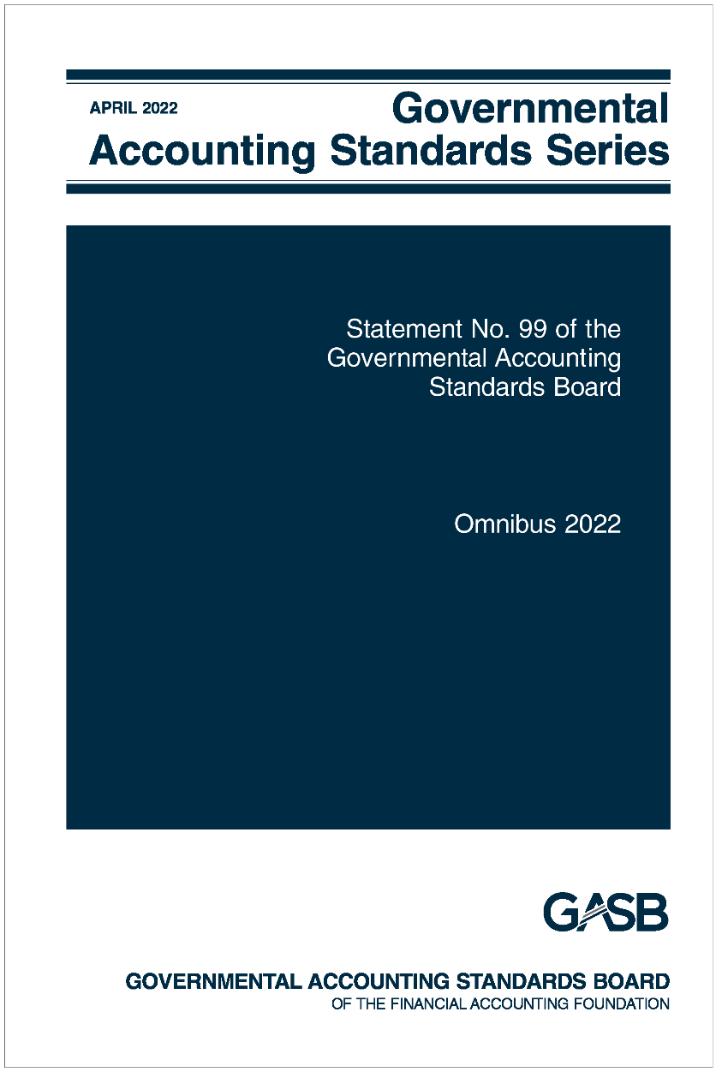
Omnibus 2022
Statement No. 99

Slide 22
Omnibus 2022
What?
Why?
When?
Practice issues identified during implementation and application of certain GASB Statements and accounting and financial reporting for financial guarantees
Omnibus Statements are issued to address issues in multiple pronouncements that, individually, would not justify a separate pronouncement
Various effective dates:
1) Upon issuance
2) Fiscal years beginning after June 15, 2022
3) Fiscal years beginning after June 15, 2023

Slide 23
General Omnibus Topics
Financial Guarantees
Extended Use of LIBOR
Technical Updates/Corrections
Leases, PPPs, and SBITAs
Other Derivative Instruments

Slide 24
Financial Guarantees
Statement 99 DOES
Apply the liability recognition, liability measurement, and disclosure requirements in Statement 70 to governments that extend exchange or exchange-like financial guarantees.
Statement 99 DOES NOT
Prescribe expense classification.
Prescribe recognition guidance for the consideration received in an exchange or exchange-like financial guarantee transaction.

Slide 25
Other Derivative Instruments
Other Derivative Instruments
Change in fair value should be reported on flow statement separately from investment revenues
Termination of hedge accounting
If hedging derivative instruments cease to be effective, the balance of the deferrals should be reported on the flows statement separately from investment revenues.
Disclosures should be distinguished from hedging derivative instruments and investment derivative instruments
Disclose fair value of derivative instruments that were reclassified from hedging derivative instruments

Slide 26
Leases, PPPs, and SBITAs
Remeasurement of certain assets and liabilities
Should not be remeasured solely for a change in an index or rate used to determine variable payments
Option to Terminate
Unconditional right that exists within the contract - the right to terminate due to the action or inaction of the other party is not an option to terminate
Short-term Leases and SBITAs
Modified short-term leases or SBITAs should be remeasured from the inception of the lease or SBITA
For leases only - the option to purchase the underlying asset would be considered an option to terminate for purposes of measuring the lease term

Slide 27
Leases, PPPs, and SBITAs (cont.)
Variable Lease Payments
Variable lease payments, other than those that depend on an index or rate or those that are fixed in substance, should not be included in the measurement of the lease liability.
Lease Incentives
Includes the assumption of or an agreement to pay a lessee’s preexisting lease obligation to a third party
The receivable for the underlying PPP asset should be remeasured if there is a change in the PPP term
PPP Remeasurement
Deferred outflow of resources should be adjusted by the same amount as any remeasurement change to the liability for the underlying PPP asset

Slide 28
Replacement of Interbank Offered Rates
London Interbank Offered Rate (LIBOR)
Date at which it is not an appropriate benchmark interest rate changes to when it is no longer determined by the ICE Benchmark Administration using the methodology in place as of December 31, 2021.

Slide 29
Technical Updates/Corrections
SNAP/ Food Stamps
States no longer use paper food stamp coupons. Specialized guidance in Statement 24 is no longer relevant. Should apply Statement 33 instead.
Nonmonetary Transactions
Should disclose measurement attribute(s), rather than basis of accounting for assets transferred.
Pledges of Future Revenue
Blending guidance provided

Slide 30
Technical Updates/Corrections (cont.)
Government-Wide Statements
Clarifies that no total column is required for the financial reporting entity as a whole.
Terminology Updates
Balance sheet – Statement of net position
Balance sheet date – Date of financial statements or Statement of net position date
Equity Funds – Other assets used
Fund Equity – Equity interest
Flow of resources statement – Resource flows statement

Slide 31
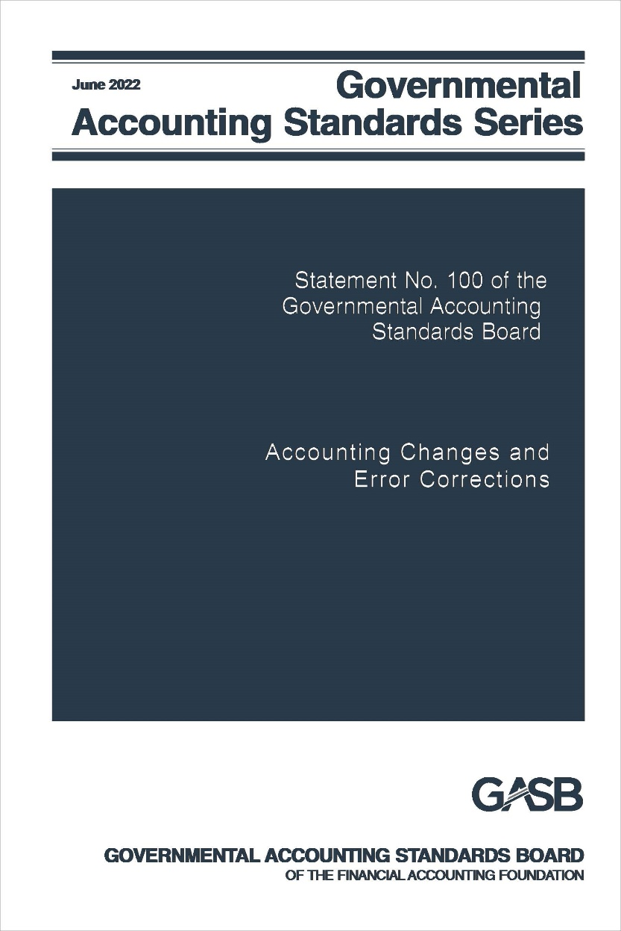
Accounting Changes and Error Corrections
Statement No. 100

Slide 32
Accounting Changes and Error Corrections
What?
Why?
When?
Based on a reexamination of the requirements in Statement 62, the Board has replaced the guidance that previously existed in Statement 62 with new standards for accounting changes and error corrections.
The previous guidance was based on several sources of accounting standards, some of which had been superseded, and much of which was been in effect without review by the GASB for decades.
Effective for changes made in fiscal years beginning after June 15, 2023, and all reporting periods thereafter.
Earlier application is encouraged.

Slide 33
Classification
Accounting changes
Change in accounting principle
Change in accounting estimate
Change to or within the financial reporting entity
Correction of an error in previously issued financial statements

Slide 34
Change in Accounting Principle
A change in accounting principle results from either:
A change from one generally accepted accounting principle to another that is justified on the basis that the newly adopted accounting principle is preferable
Preferability based on the qualitative characteristics of financial reporting
Implementation of new pronouncements

Slide 35
Accounting Estimates
Accounting estimates are:
Amounts subject to measurement uncertainty that are recognized or disclosed in basic financial statements
Outputs determined based on inputs such as data, assumptions, and measurement methodologies

Slide 36
Change in Accounting Estimate
A change in accounting estimate occurs when the inputs change
Inputs include data, assumptions, and measurement methodologies
Changes in inputs result from:
Change in circumstance
New information
More experience
Change in measurement methodology should be justified on the basis that new methodology is preferable
Based on qualitative characteristics of financial reporting

Slide 37
Change to or within the Financial Reporting Entity
A change to or within the financial reporting entity results from:
Addition/removal of a fund that results from movement of continuing operations within the primary government, including its blended component units
A change in the fund presentation as major or nonmajor
Addition/removal of a component unit (except for acquisitions, mergers, and transfers of operations, and Statement 90 component units)
Change in presentation (blended or discrete) of a component unit
Notes:
NOTE: Transactions or other events that could be classified as either a change in accounting principle in accordance with paragraph 5a or a change to or within the financial reporting entity should be considered a change to or within the financial reporting entity.

Slide 38
Correction of an Error
An error results from:
Mathematical mistakes
Misapplication of accounting principles
Oversight or misuse of facts that existed at the time the financial statements were issued about conditions that existed as of the financial statement date
Facts that could reasonably be expected to have been obtained and taken into account at that time about conditions that existed as of the financial statement date
Notes:
NOTE: Transactions or other events that could be classified as either a change in accounting principle in accordance with paragraph 5a or a change to or within the financial reporting entity should be considered a change to or within the financial reporting entity.

Slide 39
Accounting for Accounting Changes and Error Corrections
Change in accounting principle
Reported retroactively by restating prior periods presented, if practicable
Change in accounting estimate
Reported prospectively
Recognized in current-period flows
Change to/within the reporting entity
Reported by adjusting current period beginning balances
Error correction
Reported retroactively by restating prior periods presented
If not practicable, restate beginning balances of current period

Slide 40
Display
Shown separately
Aggregate amount of adjustments to and restatements of beginning balances should be displayed for each reporting unit

Slide 41
Note Disclosures
Disclosures vary depending on the type of item, but common disclosures include:
The nature of the change or error and its correction
Reason for the change
The effects on beginning net position, fund balance, or fund net position, as applicable, presented in a tabular format

Slide 44
RSI and SI
The Statement addresses how to present in RSI and SI information that is affected by an accounting change or error correction
Periods earlier than those presented in basic financial statements should not be restated for changes in accounting principles
Periods earlier than those presented in basic financial statements should be restated for error corrections, if practicable

Slide 45
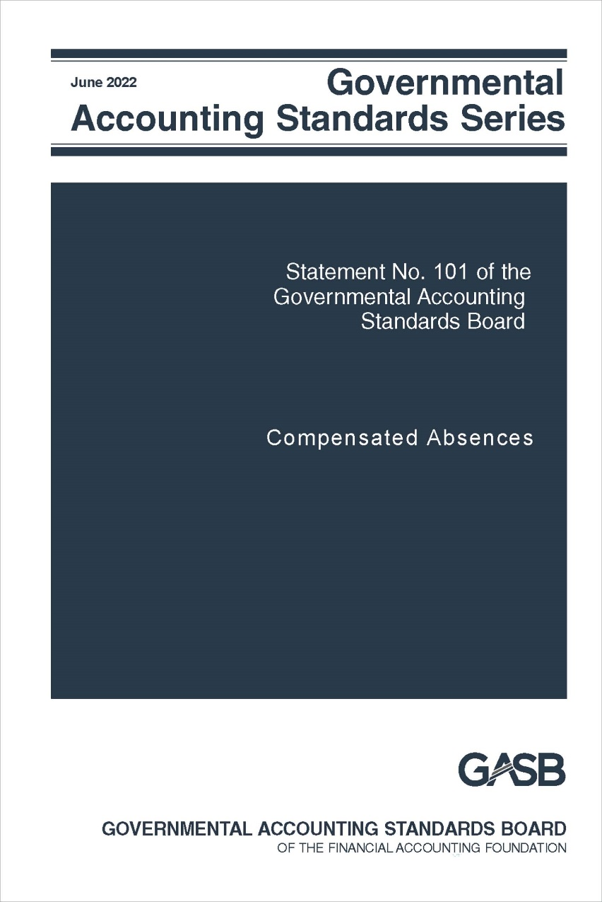
Compensated Absences
Statement No. 101

Slide 46
Compensated Absences
What?
Why?
When?
The Board has amended existing guidance for compensated absences
A review of Statement 16 indicated opportunities for improvement and additional guidance for certain types of leave
Effective for fiscal years beginning after December 15, 2023.
Earlier application is encouraged

Slide 47
Scope and Applicability
A compensated absence is
Leave for which employees may receive one or more:
Other cash payments, such as payment for unused leave upon termination of employment
Noncash settlement, such as conversion to postemployment benefits
Examples:
Vacation and sick leave
Paid time off (PTO)
Holidays
Certain types of sabbatical leave
Cash payments when the leave is used for time off
Parental leave

Slide 48
Recognition Criteria – Leave that has not been used
Leave is attributable to services already rendered
Employee has performed the services required to earn the leave
Leave is more likely than not to be used for time off or otherwise paid or settled
Likelihood of more than 50 percent
Leave accumulates
Can be carried forward from reporting period when earned to a future reporting period when it will be used or otherwise paid or settled

Slide 49
Exceptions to the General Recognition Approach
Leave that is dependent upon the occurrence of a sporadic event that affects a relatively small proportion of employees in any particular reporting period
Unlimited leave and holiday leave taken on specific date
Recognize liability when leave commences
Recognize liability when used
Parental leave, military leave, jury duty recognized when commences
Not sick leave or sabbatical leave
Leave more likely than not to be settled through conversion to defined benefit postemployment benefits
Excluded from liability

Slide 50
Measurement
Accumulated leave
Pay rate
Salary-related payments
Leave that meets the recognition criteria
Generally the employee’s pay rate at financial reporting date
Directly and incrementally related
Exception: more likely than not to be settled through other means
DC pension or OPEB recognized as pension or OPEB liability
Exception: more likely than not to be paid at a different rate
DB pension or OPEB excluded

Slide 51
Leave Used But Not Paid
Liability for amount of cash payment or noncash settlement
Include applicable salary-related payments

Slide 52
Note Disclosures and Effective Date
Note disclosures
No new note disclosures
Exceptions to existing long-term liability disclosures for compensated absences:
Option to present net increase or decrease with indication that it is a net amount
Not required to disclose governmental fund used to liquidate
Effective date
Fiscal years beginning after December 15, 2023

Slide 53
Implementation Guidance Updates
2020-1, and 2021-1

Slide 54
Implementation Guidance Updates
What?
Why?
When?
The need for updates to Q&A implementation guidance is considered annually.
New guidance is added as new pronouncements are issued and new issues arise.
Effective dates vary by Q&A from periods beginning after June 15, 2020 through periods beginning after June 15, 2023.

Slide 55
Implementation Guide 2020-1
Adds new questions on standards regarding
Certain asset retirement obligations
Updates existing Q&A guidance related to
External investment pools
Fiduciary activities
Financial reporting entity
OPEB
Pensions
Deferral of certain Implementation Guide questions and answers
Leases
Conduit debt obligations
External investment pools

Slide 56
Implementation Guide 2021-1
Adds new questions on standards regarding
Derivative instruments
Fiduciary activities
Updates existing Q&A guidance related to
Leases, including
Definition of a lease
Lease term: options to extend or terminate; reassessment
Short-term leases
Lessee recognition and measurement
Lessor recognition and measurement
Lease incentives
Modifications and terminations
Nonexchange transactions
Financial reporting model
Sales and pledges and intra-entity transfers (Statement 48)

Slide 57
Current Technical Agenda Projects

Slide 58
Current technical agenda projects
Classification of nonfinancial assets
Conceptual Framework: Recognition
Financial Reporting Model Reexamination
Going Concern Uncertainties and Severe Financial Stress: Reexamination of Statement 56
Implementation Guide Updates
Revenue and Expense Recognition
Certain Risk Disclosures

Slide 59
Pre-Agenda Research Activities

Slide 60
Pre-Agenda Research Activities
Capital Assets
Subsequent Events

Slide 61
Post-Implementation Review (PIR)

Slide 62
What is PIR?
The GASB monitors and supports implementation of all of its pronouncements
For Statements resulting from comprehensive projects and major projects that address a fundamental aspect of the standards, the GASB also:
Examines a random some of financial reports for the year prior to, year of, and year after implementation
Collects information from their preparers regarding staff hours and nonstaff costs for those three years
Examine financial reports for the same random sample in the fifth year of implementation
Conduct stakeholder roundtables and surveys regarding their experience with the standards
Reports the findings publicly

Slide 63
Why does the GASB conduct PIRs?
To provide general support to stakeholders when implementing significant new pronouncements
To identify and address practice issues that arise
To collect timely information that the Board can use to evaluate cost-benefit considerations as it develops other pronouncements and when it reexamines the standards in the future
To answer technical inquiries from stakeholders and develop and publish Q&A implementation guidance

Slide 64
How does the GASB involve stakeholders in PIR?
Stakeholders bring potential implementation issues to the GASB’s attention
Governments are recruited to keep track of their staff hours and nonstaff costs related to the pronouncement and provide that information for the year prior to implementation and the first and second years of implementation
Stakeholders of all types are invited to participate in roundtable discussions and to respond to surveys regarding their experience with the standards in practice

Slide 65
Which Statements are under review?
Statement 67—Pension plan reporting
Statement 68—Employer reporting for pensions
Statement 72—Fair Value measurement & reporting
Statement 75—Employer reporting for other postemployment benefits (OPEB)
Statement 84—Fiduciary activities
Statement 87—Leases

Slide 66
What is the status of the PIRs?
Pensions | Conducting 5 separate surveys of stakeholders to obtain additional information about certain topics raised at stakeholder roundtables, including surveys of actuarial firms, pension plans, employers/preparers, auditors, and users
Fair value | Beginning collection and analysis of fifth-year reports
OPEB | Analysis of prior year and implementation year reports completed, second year analysis nearly completed; collection of implementation effort and cost information completed and being analyzed
Fiduciary activities | Recruitment of governments completed; collection of implementation effort and cost information has begun
Leases | Collection of implementation effort and cost information and pre-implementation year reports has begun

Slide 67
Questions?

