Slide 1
General Accounting and Auditing Topics

Slide 2
We will address a number of topics
ESG reporting and attestation
Firm/Organization Quality Management Standards (SAS 146), SQMS 1 and 2
NOCLAR (SAS 147)
AICPA PEEC Ethics Interpretations (broadly)
NOCLAR (specific PEEC Ethics Interpretation)
AICPA PEEC Ethics Interpretation related to Independence in Compliance Audits Update to the Code of Professional Conduct (specific)
AICPA PEEC Ethics Interpretation related nonattest IT services assistance
Miscellaneous stuff
Fraud Risk Management

Slide 3
ESG disclosures in SLG
Environmental, Social and Governance (ESG)
Current SEC proposal does NOT apply to State and Local Governments (SLG)
However, it is very noteworthy in the corporate world and should be on the radar of every SLG
Expect increased pressure on the SLG world from stakeholders, although currently there isn’t anything on the table by the GASB
Stakeholders seem interested in how ESG factors are influencing decision-making, such as asset purchases and debt decisions, and how SLG are promoting public the public interest through ESG influence

Slide 4
ESG disclosures in SLG
Potential environmental disclosures for SLG
Energy diversity
Water availability
Risk of natural disasters
Pollution clean up costs

Slide 5
ESG disclosures in SLG
Potential social issues disclosures
Affordable housing
Social equity
Diversity
Public health

Slide 6
ESG disclosures in SLG
Potential governance issues disclosures
Financial reporting transparency
Cybersecurity
Governance structure
Internal controls

Slide 7
ESG disclosures in SLG
Potential challenges to ESG reporting in SLG will be related to transparency, comparability, and resource management
For municipal issuers that produce ACFRs, there is potential of credit issuers taking notice of such disclosures, or the lack thereof
GFOA evens says there could be credit rating differentiation due to a government’s approach to ESG factors

Slide 8
ESG disclosures in SLG
Although ESG reporting could be considered that the government is being more transparent and accountable, there could be problems
Greenwashing
Overstating ESG disclosures to the point of falsifying information
There is even an SEC task force to probe this, as more scrutiny is applied to such disclosures

Slide 9
ESG disclosures in SLG
Another issue is the need for comparability, which typically come from reporting standards
Currently, there are 3 ESG reporting standards that I think the SLG should be made aware of
Global Reporting Initiative (GRI)
Sustainability Accounting Standards Board (SASB)
Task Force on Climate-related Financial Disclosures (TFCD)
These are the 3 prominent private sector standards that might give a baseline for future information required in an ACFR

Slide 10
ESG disclosures in SLG
GRI standards have a focus on continuous improvement, and are regularly reviewed and updated to ensure they reflect the best practices for sustainability reporting
geared to allow any organization to “understand and report on their impacts on the economy, environment and people in a comparable and credible way

Slide 11
ESG disclosures in SLG
SASB Standards
Independent standard-setting board
Industry specific, but typically all profit-seeking
However, some of these industries that have a government twist would be
Electric Utilities and Power Generators
Engineering and Construction Services
Gas Utilities and Distributors
Waste Management and Water Utilities & Services

Slide 12
ESG disclosures in SLG
TFCD
Created by the Financial Stability Board (FSB)
Basically for risks related to climate change
Although this may not be directly applicable to all state and local governments, it is essential to understand for municipal issuers and provides a solid foundation for ESG disclosure

Slide 13
ESG disclosures in SLG
The 3rd issue with these standards relates to government resources
Do you currently get your ACFR out with plenty of time to spare, in order to add several more disclosures and leave time for them to be audited?
How would you measure environmental, social and governance data to be included?
One resource that is free for state and local governments is the GASB publication, Intersection of Environmental, Social and Governance Matters With Governmental Accounting Standards (gasb.org). Although GASB does not have a statement specific to ESG, this publication provides an outline of ESG matters and considers how they are related to public accountability and the objectives of GASB standards.

Slide 14
ESG disclosures in SLG
Best prepare, as I can feel this one coming on in down the line in one form or another
Third-party assurance from an independent accounting firm can enhance the reliability of ESG information reported by companies, in a manner similar to the process that occurs with audits of financial statements and internal control over financial reporting
Now, for the auditors out there, how comfortable would you feel providing some form of attestation on such information (this is not a trick question)
Review or examination level engagement attestation (opinion)

Slide 15
ESG disclosures in SLG

Slide 16
Quality Management Standards
SQMS 1, A Firm’s System of Quality Management
SQMS 2, Engagement Quality Reviews
SAS 146, Quality Management for an Engagement Conducted in Accordance with Generally Accepted Auditing Standards (GAAS)
See attached article dated May 13, 2022, by Faye Hayhurst, CPA (See Attachment A in your materials)

Slide 17
Statements on Quality Management Standards
Statement on Quality Management Standards (SQMS) 1, A Firm’s System of Quality Management
SQMS 2, Engagement Quality Reviews (New!)
SAS No. 146, Quality Management for Engagements Performed in Accordance with Generally Accepted Auditing Standards (AU-C section 220)
Related conforming amendments
SQMS 2
AU-C 220
(
new
)
(
Revised
)
SQMS 1
(
Previously
SQCS 1)
Affects every firm that performs engagements in accordance with SASs, SSAEs or SSARS.
Access AICPA Quality Management Resources

Slide 18
SQMS 1 – Key Changes from Current AICPA Quality Control Standards
New risk-based approach focused on quality management
Revised components of the system of quality management
New risk assessment process
More robust leadership and governance requirements
Enhanced monitoring and remediation process
New requirements for networks and service providers

Slide 19
SAS No. 146, Quality Management for an Engagement Conducted in Accordance with GAAS
Evolving use of varying audit delivery models
Engagement team may be located together or across different geographic regions
Revised definition of engagement team that includes partner, staff and any other individuals who perform audit procedures on the engagement, including those engaged by a network firm
Requirements have been enhanced to recognize the use of technological resources in the audit

Slide 20
Understanding Effective Dates
Dec. 15,
2025
Dec. 15, 2026
Now
Operate extant system of quality control
Operate the new system of quality management
Perform risk assessment and gap analysis, and design and implement new responses
Perform the first annual evaluation of the system of quality management (SQMS No. 1)
Consult with your peer reviewer.
Perform EQ reviews when required by firm policy in accordance with SQMS No. 2 starting with
Calendar-year 2026 financial statement audits or review engagements
Other engagements that begin on or after Dec. 15, 2025
Early adoption permitted if all three standards are implemented at the same time.
Apply the requirements of the QM SAS starting with calendar-year 2026 financial statement audits

Slide 21
AICPA Ethics – Recent Interpretations
Loans, Acquisitions, and Other Transactions
Assisting Attest Clients With Implementing Accounting Standards
Unpaid Fees
ET 1.295.113
Effective 12/31/22
Official release
JofA article
Effective 12/31/22
Official release
JofA article
ET 1.230.010
Effective 12/31/22
Official release
JofA article
ET 0.400.06, 1.210.010, 1.224.010, 1.260.010, 1260.020, 1.270.010
Responding to Noncompliance with Laws and Regulations (NOCLAR)
ET 1.295.145
Official release
Effective June 30, 2023
Official release
JofA article
Information System Services
ET 1.180.010, 2.180.010, 1.000.020, 2.000.020
Effective January 1, 2023
JofA article
Compliance Audits
ET 0.400
Effective June 15, 2023
Official release
JofA article

Slide 22
AICPA Ethics - NOCLAR
Establishes a member’s responsibilities when encountering noncompliance or suspected noncompliance with laws and regulations
Guides the member in evaluating the implications of a matter and the possible courses of action when responding to it
Provides separate guidance for members in business; members providing financial statement audit or review services; and members providing services other than a financial statement audit or review service.
Access interactive NOCLAR tool issued by AICPA Ethics team
Effective June 30, 2023, with early implementation allowed.

Slide 23
NOCLAR (SAS 147)
SAS No. 147 was issued in June 2022 in conjunction with changes to interpretations of the Code of Ethics on the previous slide and effective for audits of financial statements for periods beginning on or after June 30, 2023.
As the previous slide stated, the interpretations changes to the Code of Ethics ARE effective June 30, 2023

Slide 24
SAS No. 147
What’s different than what we used to do?
Before Engagement Acceptance
Auditor is required to request management to authorize the predecessor auditor to respond fully to auditor’s inquiries.
Does management authorize the predecessor auditor to respond?
Yes
No
New requirement
Auditor required to inquire of predecessor regarding identified or suspected fraud and matters involving NOCLAR
Auditor required to inquire about the reasons and consider the implications of refusal in deciding whether to accept engagement
New requirement
Predecessor auditor required to respond fully and timely and to indicate if the response is limited
Evaluate the predecessor auditor’s response and consider the implications if there is no or limited response in determining whether to accept the engagement
Notes:
There is no revision to the existing audit requirement that the auditor request management to authorize the predecessor auditor to respond fully to the auditor’s inquiries regarding matters that will assist the auditor in determining whether to accept the engagement.
One management authorizes the predecessor to respond, prospective auditor required to inquire of the predecessor regarding fraud and NOCLAR. Absence of authorization by management or limited response from predecessor are red flags to be considered in engagement acceptance.

Slide 25
NOCLAR Code of Ethics Interpretations
See article dated June 23, 2022 by Bryan Strickland (See Attachment B in your materials)

Slide 26
PEEC Changes to Code of Conduct for Independence in Compliance Audits
Approved two revisions to the Code related to compliance audits
Compliance audits are on the rise because of pandemic relief funding and the Infrastructure Investment and Jobs Act
PEEC took a closer look at how independence requirements are currently applied in compliance audits and found that the requirements are overly cumbersome and are not applied consistently

Slide 27
PEEC Changes to Code of Conduct for Independence in Compliance Audits
To provide clarity and align the requirements with applicable threats, PEEC has approved two new definitions and one revised definition related to independence in compliance audits
The changes apply to members in public practice
The revisions to the code will be effective for compliance audits beginning after June 15, 2023

Slide 28
PEEC Changes to Code of Conduct for Independence in Compliance Audits
1st new definition
Compliance audit. An attest engagement that is performed in accordance with AU-C section 935. When a compliance audit performed in accordance with AU-C section 935 also includes separate reporting under AU-C section 725 or 805, this definition also extends to the audit of the schedule or statement that will accompany the AU-C section 935 report. A compliance audit may include multiple compliance audit clients. For example, multiple compliance audit clients may have amounts included in a schedule of expenditures of federal awards in a compliance audit performed in accordance with the Uniform Guidance.

Slide 29
PEEC Changes to Code of Conduct for Independence in Compliance Audits
2nd new definition
Compliance audit client. An entity with respect to which a compliance audit is performed. Members should apply the “Independence Rule” [1.200.001] and related interpretations applicable to an attest client to the compliance audit client. To the extent the compliance audit includes amounts from multiple entities in a schedule or statement, an entity would not be considered a compliance audit client, and, therefore, the “Independence Rule” [1.200.001] and related interpretations would not apply with respect to an entity, if that entity a. is not subject to compliance audit procedures and b. includes amounts in the schedule or statement that are trivial and clearly inconsequential to the schedule or statement as a whole. When an entity meets the definition of a compliance audit client, the “Client Affiliates” interpretation [1.224.010] and the “State and Local Government Client Affiliates” interpretation [1.224.020] do not apply.

Slide 30
PEEC Changes to Code of Conduct for Independence in Compliance Audits
Revised definition
Financial statement attest client. An entity whose financial statements are audited, reviewed, or compiled when the member’s compilation report does not disclose a lack of independence. This definition does not include a compliance audit client. Therefore, the “Client Affiliates” interpretation [1.224.010] and the “State and Local Government Client Affiliates” interpretation [1.224.020] would not apply with respect to the compliance audit client.

Slide 31
PEEC Changes to Code of Conduct for Independence in Compliance Audits – Q and A
See Attachment C in your materials

Slide 32
AICPA Ethics – Information System Services
Applies when a member provides nonattest services related to an attest client’s information systems.
Examples include operating the attest client’s information technology help desk, loading commercial off-the-shelf software for the attest client, and being responsible for the maintenance of an attest client’s network performance procedures.
Includes a discrete tool exception
Access a Practice Aid issued by AICPA Ethics team
Effective January 1, 2023, with early implementation allowed.

Slide 33
AICPA Ethics - Other Resources
Requirements
Other resources
Ethics Questions and Answers
Access the AICPA Professional Code of Conduct
FAQs
“Ethically Speaking” Podcasts - Check out recent podcasts on auditing government entities; independence and nonattest services; and more - Access podcasts
Practice Aid – Independence Considerations for Information Services Practice Aid
Answers to common member inquiries provided by AICPA Ethics team
Relocated to an Online Ethics Library
New Q&As on
Assisting Attest Clients (December 2022)
Noncompliance with Laws and Regulations (December 2022)
Compliance Audits (December 2022)
Interactive Decision Tree – Responding to Noncompliance with Laws and Regulations
Tool – Independence rules comparison: AICPA and Government Auditing Standards

Slide 34
Municipal Securities Issuers - Financial Data Transparency Act (FDTA)
Establishes data standards, defined as:
Common identifiers
Open and nonproprietary
Render data searchable and machine-readable
Incorporate standards developed and maintained by voluntary consensus standards bodies
Consistent with applicable accounting and reporting principles
Governments, NFPs, and healthcare entities that have municipal securities that file financial information with the EMMA website will have to comply with the FDTA provisions
The SEC is charged with issuing the data standards for municipal securities issuers
Unclear the relationship of this Act and the GREAT Act which was issued to establish data standards and collect data from grant recipients

Slide 35
AICPA Updated and New TQAs Relevant to SLGs and NFPs – Coming Soon!
TQA Section 9165.01, Auditor Reporting When The Entity Issues Its Annual Report Subsequent to Its Financial Statements (revised in May 2023 to include additional guidance)
TQA Section 9165.02, Reissuance of the Auditor’s Report on Financial Statements to Address Other Information Obtained After the Original Report Date (no change)
TQA Section 9165.03, Dating a Reissued Auditor’s Report to Address Other Information Obtained After the Original Report Date (no change)
TQA Section 9165.04, Auditor Reporting When the Entity Issues an Annual Report and Separate Stand-alone Financial Statements on the Same Date (issued in May 2023)
Access AICPA TQAs

Slide 36
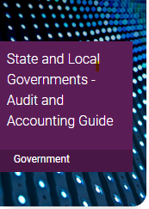
AICPA Audit and Accounting Guide, State and Local Governments
Key resource for auditors of SLGs; you should be using this Guide!
New edition expected in late Summer 2023
Key changes made:
Introduces SAS No. 143 - 145
Newly effective GASB standards
Order when published at: https://www.aicpa-cima.com/cpe-learning

Slide 37
Reminder: AICPA SLG Guide Chapter on Leases and SBITAs
Includes accounting guidance for both lessees and lessors
Includes audit guidance primarily focused on lessees
Audit guidance for lessees can be adapted as appropriate for lessors

Slide 38
Let’s talk about fraud risk management for a bit

Slide 39
The ACFE/COSO Fraud Risk Management Guide: 2022 Edition
A short history: COSO, internal control, enterprise risk management, and fraud risk management
The big picture: principles, standards, and leading practices
FRMG overview
The 2022 Update Task Force
What has not changed
Major changes
Fraud risk management tools
Be part of the antifraud effort

Slide 40
A short history: COSO, internal control, enterprise risk management, and fraud risk management
1985: Committee of Sponsoring Organizations of the Treadway Commission
1987: Treadway Commission Report
1992: Internal Control—Integrated Framework

Slide 41
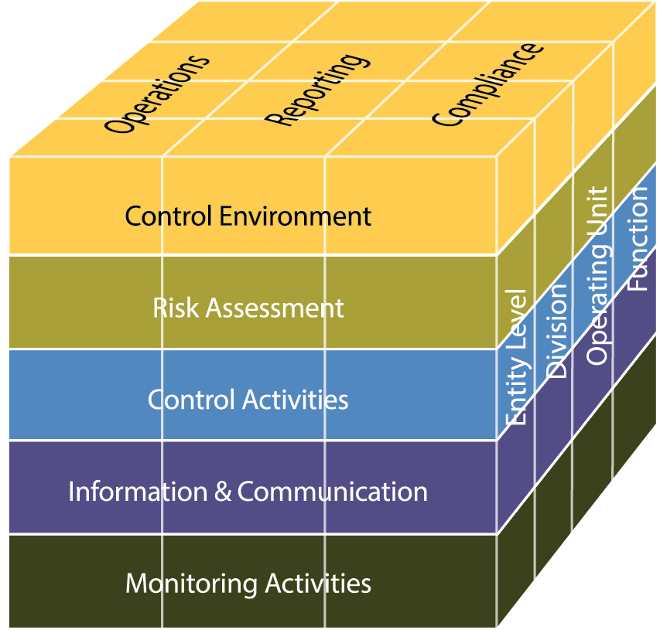
Focus on accuracy in accounting and financial reporting

Slide 42
Focus on accuracy in accounting and financial reporting

Slide 43
Very little emphasis on fraud
Focus was on:
Economy and efficiency of operations, including safeguarding of assets and achievement of desired outcomes;
Reliability of financial and management reports; and
Compliance with laws and regulations.

Slide 44
A short history: COSO, internal control, enterprise risk management, and fraud risk management
1985: Committee of Sponsoring Organizations of the Treadway Commission
1987: Treadway Commission Report
1992: Internal Control—Integrated Framework
1992-2001: COSO IC Framework gained broad recognition
2002: SOX section 404 mandated establishing/reporting on IC
2002-2012: COSO IC Framework gained global recognition

Slide 45
A short history: COSO, internal control, enterprise risk management, and fraud risk management
2004: COSO Enterprise Risk Management Framework
2013: COSO Internal Control—Integrated Framework
Principle 8: Consider fraud when assessing risks

Slide 46
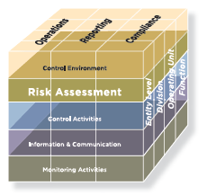
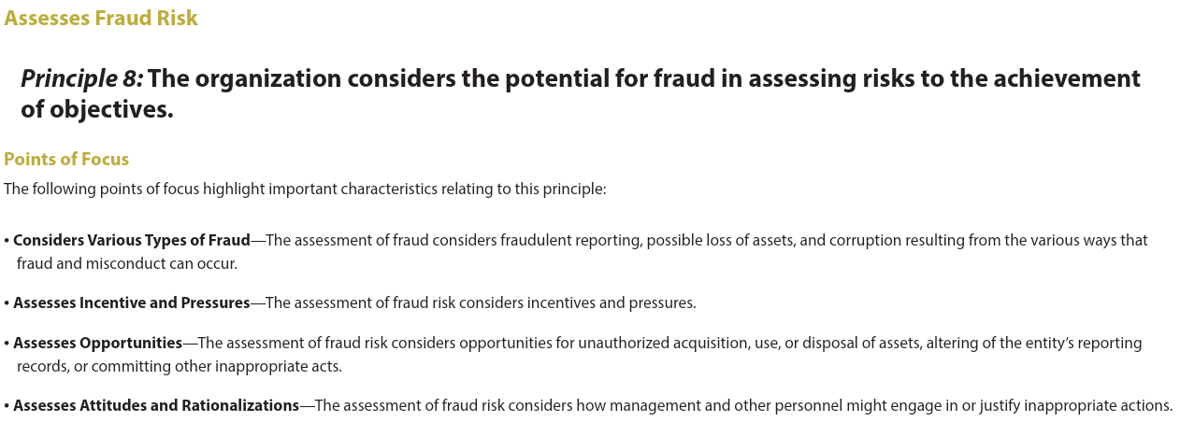

Slide 47
A short history: COSO, internal control, enterprise risk management, and fraud risk management
2004: COSO Enterprise Risk Management Framework
2013: COSO Internal Control—Integrated Framework
Principle 8: Consider fraud when assessing risks
2014: ACFE/COSO Fraud Risk Management task force
2015: GAO Fraud Risk Management Framework

Slide 48
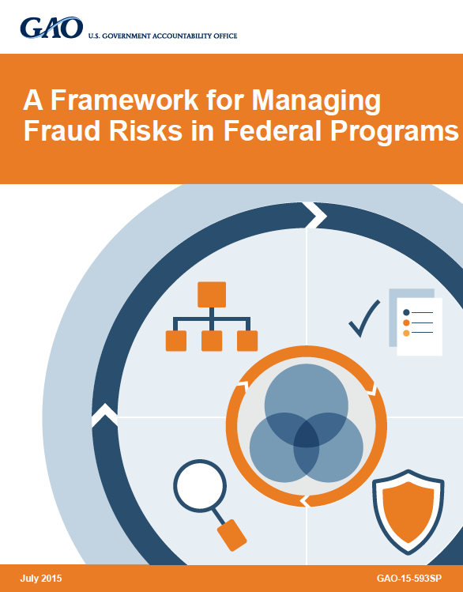

Slide 49
A short history: COSO, internal control, enterprise risk management, and fraud risk management
2004: COSO Enterprise Risk Management Framework
2013: COSO Internal Control—Integrated Framework
Principle 8: Consider fraud when assessing risks
2014: ACFE/COSO Fraud Risk Management task force
2015: GAO Fraud Risk Management Framework
2016: ACFE/COSO Fraud Risk Management Guide

Slide 50
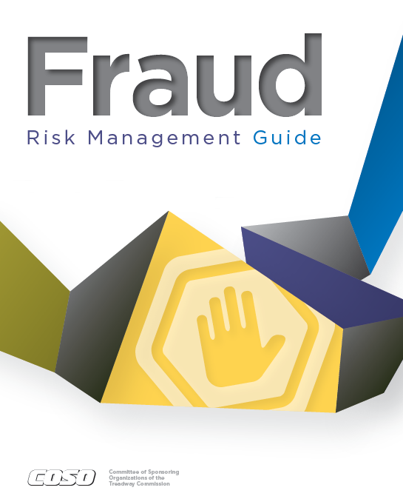

Slide 51
A short history: COSO, internal control, enterprise risk management, and fraud risk management
2004: COSO Enterprise Risk Management Framework
2013: COSO Internal Control—Integrated Framework
Principle 8: Consider fraud when assessing risks
2014: ACFE/COSO Fraud Risk Management task force
2015: GAO Fraud Risk Management Framework
2016: ACFE/COSO Fraud Risk Management Guide
2017: COSO Enterprise Risk Management Framework—Integrating with Strategy and Performance

Slide 52
The big picture: principles, standards, and leading practices

Slide 53
The big picture: principles, standards, and leading practices
Private Sector
Government
Accounting Principles

Slide 54
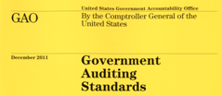
The big picture: principles, standards, and leading practices
Private Sector
Government
Accounting Principles
Auditing Standards

Slide 55
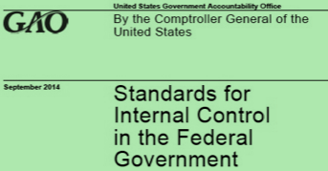
The big picture: principles, standards, and leading practices
Private Sector
Government
Accounting Principles
Auditing Standards
Internal Control

Slide 56
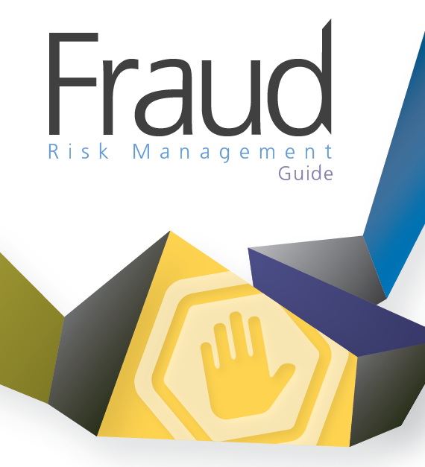
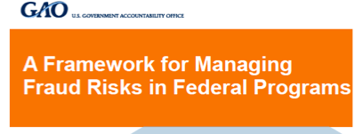
The big picture: principles, standards, and leading practices
Private Sector
Government
Accounting Principles
Auditing Standards
Internal Control
Fraud Risk Management

Slide 57
The big picture: principles, standards, and leading practices
Private Sector
Government
Accounting Principles
Auditing Standards
Internal Control
Fraud Risk Management
Enterprise Risk Management

Slide 58
The big picture: principles, standards, and leading practices
Private Sector
Government
Accounting Principles
Auditing Standards
Internal Control
Fraud Risk Management
Leading practices
Enterprise Risk Management

Slide 59
The big picture: principles, standards, and leading practices
Private Sector
Government
Accounting Principles
Auditing Standards
Internal Control
Fraud Risk Management
Required by law
Enterprise Risk Management

Slide 60
2016 FRMG overview
Five fraud risk management principles
Maps to COSO IC Framework
Detailed information on performing a fraud risk assessment
19 Appendices

Slide 61
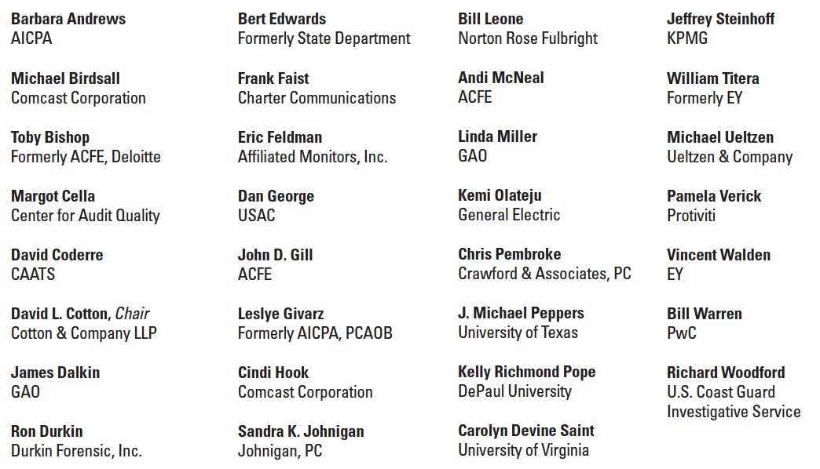
Joint ACFE-COSO Task Force

Slide 62
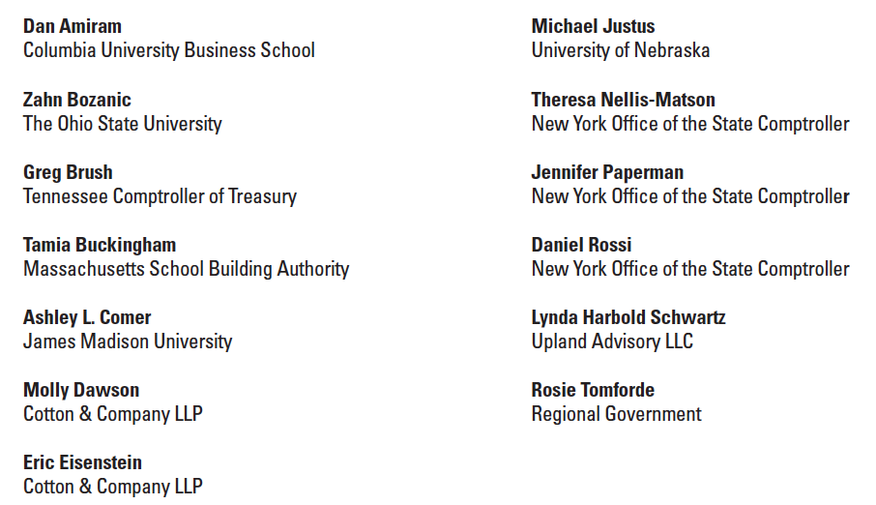
Joint ACFE-COSO Advisory Panel

Slide 63
The 2022 Update Task Force

Slide 64
What has not changed
Mapping to COSO IC Framework

Slide 65
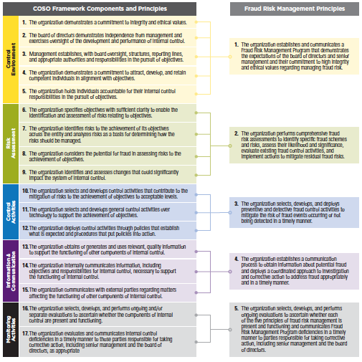
Mapping of COSO Components and Principles to the Fraud Risk Management Guide

Slide 66
What has not changed
Mapping to COSO IC Framework
Five fraud risk management principles and the basic process

Slide 67
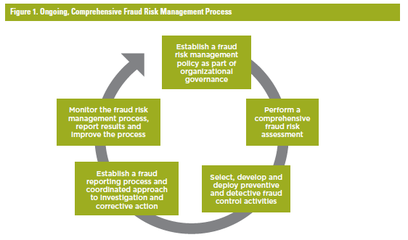
Basic fraud risk management process has not changed

Slide 68
What has not changed
Mapping to COSO IC Framework
Five fraud risk management principles and the basic process
The fraud risk assessment process

Slide 69
Risk assessment process has not changed
Establish the fraud risk assessment team, considering:
- Appropriate management levels
- All organizational components
Identify all fraud schemes and fraud risks, considering:
- Internal and external factors
- Various types of fraud
- Risk of management override
Estimate likelihood and significance of each fraud scheme and risk
Identify existing controls and assess their effectiveness
Reassess risk periodically, considering changes:
- External to the organization
- Operational
- Leadership
Determine all personnel and departments potentially involved considering the fraud triangle
Assess and respond to residual risks that need to be mitigated:
-Strengthen existing control activities
-Add control activities
-Consider data analytics
Document the risk assessment
Fraud Risk Assessment

Slide 70
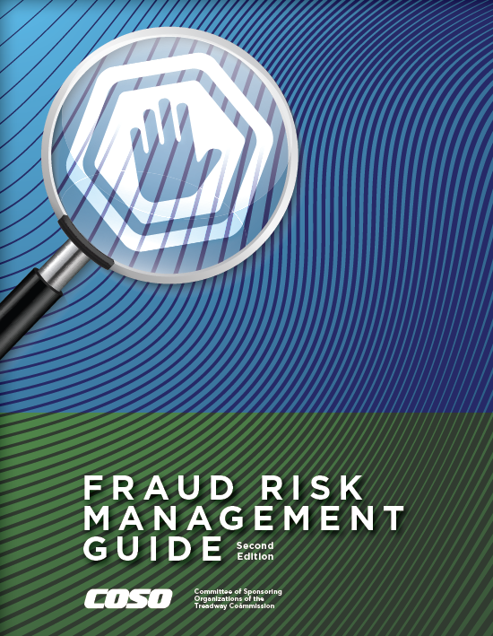
Let’s Look at the FRMG, 2nd Edition

Slide 71
Major changes
Fraud risk management and deterrence linkage
COSO’s two frameworks and fraud risk management linkage
Expanded information on data analytics
Internal control and fraud risk management: how they differ
Assessing the effectiveness of existing control procedures
Changes in the legal and regulatory environment
Fraud reporting systems (hotlines)
Changes in the external environment and fraud landscape
Appendices changes
Fraud risk management tools

Slide 72
Fraud risk management and deterrence
COSO’s mission is to help organizations improve performance by developing thought leadership that enhances internal control, risk management, governance and fraud deterrence.
According to the National Institute of Justice:
The certainty of being caught is a vastly more powerful deterrent than the punishment.
Police deter crime by increasing the perception that criminals will be caught and punished.

Slide 73
Fraud risk management and deterrence
Fraud deterrence is the combined result of prevention and detection:
Prevention
Detection
Deterrence
+
=

Slide 74
Fraud risk management and deterrence
Deterrence is also supported and enhanced by the knowledge throughout the organization that:
Those charged with governance have made a commitment to comprehensive fraud risk management.
Periodic fraud risk assessments are being conducted.
Overt and covert fraud control activities are in place.
Suspected frauds are investigated quickly.
Fraud reporting mechanisms are in place.
Discovered frauds are remediated thoroughly.
The entire Fraud Risk Management Program is being monitored on an ongoing basis.

Slide 75
COSO’s two frameworks and fraud risk management
COSO Internal Control—Integrated Framework: 1992, 2013
COSO Enterprise Risk Management Framework: 2004
Enterprise Risk Management — Integrating with Strategy and Performance: 2017
Fraud Risk management Guide: 2016, 2022

Slide 76
COSO’s two frameworks and fraud risk management

Slide 77
Expanded information on data analytics
Added a data analytics Point of Focus under each of the five fraud risk management Principles:
Uses Data Analytics to Support Fraud Risk Governance
Uses Data Analytics Techniques for Fraud Risk Assessment and Fraud Risk Responses
Uses Proactive Data Analytics Procedures
Performs Data Analytics
Uses Data Analytics to Continuously Monitor and Improve

Slide 78
Expanded information on data analytics
Expanded Data Analytics Appendices
Appendix D-1 explains how to build a sustainable data analytics capability, develop a data analytics plan, attract, and develop a team of skilled professionals, acquire the right technological solutions, and implement processes and procedures.
Appendix D-2 provides both guidance and practical examples of the application of data analytics techniques and approaches as part of a fraud risk assessment.
Appendix D-3 explains how data analytics techniques can enhance fraud control activities to mitigate residual risks that were identified during the fraud risk assessment.

Slide 79
Internal control and fraud risk management
Internal control and fraud risk management are related and support each other, but are different in some important respects.
Controls that may assure accuracy in accounting and financial reporting may not be sufficient to protect against fraud.

Slide 80
Establish the fraud risk assessment team, considering:
- Appropriate management levels
- All organizational components
Identify all fraud schemes and fraud risks, considering:
- Internal and external factors
- Various types of fraud
- Risk of management override
Estimate likelihood and significance of each fraud scheme and risk
Identify existing controls and assess their effectiveness
Reassess risk periodically, considering changes:
- External to the organization
- Operational
- Leadership
Determine all personnel and departments potentially involved considering the fraud triangle
Assess and respond to residual risks that need to be mitigated:
-Strengthen existing control activities
-Add control activities
-Consider data analytics
Document the risk assessment
Fraud Risk Assessment
VERY Important Step

Slide 81
Internal control and fraud risk management
Internal control and fraud risk management are related and support each other, but are different in some important respects.
Controls that may assure accuracy in accounting and financial reporting may not be sufficient to protect against fraud.
Let’s look at some examples …

Slide 82
Internal control and fraud risk management
Segregation of Duties.
Approved Vendor Lists.
Higher Transaction Approval Authorities.
Asset Verification Physical Counts.

Slide 83
Segregation of Duties
Do not let one person control all transaction phases
Good for accuracy in accounting and financial reporting
BUT, in assessing fraud risk, we need to consider how that control can be circumvented or rendered ineffective
Collusion among the people across whom duties are segregated
Password-sharing
I.e., residual fraud risk
Let’s apply additional controls to mitigate the residual risk
Frequently rotate the duties
Monitor password use and attendance

Slide 84
Segregation of Duties
Overt Control Activity
Do not let one person control all transaction phases
Good for accuracy in accounting and financial reporting
BUT, in assessing fraud risk, we need to consider how that control can be circumvented or rendered ineffective
Collusion among the people across whom duties are segregated
Password-sharing
I.e., residual fraud risk
Let’s apply additional controls to mitigate the residual risk
Frequently rotate the duties
Monitor password use and attendance

Slide 85
Segregation of Duties
Overt Control Activity
Do not let one person control all transaction phases
Good for accuracy in accounting and financial reporting
BUT, in assessing fraud risk, we need to consider how that control can be circumvented or rendered ineffective
Collusion among the people across whom duties are segregated
Password-sharing
I.e., residual fraud risk
Let’s apply additional controls to mitigate the residual risk
Frequently rotate the duties
Monitor password use and attendance
Covert Control Activity

Slide 86
Approved Vendor List
We only do business with reputable companies that have been thoroughly vetted
Good for accuracy in accounting and financial reporting
BUT, in assessing fraud risk, we need to consider how that control can be circumvented or rendered ineffective
Employee gains access to vendor database and adds bogus company
Corrupt vendor offers bribes or kickbacks
I.e., residual fraud risk
Let’s apply additional controls to mitigate the residual risk
Match fields in employee and vendor databases
Apply data analytics to track unusual buying and pricing patterns

Slide 87
Approved Vendor List
Overt Control Activity
We only do business with reputable companies that have been thoroughly vetted
Good for accuracy in accounting and financial reporting
BUT, in assessing fraud risk, we need to consider how that control can be circumvented or rendered ineffective
Employee gains access to vendor database and adds bogus company
Corrupt vendor offers bribes or kickbacks
I.e., residual fraud risk
Let’s apply additional controls to mitigate the residual risk
Match fields in employee and vendor databases
Apply data analytics to track unusual buying and pricing patterns

Slide 88
Approved Vendor List
Overt Control Activity
We only do business with reputable companies that have been thoroughly vetted
Good for accuracy in accounting and financial reporting
BUT, in assessing fraud risk, we need to consider how that control can be circumvented or rendered ineffective
Employee gains access to vendor database and adds bogus company
Corrupt vendor offers bribes or kickbacks
I.e., residual fraud risk
Let’s apply additional controls to mitigate the residual risk
Match fields in employee and vendor databases
Apply data analytics to track unusual buying and pricing patterns
Covert Control Activities

Slide 89
Approved Vendor List
Wait: what if your organization includes employees in the vendor database in order to process travel expense reimbursement transactions?

Slide 90
Higher Level Approvals Required for Large Transactions
Any purchase of more than $50,000 requires regional manager approval
Good for accuracy in accounting and financial reporting
BUT, in assessing fraud risk, we need to consider how that control can be circumvented or rendered ineffective
Purchase-splitting
Regional manager becomes corrupt
I.e., residual fraud risk
Let’s apply additional controls to mitigate the residual risk
Apply Benford’s Law to the purchasing database
Apply data analytics to track unusual buying and pricing patterns

Slide 91
Higher Level Approvals Required for Large Transactions
Overt Control Activity
Any purchase of more than $50,000 requires regional manager approval
Good for accuracy in accounting and financial reporting
BUT, in assessing fraud risk, we need to consider how that control can be circumvented or rendered ineffective
Purchase-splitting
Regional manager becomes corrupt
I.e., residual fraud risk
Let’s apply additional controls to mitigate the residual risk
Apply Benford’s Law to the purchasing database
Apply data analytics to track unusual buying and pricing patterns

Slide 92
Higher Level Approvals Required for Large Transactions
Any purchase of more than $50,000 requires regional manager approval
Good for accuracy in accounting and financial reporting
BUT, in assessing fraud risk, we need to consider how that control can be circumvented or rendered ineffective
Purchase-splitting
Regional manager becomes corrupt
I.e., residual fraud risk
Let’s apply additional controls to mitigate the residual risk
Apply Benford’s Law to the purchasing database
Apply data analytics to track unusual buying and pricing patterns
Overt Control Activity
Covert Control Activities

Slide 93
Physical Counts of Assets/Inventory
We periodically take physical counts of assets and inventory
Good for accuracy in accounting and financial reporting
BUT, in assessing fraud risk, we need to consider how that control can be circumvented or rendered ineffective
Actual inventory is moved from location to location
Empty boxes are disguised to appear to have contents
I.e., residual fraud risk
Let’s apply additional controls to mitigate the residual risk
Vary the inventory counting process to conduct surprise counts or simultaneous location counts
Vary the counting process (weigh boxes; open boxes; etc.)

Slide 94
Physical Counts of Assets/Inventory
Overt Control Activity
We periodically take physical counts of assets and inventory
Good for accuracy in accounting and financial reporting
BUT, in assessing fraud risk, we need to consider how that control can be circumvented or rendered ineffective
Actual inventory is moved from location to location
Empty boxes are disguised to appear to have contents
I.e., residual fraud risk
Let’s apply additional controls to mitigate the residual risk
Vary the inventory counting process to conduct surprise counts or simultaneous location counts
Vary the counting process (weigh boxes; open boxes; etc.)

Slide 95
Physical Counts of Assets/Inventory
Overt Control Activity
We periodically take physical counts of assets and inventory
Good for accuracy in accounting and financial reporting
BUT, in assessing fraud risk, we need to consider how that control can be circumvented or rendered ineffective
Actual inventory is moved from location to location
Empty boxes are disguised to appear to have contents
I.e., residual fraud risk
Let’s apply additional controls to mitigate the residual risk
Vary the inventory counting process to conduct surprise counts or simultaneous location counts
Vary the counting process (weigh boxes; open boxes; etc.)
Covert Control Activities

Slide 96
More examples …
Two signatures required for checks above a certain amount.
Thresholds for procurements:
Up to $50,000 requires 3 or more quotes/bids
Above $50,000 requires full/open competition
CFO approval of all journal entries above $100,000
?
?
?

Slide 97
Library of Internal Controls
If your organization is following the COSO framework, you probably have a list (“library”) of all controls
Apply this “how could fraud happen despite this control” analysis to every control

Slide 98
Assessing the effectiveness of existing control procedures
Clarification that assessing the effectiveness of existing controls is a two step process.
First, a determination will be made as to whether the control is in place and functioning as designed.
Once that determination is made, the control will be re-assessed in terms of its effectiveness for preventing and detecting fraud.

Slide 99
Changes in the legal and regulatory environment
Includes updated information with respect to recent legal and regulatory developments pertaining to fraud and fraud risk management, including:
The Department of Justice’s Evaluation of Corporate Compliance Programs.
The Government Accountability Office’s A Framework for Managing Fraud Risks in Federal Programs.
U.S. Securities and Exchange Commission Climate and ESG Task Force

Slide 101
Fraud reporting systems (hotlines)
ACFE research consistently reveals the importance of having fraud hotlines or whistleblower reporting systems in place.

Slide 102
2022 Report to the Nations

Slide 103
2022 Report to the Nations

Slide 104
2022 Report to the Nations

Slide 105
2022 Report to the Nations

Slide 106
Fraud reporting systems (hotlines)
ACFE research consistently reveals the importance of having fraud hotlines or whistleblower reporting systems in place.
Expanded information on the importance of hotlines as part of Principle 1 (Control Environment) and Principle 4 (Information and Communication)

Slide 107
Changes in the external environment and fraud landscape
The fraud landscape is changing rapidly. The 2022 FRMG edition includes information on this changing environment, including:
Environmental, social and governance (ESG) initiatives and reporting
Cyberfraud
Blockchain, cryptocurrency, and digital assets
Ransomware
COVID-19 response efforts, the CARES Act, and related programs
Remote working and hybrid working environments
Innovative and virtual management tools and accounting procedures

Slide 108
Appendices changes
2016 edition had 19 appendices
2022 edition has 7 appendices

Slide 109
Appendices changes

Slide 110
Fraud risk management tools at ACFE
https://www.acfe.com/fraud-resources/fraud-risk-tools---coso/tools
Antifraud Playbook
Library of Antifraud Data Analytic Tests
Fraud Risk Management Interactive Scorecards
Risk Assessment and Follow-Up Action Templates
Points of Focus Documentation Templates

Slide 111
Fraud risk management tools at ACFE
Sample Fraud Control Policy
Fraud Risk Management High-Level Assessment
Sample Fraud Policy Responsibility Matrix
Sample Fraud Risk Management Policy
Sample Fraud Risk Management Survey
Expanded list of fraud exposures, hyperlinked to underlying descriptions
Generic schemes
Industry-specific schemes

Slide 112
Fraud risk management tools at ACFE
Coming soon:
PowerPoint Deck to use to explain Fraud Risk Management and its importance to senior management and those charged with governance.
Fraud Risk Management Implementation Program: an audit-program-like set of step-by-step procedures for implementing a robust FRM program.

Slide 114
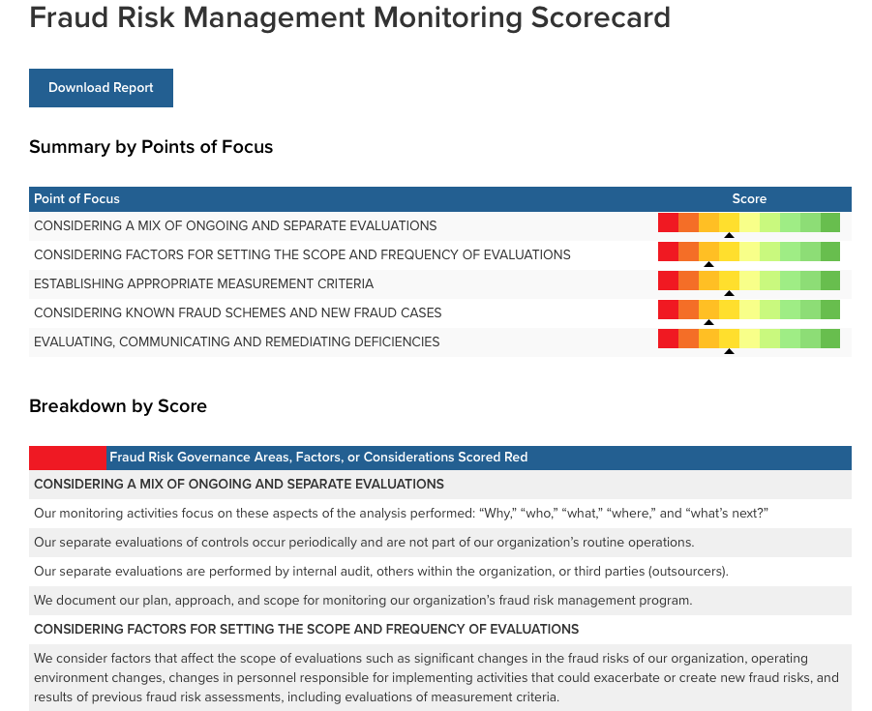

Slide 115
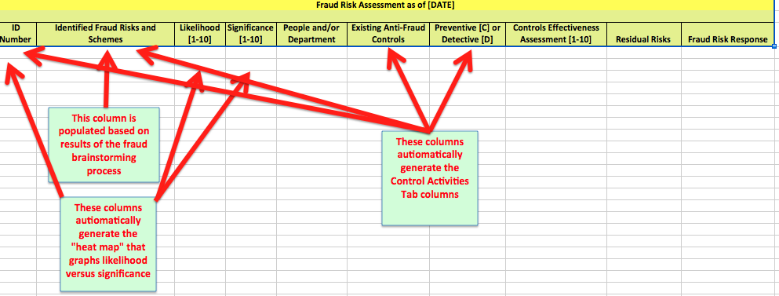
Risk Assessment and Follow-up Actions Template

Slide 116
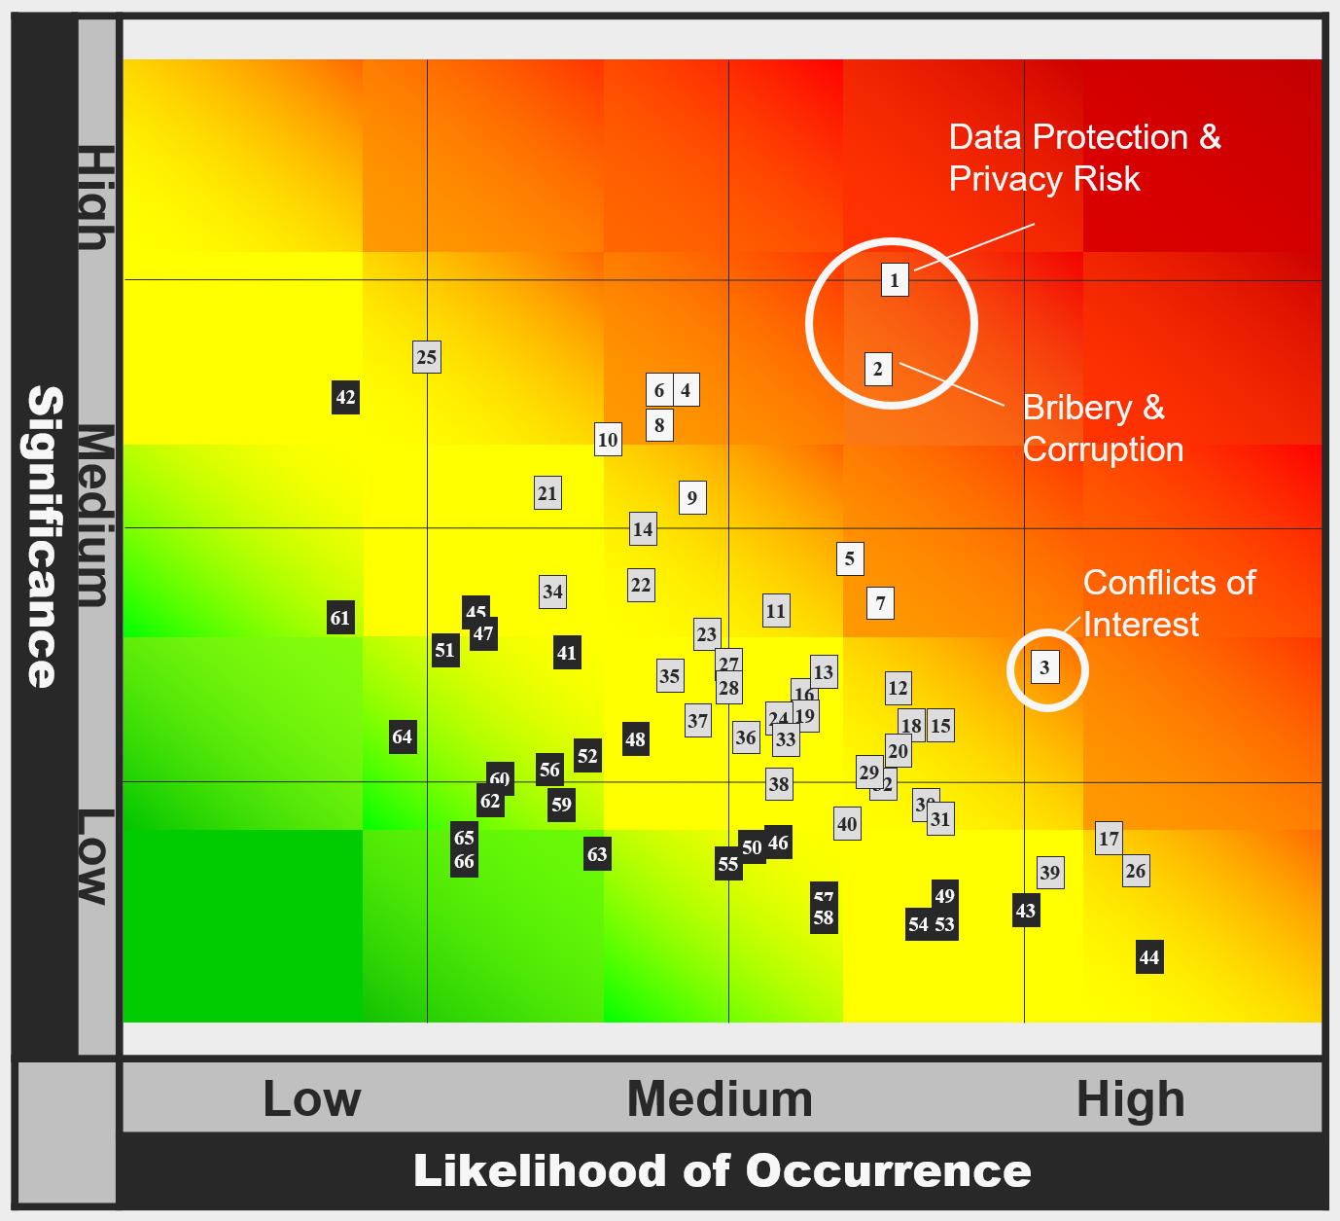
Fraud Risk Heat Map

Slide 117
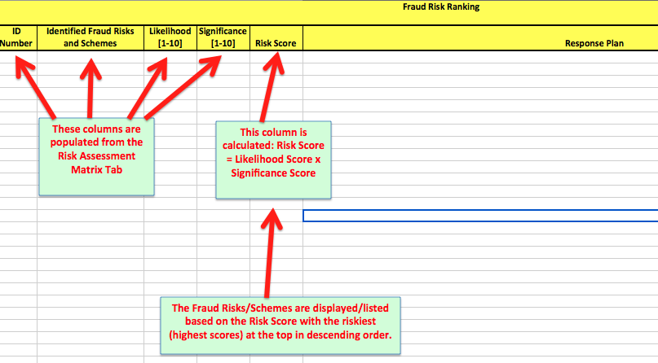
Fraud Risk Ranking Matrix

Slide 118
Points of Focus Documentation

Slide 119
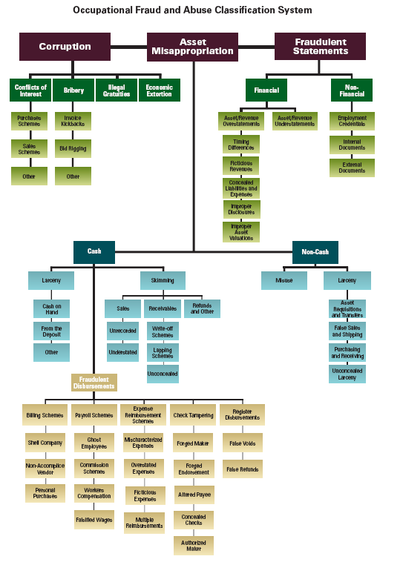
Data Analytics Library

Slide 120
Skimming
Data Analytics Library

Slide 121
Library of Data Analytics Tests
CASH - SKIMMING
 | Cash Receipts Analysis | Review sequential numbering of cash receipts journal to ensure no out-of-sequence numbers
 | Vertical Analysis | Vertical analysis of sales accounts, (i.e., cash as a percentage of total assets over time, etc. can be used to detect skimming at a high level)
 | Horizontal Analysis | Horizontal analysis of sales accounts, (i.e., cash percent change over time, can be used to detect skimming at a high level)
 | Current Ratio Analysis | Track current assets to current liabilities over time
 | Quick Ratio Analysis | (Cash+Securities+Receivables) over Current Liabilities percent change over time
 | Inventory Analysis | Track inventory shrinkage due to unrecorded sales. Inventory detection may include statistical sampling, trend analysis, reviews of receiving reports and inventory records and verification for material requisition and shipping documentation as well as actual physical inventory counts
 | Red Flags | Bank employee questions the validity of a check
 | Red Flags | Inspect for a forged endorsement on a check
 | Red Flags | Inspect for an employee bank account with a name similar to the company name
 | Red Flags | Inspect for alteration of the check payee or endorsement
 | Journal Entry Review | Analysis of journal entries made to the cash and inventory accounts to identify: (1) False credits to inventory to conceal unrecorded or understated sales, (2) Write-offs related to lost, stolen or obsolete product, (3) Write-offs to accounts receivable, (4) Irregular entries to cash accounts
 | Journal Entry Review | Analysis of journal entries to review suspicous or inaccurate journal entries.
 | Journal Entry Review | Identify larger entries split into smaller entries to avoid exceeding their approval limit. To ensure authorization and validity of the Journal Entry based on the approval limits

Slide 122
Bid Rigging
Data Analytics Library

Slide 123
Library of Data Analytics Tests
BID RIGGING
 | Corruption: Bid Rigging | Compare inventory levels and turnover rates on a by project or by product basis, by region
 | Corruption: Bid Rigging | Inventory written-off and then new purchase made (total write-offs and quantities purchased by product)
 | Corruption: Bid Rigging | Compare contract awards by vendor (number of contracts won compared to bids submitted)
 | Corruption: Bid Rigging | Sole sourced contracts - number of bids per contract
 | Corruption: Bid Rigging | Check for vague contract specifications: (i) amendments, extension, increases in contract values, (ii) total number of amendments, (iii) original delivery date and final delivery date, (iv) original contract value and final contract value
 | Corruption: Bid Rigging | Check for split contract (same vendor, same day)
 | Corruption: Bid Rigging | Bids submitted after bid closing date
 | Corruption: Bid Rigging | Last bid wins
 | Corruption: Bid Rigging | Low bidder drops out, and subcontracts to higher bidder (compare contractor with invoice payee)
 | Corruption: Bid Rigging | Fictitious bids - verify bidders and prices

Slide 124
Data Analytics Library
Fictitious Revenue

Slide 125
Library of Data Analytics Tests
REVENUE RECOGNITION
 | Bill & Hold | Analysis of inventory that has been "segregated" or shipped to a third party intermediary where the customer has not taken title and assumed the risks, yet the company has booked this isolated inventory as revenue
 | Bill & Hold | Identify revenue and receivables recorded prior to shipment
 | Channel Stuffing | Compare discounts or incentives on a monthly basis to identify unusual spikes at the end of the quarter or year.
 | Channel Stuffing | Compare sales and corresponding returns on a per customer basis
 | Debt Swap | Identification of Journal Entries with Net Debit to Liability and Credit to Revenue
 | Debt Swap | Identification of Journal Entries with Net Debit to Liability and Credit to Expenses
 | Fake Invoices | Analysis of sequentially numbered invoices
 | Fake Invoices | Benford's analysis of the first two digits to identify anomalies such as a disproportionate number of invoices starting with 7, 8 or 9
 | Fake Invoices | Analysis of company names that "sound like" known vendors
 | Fake Invoices | Examine inventory records to identify locations or items that require specific attention during or after the physical inventory count
 | Revenue Recognition | Analysis and anomaly detection of the sequence of transactions to identify missing checks, invoices
 | Revenue Recognition | Compare A/R credit memos to A/P invoices
 | Revenue Recognition | Compare revenue reported by month and by product line during the current period with comparable prior periods
 | Revenue Recognition | Confirm with selected, high risk customers relevant contract terms or question company staff regarding shipments near the end of the period
 | Revenue Recognition | Identification of revenue recognized at period end and subsequently reversed or partially reversed
 | Fraud Triangle Analytics | E-mail analysis of selected employees (accounting or sales) for "Rev Rec" related key words around incentive/pressure, opportunity and rationalization

Slide 126
Be part of the antifraud effort
The tools at ACFE are intended to be crowd-sourced.
If you have:
Suggestions for modifications to existing tools
Ideas for additional tools
Additional fraud exposures to add to the list
Other comments or recommendations….
Contact us.

Slide 127
Yes, Yes, Yes…It’s Hard Work
Just remember
The perps hope you are lazy
If the perps discover that you are not lazy and have thoroughly implemented fraud risk management processes, they will move on to find easier targets

Slide 128
Questions?

