Slide 1
All About the DOAA checklist
For local Government Reviews
Presentation by DOAA: Local Government Desk Review Team Members

Slide 2
Topics for this Session
What is the checklist and how do WE use it?
Where can it be found?
How can YOU use it?
New items to look for.

Slide 3
What is the checklist and how do WE use it?
Excel file that includes a listing of financial statement requirements as determined by GASB, AICPA, GAS, State Law and other sources.
Citations relate to both the presentation of the financial statements and the auditor’s reports included within.
Citations have significance levels based on the source (authoritative, non-authoritative, state law).
A new checklist is completed for every local government report we receive.

Slide 4
What is the checklist and how do WE use it?
The checklist had an extensive update in
January of this year and all resource references
are now up to date.

Slide 5
Where to find the Checklist tool.
Available for download at our Local Government Technical Assistance page:
Technical assistance page:
https://www.audits2.ga.gov/resources/orgs/local-government/?rcat=technical-assistance
Direct link to checklist:
https://www.audits2.ga.gov/wp-content/uploads/2023/09/Local-Government-Checklist.xlsx

Slide 6
How can the checklist be used?
To Review the Audit
Report Before Submission
Can review as a whole, or sort
By section or topic
To Review Major
Fund Criteria
Contains a tab with a major
fund calculator

Slide 7
How can the checklist be used?
Auditor’s Report
MD&A
Government-Wide Statements
Fund Statements
Notes to the Financial Statements
RSI
Supplementary Information
Internal Control Report
Single Audit
Sort by section:
Sort by section

Slide 8
How can the checklist be used?
Budgets
Capital Assets
Long-term Debt
Leases
Net Position
Pensions
SPLOST
Reconciliations
State Law Compliance
Sort by topic:

Slide 9
Significance Levels
How can the checklist be used?
Level 1 – Material item and the audit can not be accepted until this item is corrected.
Level 2 – Item requiring correction on future reports.
Level 3 – Suggested item from nonauthoritative guidance.
Level X – State Law compliance item.

Slide 10
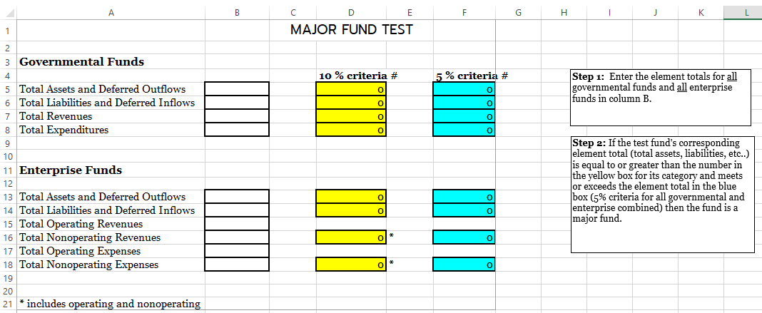
Major Fund Test Calculator
This is the most common level 1 item we cite.
It only takes a couple of minutes to perform this test!

Slide 11
Major Fund Test Calculator
A couple of notes about what should and should not be included in the calculations:
Per the GASB implementation guide (question 7.56.5), other financing sources should NOT be used in the calculations for governmental funds.
Per the GASB implementation guide (question 7.56.10), revenues and expenses of enterprise funds WOULD include gains, losses, capital contributions, additions to permanent endowments and special items, however it WOULD NOT include extraordinary items.

Slide 12
What’s new you should know about?
Leases
Transportation expenditures note requirement
CSLFRF Alternative Engagement
SPLOST – Allocation of expenditures from other funding sources

Slide 13
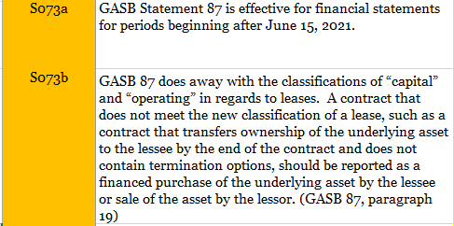
Leases
New lease citations for the notes to the financial statements start at S073a in the checklist.

Slide 14
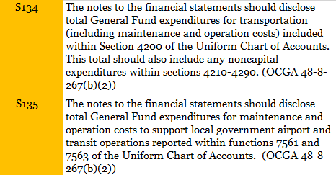
Transportation Expenditures
Required by OCGA 48-8-267(b)(2) for TSPLOST certifications

Slide 15
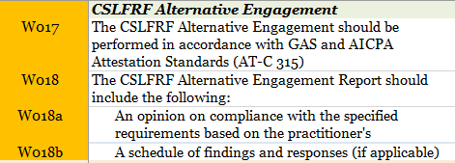
CSLFRF Alternative Engagement
Total CSLFRF awards at or below $10,000,000
Other federal awards are less than $750,000

Slide 16
SPLOST – Allocation of expenditures from other sources

Slide 17
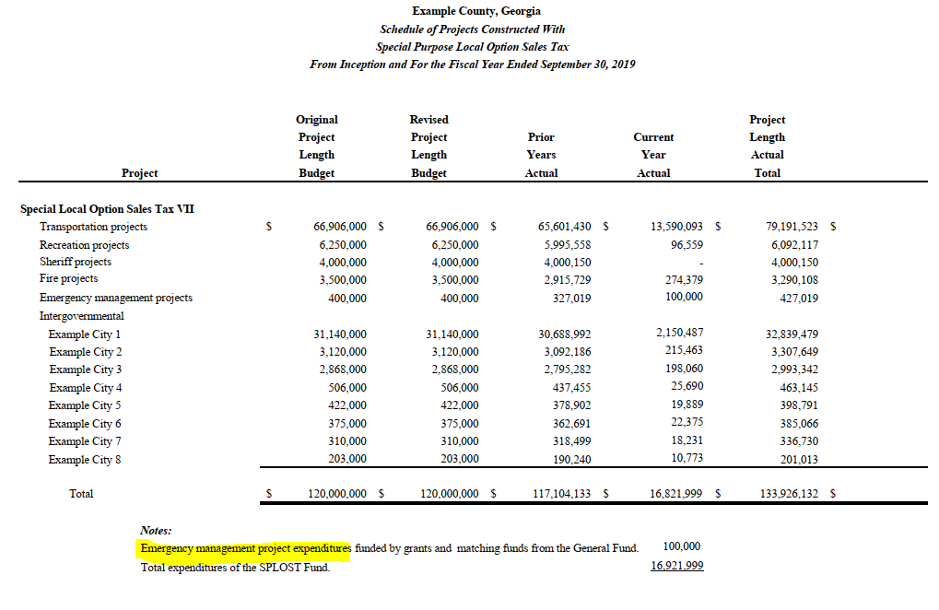

Slide 18
Review Checklist Items for Leases & SBITAs
Leases
GASB 87 – effective for fiscal periods beginning after June 15, 2021
SBITAs
GASB 96 – effective for fiscal periods beginning after June 15, 2022
Review checklist items – S073a and S073b
Review checklist will be updated soon and posted to local government resource page on website

Slide 19
Disclosure of Transportation Expenditures
Required by OCGA 48-8-267(b)(2)
Disclosure of total General Fund expenditures for transportation reported in Section 4200 of the Uniform Chart of Accounts (Sections 4210-4290)
Disclosure of total General Fund expenditures for maintenance and operation costs to support local government airport reported within functions 7561 and 7563 of the Uniform Chart of Accounts

Slide 20
Disclosure of Transportation Expenditures (continued)
Required as part of the determination of disbursement of proceeds
Desk reviewers will be noting if disclosures are omitted
Significance level – state law compliance

Slide 21
Opinions & Compliance With OCGA 36-81-7
Annual financial statements prepared in conformity with generally accepted governmental accounting principles (GAAP)
Audit opinion modified to contain qualifications – auditor is opining that the overall financial statements are materially in compliance with GAAP (requirement is met)
Audit opinion contains disclaimers of opinion – conformity with GAAP cannot be verified (considered out of compliance)
Audit opinion is adverse – auditor is opining that the financial statements are not in compliance with GAAP (considered out of compliance)

Slide 22
Local Government Eligibility for State Grants
No state agency shall make or transmit any state grant funds to any local government which has failed to provide all the audits required by law within the preceding five years
Listing of Noncompliant Local Governments used by all state agencies
Compliance status may be confirmed at any time

Slide 23
Questions?
Contact Info:
locgov@audits.ga.gov
Jackie Neubert neubertj@audits.ga.gov
Eric Moody moodyen@audits.ga.gov

