Slide 2
Reporting Requirements and Program Updates
John Brock
Research and Data Analyst, Office of Research and Geoanalytics

Slide 3
Agenda:
DCA Office of Research and Geoanalytics
Hotel-Motel Tax Review; emphasis on auditing and reporting requirements
Required Reports and Compliance
UCOA Process and Procedures
Objectives:
Understand which of DCA’s survey programs affect certain funding opportunities.
Learn how hotel-motel tax spending and reporting requirements relate to a local government’s audit.
Learn about DCA’s process for making updates to the Uniform Chart of Accounts.

Slide 4
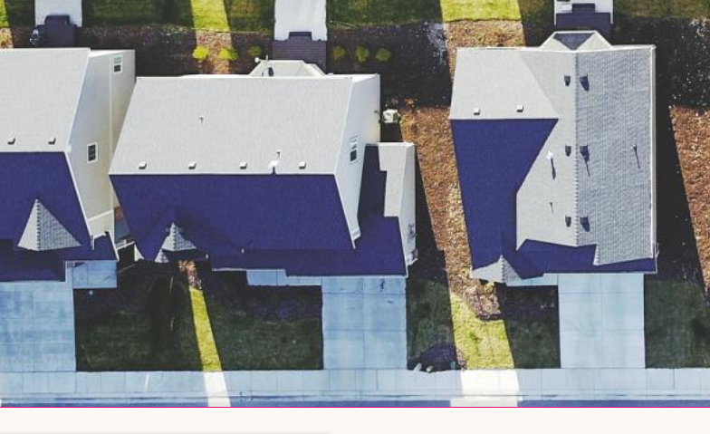
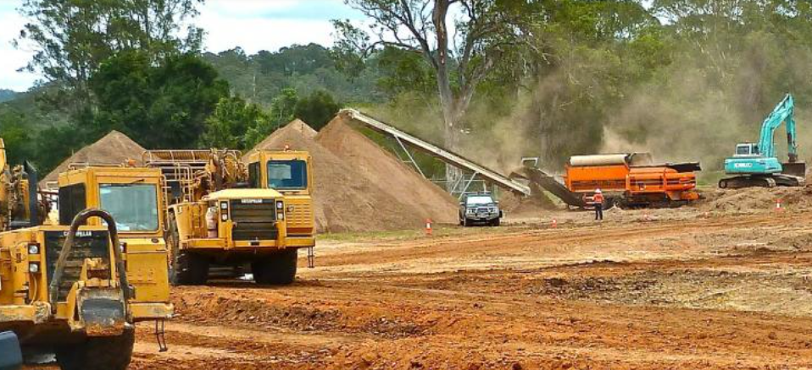
Office of Research and Geoanalytics
Office of Research and Geoanalytics
DCA has 70+ programs primarily involving funding related to housing economic development.
Research is part of the Office of Planning, Mapping and Research in the Community Development Division.
The Research office collects information on government and authority operations and finances, makes that information available to stakeholders, and monitors compliance.
O.C.G.A. 36-81-8 requires local governments and authorities to submit various reports to DCA as a condition of receiving state appropriated funds from the Department.
These surveys create datasets to allow stakeholders and policy makers to understand and research how local governments in Georgia fund and provide services.

Slide 5
Reporting to the Office of Research
Survey | Description | Users
Report of Local Government Finance | Standardized report on all funds, assets, revenues, expenditures and debts of the Local Government. | All Local Govs
Government Management Indicators | Covers all facets of local governments describing the scope and methods for service provision. | All Local Govs
Hotel-Motel Tax Report | Report on the amount of Hotel-Motel Tax received, and how restricted funds were spent. | All Local Govs Collecting the HMT
Authority Registration and Financial Reporting | Local authorities must annually register and report their finances to DCA. | All Local Authorities
Debt Issuance Report | Filed for all GO, Revenue, or other obligations of at least 1 million | All Local Govs and Authorities
Annexation Filings | Report filed ad hoc for annexed territory | All Local Govs
Wage and Salary Report | Optional report on the staffing and salaries for a local government | All Local Govs
Local Government Contacts | Optional report with a local governments contact information for 20 positions | All Local Govs

Slide 6

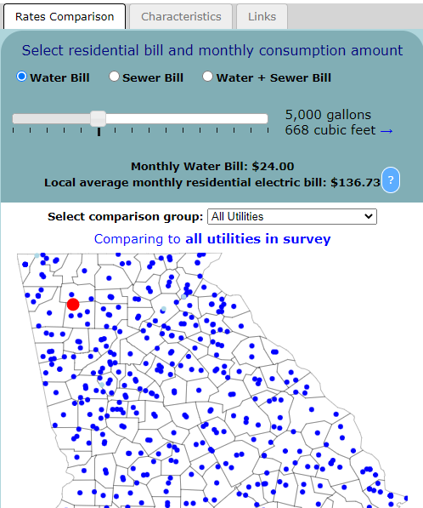
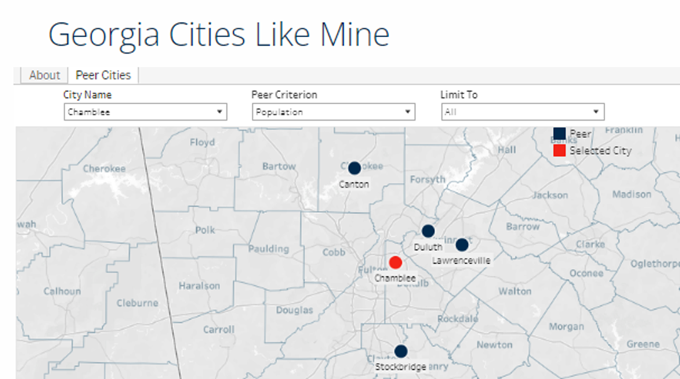
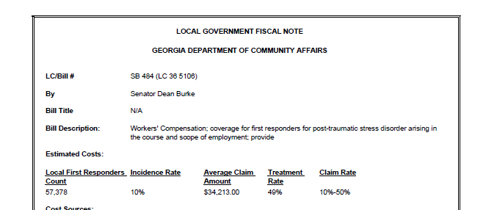
Allows for comparative analysis of local government finances, indebtedness, and service delivery
Used by state and local policy makers to better understand and evaluate operations and financial impacts
Why we collect it

Slide 7
Compliance
***Ultimately the inclusion of RLGF/GOMI or AARF compliance requirements depends on program manager/rules, below is not an exhaustive list.
RLGF/GOMI compliance does not affect funding programs from other state agencies like QLG/SDS requirements
RLGF/GOMI***
CDBG
DDRLF
OneGeorgia
Rural Zones
Plan First
HMT Report
As a condition of continuing to collect the tax
AARF***
To issue debt
DDRLF
OneGeorgia
REBA

Slide 8
Poll: SESSION B - POLL QUESTION #1
True or False? Submitting various reports to the DCA is not a requirement for local governments and authorities to receive state appropriated funds from the Department.
_____TRUE
_____FALSE

Slide 9
Poll: SESSION B - POLL QUESTION #1
True or False? Submitting various reports to the DCA is not a requirement for local governments and authorities to receive state appropriated funds from the Department.
_____TRUE
_XXX_FALSE

Slide 10
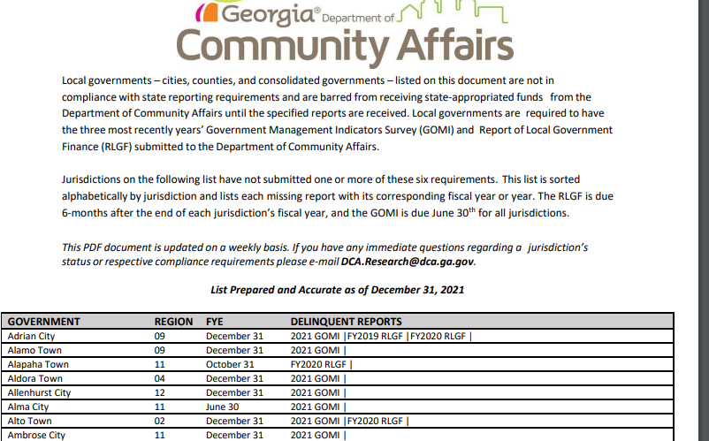
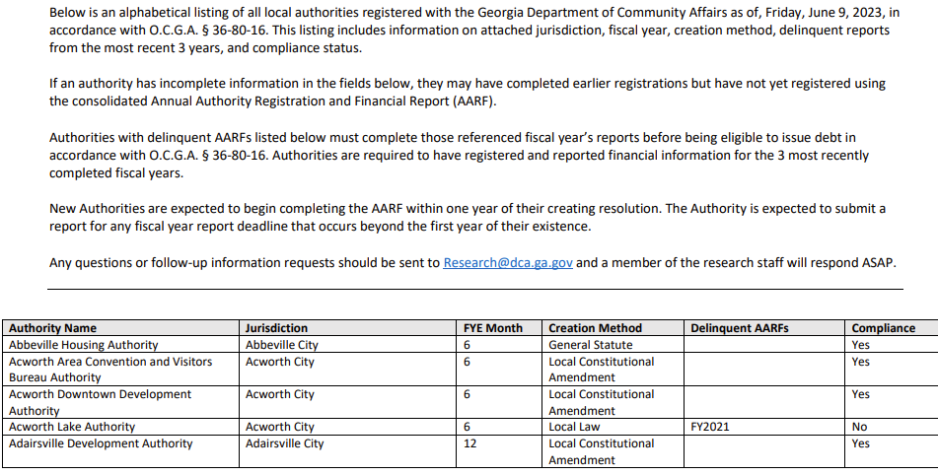
Compliance
Weekly updated compliance list for local authorities:
https://www.dca.ga.gov/local-government-assistance/research-surveys/local-government-authorities
Weekly updated compliance list for local governments:
https://www.dca.ga.gov/local-government-assistance/research-surveys/compliance
The 3 most recently completed fiscal years are required, and compliance is immediately restored upon receipt.

Slide 11

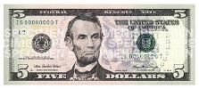

Hotel-Motel Tax Overview
MOST
MARTA
TSPLOST
Base Hotel/Motel Rate
Sales-Use Tax
6.0%-8.9%
State Hotel-Motel Fee
$5 Per Room/Per Night
Local Hotel-Motel Excise Tax
2.0%-8.0%
LOST
E-LOST
SPLOST
HOST
4% State

Slide 12
Hotel-Motel Tax Overview
298
Local Governments with a Hotel Motel Tax
13
Governments change or adopt a new tax a year on average
FY22 Forecasted (60% reported)
$305m
FY2019 Total Revenues
$131m
FY2019 Restricted for Tourism Promotion
$47m
FY2019 Restricted for Tourism Product Development

Slide 13
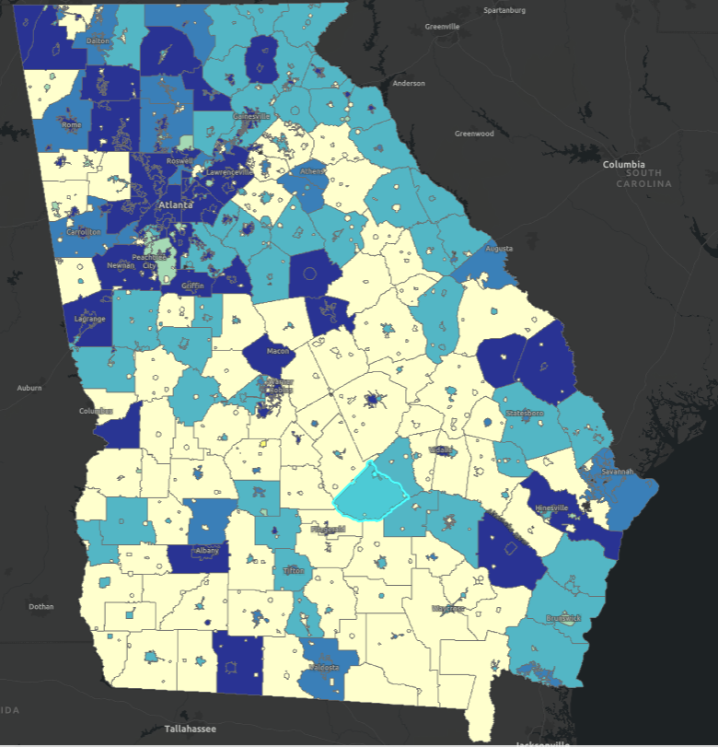
Hotel-Motel Tax Overview
Most governments collect under 1 of 3 current authorization paragraphs.
  O.C.G.A. § 48-13-51(a)1 (1-3%)
  O.C.G.A. § 48-13-51(a)3 (5%)
  O.C.G.A. § 48-13-51(b) (6-8%)
About 40 still collect under grandfathered authorization paragraphs.
  These have varying unique restrictions and can no longer be adopted.
Tax Rates | Governments
2% | 1
3% | 23
5% | 114
6% | 26
7% | 23
8% | 111
Grand Total | 298

Slide 14
Generally, includes things like:
  Brochures, billboards, magazines
  Social media and internet marketing campaigns
  Radio and television commercials
  Attracting convention or trade shows
Avoid paying directly for events
Expended through contracts with DMO
*Always ask the City or County Attorney*
Tourism, Convention and Trade Shows (TCT)
Means “Planning, conducting, or participating in programs of information and publicity designed to attract or advertise tourism, conventions, or trade shows.” O.C.G.A. § 48-13-50.2(4)

Slide 15
Destination Marketing Organization (DMO)
Private Sector Non-Profit Organization
“A private sector non-profit organization or other private entity which is exempt…under Section 501(c)(6) of the IRS Code of 1986…”
“Supported by the tax under this article, government budget allocations, private membership, or any combination thereof…”
“Primary responsibilities of which are to “encourage travelers to visit their destinations, encourage meetings and expositions in the area, and provide visitor assistance and support as needed” OCGA 48-13-50.2(1)
“…a chamber of commerce, a convention and visitors bureau, a regional travel association, or any other private group organized for similar purposes which is exempt from federal income tax under Section 501(c)(6) of the Internal Revenue Code of 1986; O.C.G.A. § 48-13-50.2(3)

Slide 16
Tourism Product Development (TPD)
(A) Lodging for the public for no longer than 30 consecutive days to the same customer;
(B) Overnight or short-term sites for recreational vehicles, trailers, campers, or tents;
(C) Meeting, convention, exhibit, and public assembly facilities;
(D) Sports stadiums, arenas, and complexes;
(E) Golf courses associated with a resort development that are open to the general public on a contract or fee basis;
(F) Racing facilities, including dragstrips, motorcycle racetracks, and auto or stock car racetracks or speedways;
(G) Amusement centers, amusement parks, theme parks, or amusement piers;
(H) Hunting preserves, trapping preserves, or fishing preserves or lakes;
(I) Visitor information and welcome centers;
(J) Wayfinding signage;
(K) Permanent, nonmigrating carnivals or fairs;
(L) Airplanes, helicopters, buses, vans, or boats for excursions or sightseeing;
(M) Boat rentals, boat party fishing services, rowboat or canoe rentals, horse shows, natural wonder attractions, picnic grounds, river-rafting services, scenic railroads for amusement, aerial tramways, rodeos, water slides, or wave pools;
(N) Museums, planetariums, art galleries, botanical gardens, aquariums, or zoological gardens;
(O) Parks, trails, and other recreational facilities; or
(P) Performing arts facilities.
“Creation or expansion of physical attractions which are available and open to the public and which improve destination appeal to visitors, support visitors' experience, and are used by visitors. Such expenditures may include capital costs and operating expenses.” O.C.G.A. § 48-13-50.2(6)

Slide 17
O.C.G.A. § 48-13-51(a)(1) – 1-3%
100% of HMT Revenue
Non-Restricted
Proceeds can be used for any legal general fund purpose in the city, county, or consolidated government
Restricted
None, or not less than the percentage of such tax collections expended for TCT during the immediately preceding fiscal year

Slide 18
O.C.G.A. § 48-13-51(a)(3) – 5%
60% of HMT Revenue
Non-Restricted
Proceeds can be used for any legal general fund purpose in the city, county, or consolidated government
Restricted
In each fiscal year, at least 40% of the HMT revenue must be used for TCT
40% of HMT Revenue TCT

Slide 19

O.C.G.A. § 48-13-51(b) – 8%
37.5% of HMT Revenue
Non-Restricted
Proceeds can be used for any legal general fund purpose in the city, county, or consolidated government
Restricted
In each fiscal year, at least 18.75% of the HMT revenue must be used for TPD, Otherwise to be used for TCT
Restricted
In each fiscal year, at least 43.75% of the HMT revenue must be used for TCT
18.75% of HMT Revenue TPD
43.75% of HMT Revenue TCT

Slide 20
Poll: SESSION B - POLL QUESTION #2
HB317 changed the definition of "innkeeper" and became effective July 1, 2021.
___TRUE
___FALSE

Slide 21
Poll: SESSION B - POLL QUESTION #2
HB317 changed the definition of "innkeeper" and became effective July 1, 2021.
_XXX_TRUE
_____FALSE

Slide 22



Tax Changes on STVR- HB317
HB317 changed the definition of “innkeeper” to include marketplace facilitators in O.C.G.A. § 48-13-50.2.
That means, beginning on July 1, 2021, they became responsible for the collection and remission of the $5 fee and local HMT.
Revenue is treated the same way as traditional hotel revenue, should be accounted for in Fund 275 and distributed accordingly.

Slide 23
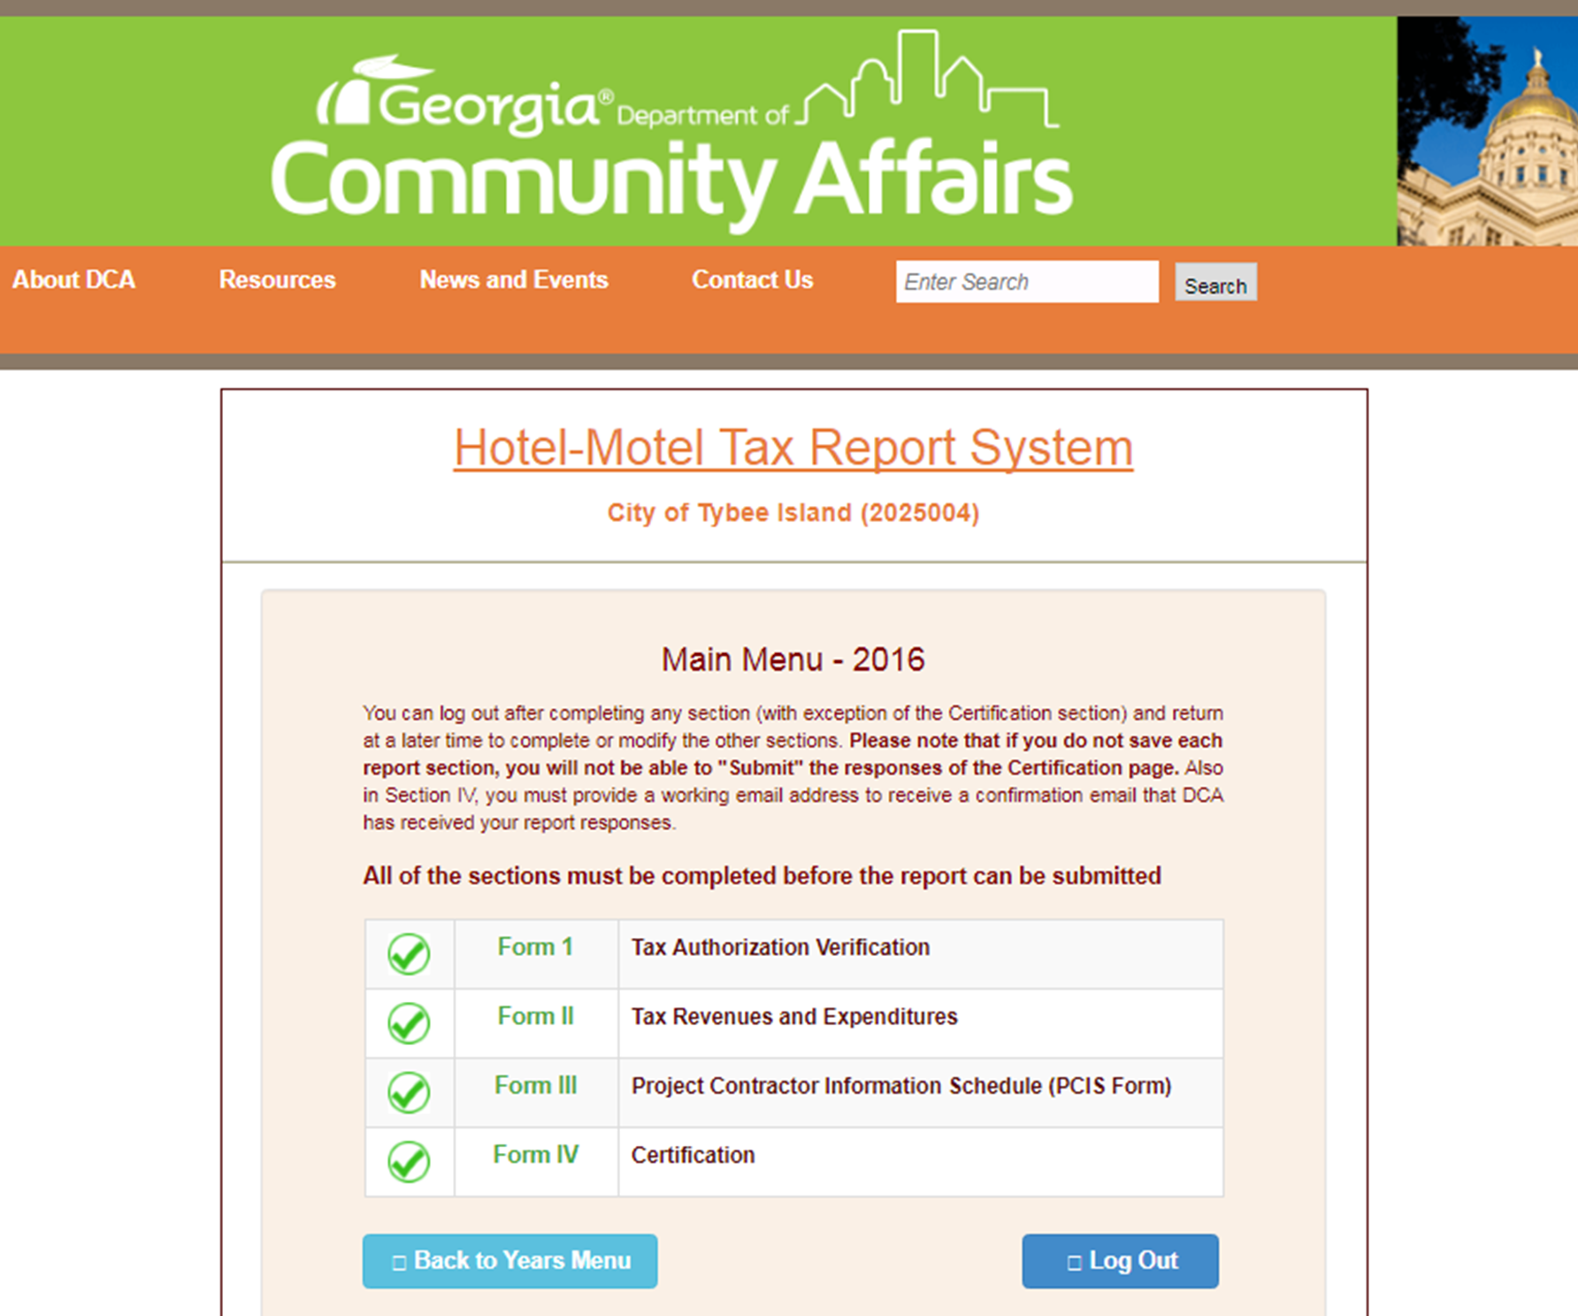
Hotel-Motel Tax Report
Within six (6) months of the end of the fiscal year, each jurisdiction imposing the HMT is responsible for completing the Hotel Motel Tax Report
  Confirm rate and ordinance
  Total Revenues (SR Fund 275);
  Expenditures by statutory purpose (amount of revenue allocated to TCT and TPD)
  Project Contractor Information Schedule (PCIS)
This uses the same login as DCA’s other web-based reports

Slide 24
Hotel-Motel Tax Report
“Schedule of all revenues therefrom which are expended for the promotion of tourism, conventions, and trade shows or any other tourism related purpose which is specified under Code Section O.C.G.A. § 48-13-51
Such schedule shall identify both the project or projects involved and the contracted entity involved in each such expenditure” O.C.G.A. § 36-81-8(b)(1)(B)
Have contracting entity (DMO) complete form and submit to local government

Slide 25
Additional Finance Requirements
HMT Audit Disclosure
48-13-51(a)(9)(B) requires the annual audit disclose:
Amount of funds expended during the fiscal year
Amount of tax receipts during the fiscal year
Expenditures as a percentage of tax receipts
Determination of compliance with the spending requirements
Contractor Audit Verification
County or municipality must require their contractor (DMO or other) to obtain “audit verification” that the expenditure requirements were met
Budget Plan
Both the contractor and the government must annually adopt a budget plan specifying how the funds must be spent
Compliance with such budget plan satisfies the requirement that funds be spent in the fiscal year they are collected

Slide 26
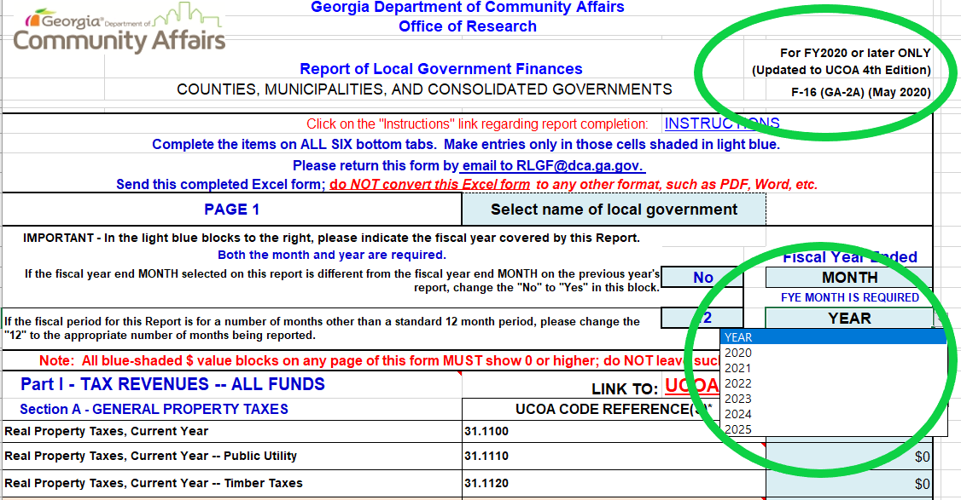
Report of Local Government Finance (RLGF)
UCOA based report on all revenues, expenditures, assets, and debts of all funds and agencies of the local government
Required under O.C.G.A. 36-81-8(b)(1)(a)
Includes revenue information on taxes, licenses and fees, enterprise funds etc.
Includes expenditures on general government, judicial, housing and development, etc.

Slide 27

Report of Local Government Finance (RLGF)
Due for all local governments regardless of size or type within 6-months of your fiscal year.
Locked 6-page excel file which should be completed and emailed to RLGF@dca.ga.gov, we will send a confirmation back.
Local Governments and auditors sometimes miscommunicate on ultimately sending it to DCA.
Extensions are independent of DOAA’s audit extensions, can be submitted before audited figures are available.

Slide 28
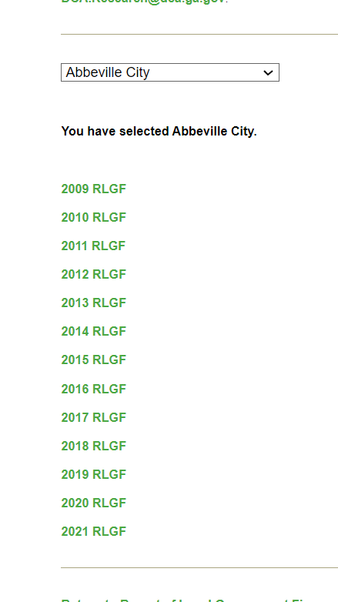
Report of Local Government Finance (RLGF)
If the full audit isn’t available, use last year’s as a guide
Submitting tentative numbers to maintain compliance is okay
Make sure all sections are completed, including those on debt, assets and fund balances

Slide 29
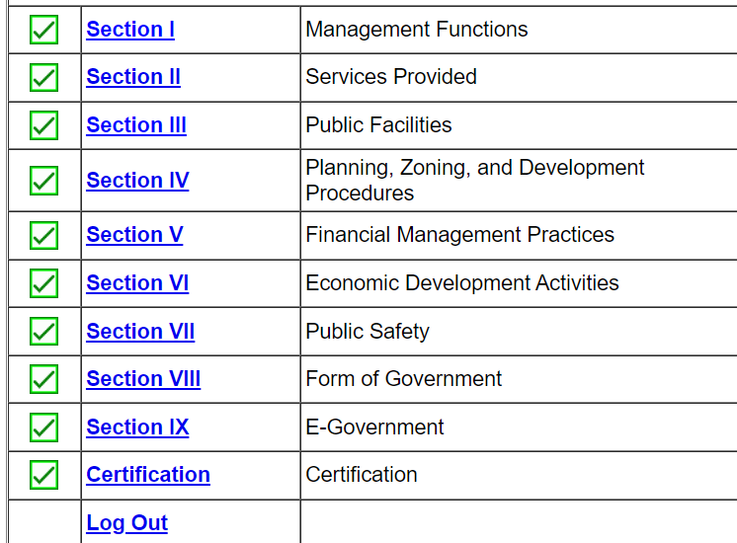
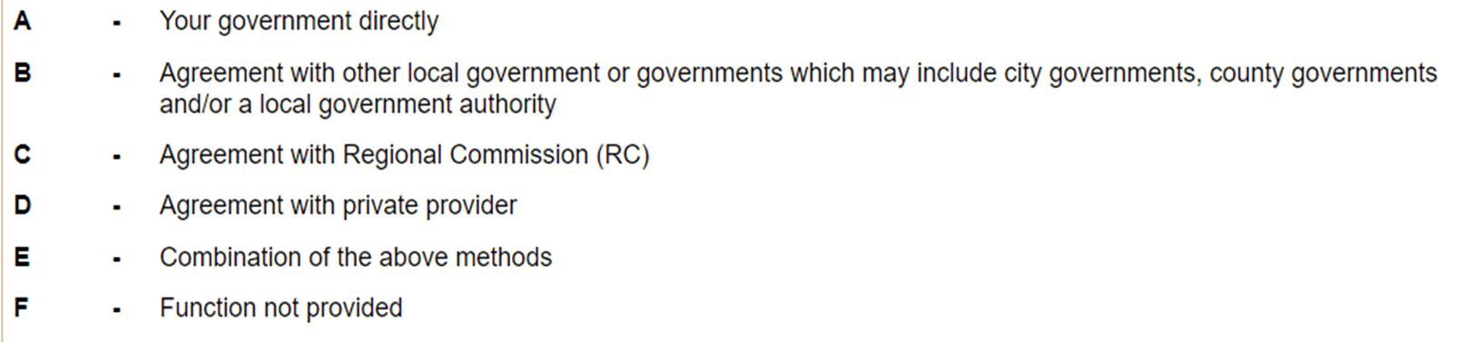
Government Management Indicators (GOMI)
Annual survey collecting information on local government operations, service delivery, and management.
DCA is required by O.C.G.A. 36-81-8(b)(h) to maintain and publish information on certain community indicators.
Nine sections on almost every aspect of local government.
Each section has about 10-15 questions on the structure and depth of each function.

Slide 30
Government Management Indicators (GOMI)
Planning, Zoning and Development
Who enforces your zoning ordinance?
What codes do you enforce?
Who maintains the comp plan?
Financial Management Practices
Time frame of the capital budget?
Who is your designated Budget Officer?
How is LOST share determined?
Economic Development Activities
Do you have a full-time economic development Director?
What incentives do you use to attract new industry?
Level of government financial support to Development Authority?

Slide 31
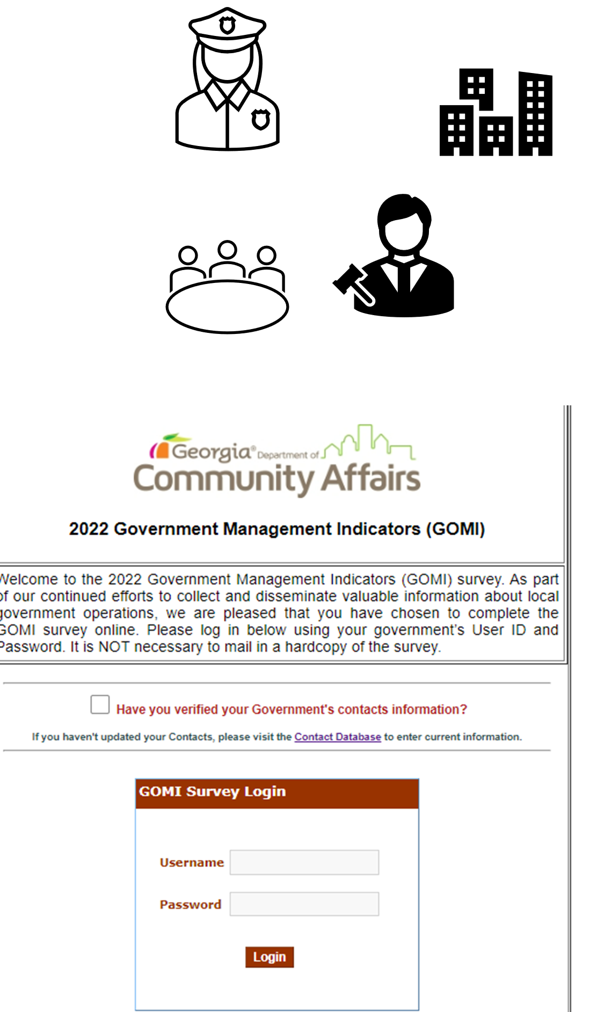
Government Management Indicators (GOMI)
Due on June 30 by all local governments regardless of size, type, or fiscal year.
Typically published each year in April and reminder emails sent out to government contacts.
Link to submission portal can be found on our website.
Uses your governments unique Username and Password.

Slide 32
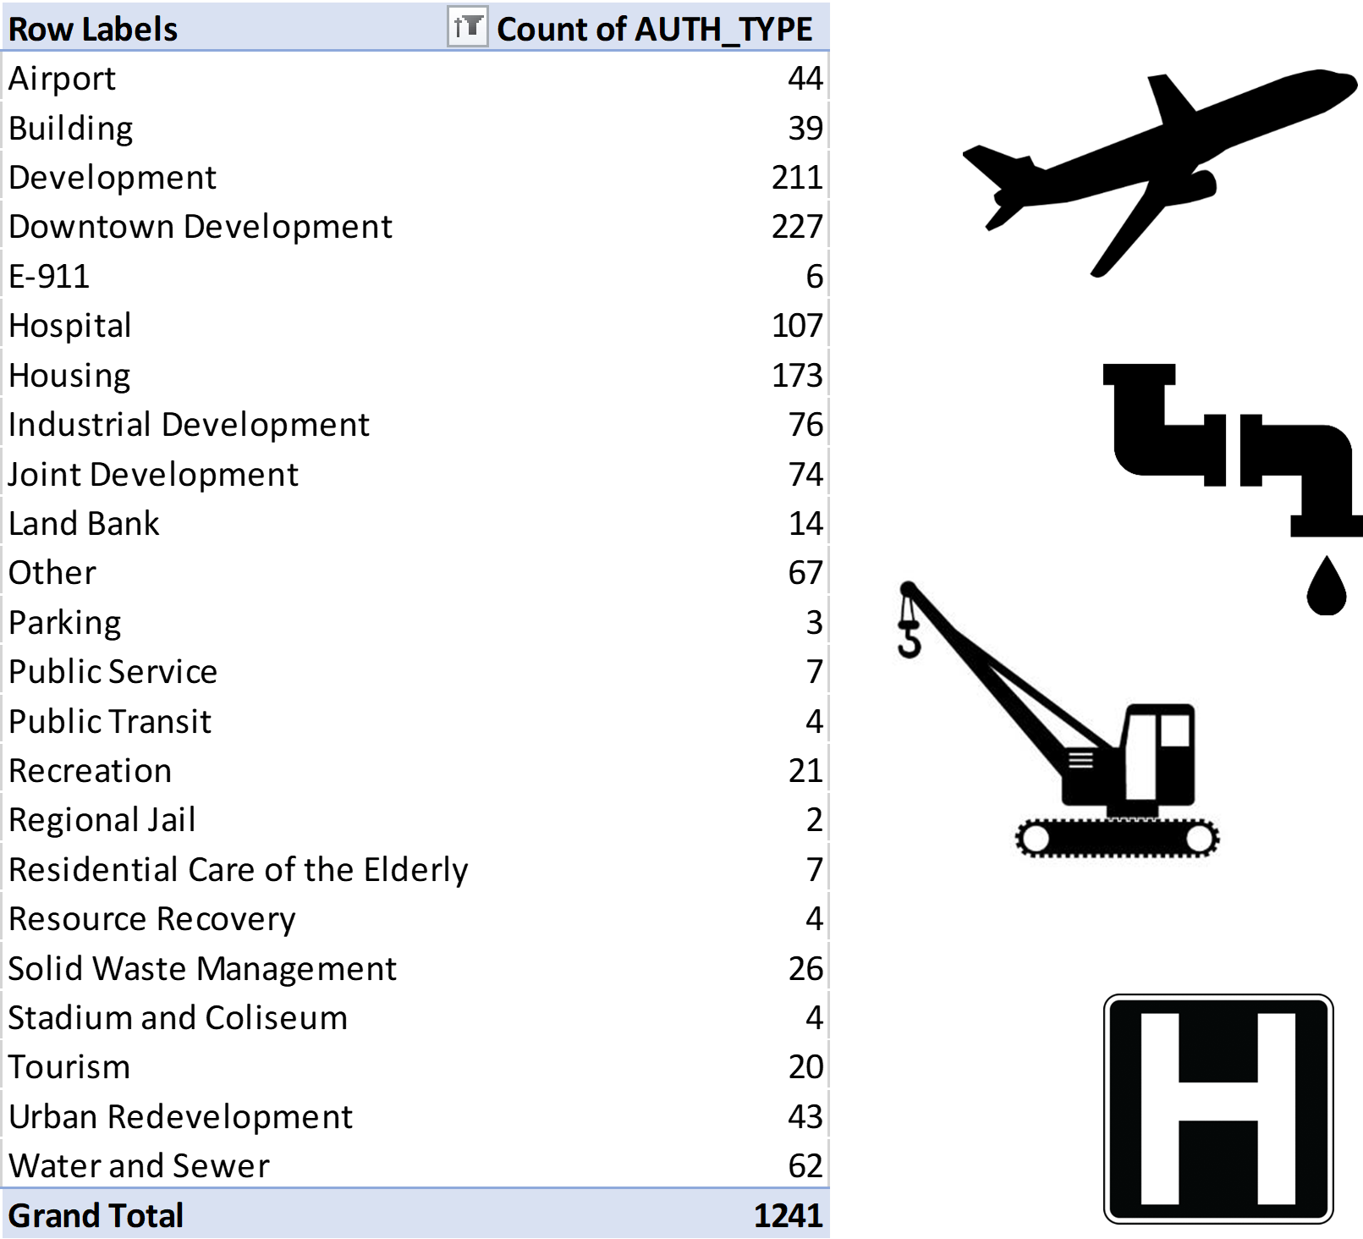
Annual Authority Registration and Financial Report (AARF)
UCOA based report on all revenues, expenditures, assets, and debts of local authorities.
Required under O.C.G.A. 36-81-8(b)(2)
Submitted within 6-months of the authority’s FYE
All local authorities, regardless of type, creation method, or degree of independence should be completing this report annually.
Two components:
  Registration (board members, staff, legal information)
  Authority finances (revenues, expenditures, assets, debts).

Slide 33
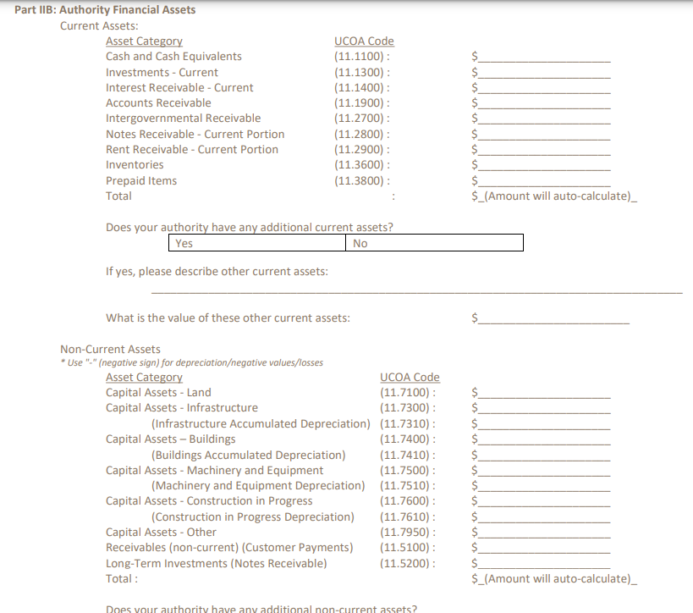

Slide 34
Poll: SESSION B - POLL QUESTION #3
What is the report that all local authorities, regardless of type, creation method, or degree of independence should be completing annually?
Government Management Indicators (GOMI)
Annual Authority Registration and Financial Report (AARF)
Uniform Chart of Accounts (UCOA)

Slide 35
Poll: SESSION B - POLL QUESTION #3
What is the report that all local authorities, regardless of type, creation method, or degree of independence should be completing annually?
Government Management Indicators (GOMI)
Annual Authority Registration and Financial Report (AARF)
Uniform Chart of Accounts (UCOA)

Slide 36
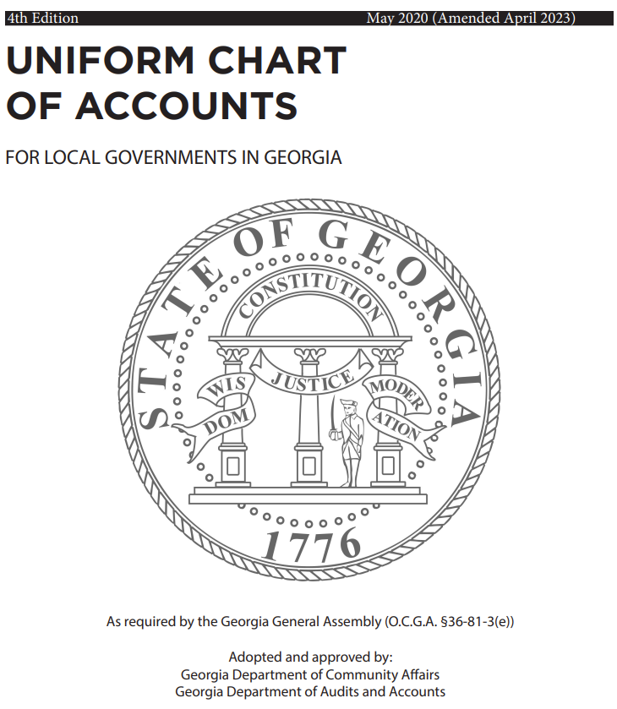
Uniform Chart of Accounts
Required under O.C.G.A. 36-81-3, the same statute requiring an annual balanced budget.
Tasks DCA with creating the UCOA in cooperation with ACCG and GMA.
Because of this, DCA administratively houses and facilitates updates, but all revisions must be approved by the State Auditor.

Slide 37
Updating the Uniform Chart of Accounts
New Funding Stream
GASB Statement
Questions from Auditors or Local Governments
Engage with Our Partners at DOAA, CVIOG, GMA, ACCG
Public Hearing, Notice to Legislative Counsel
Approval by DCA Commissioner and State Auditor
Full document and an FAQ available on our website.
For questions on using the account, reach out to research@dca.ga.gov.
We will assist to the extent that we can, we are limited with our ability to provide general accounting advice or interpretations.
Feedback is recorded to be reviewed at UCOA working group meetings as needed.

Slide 38
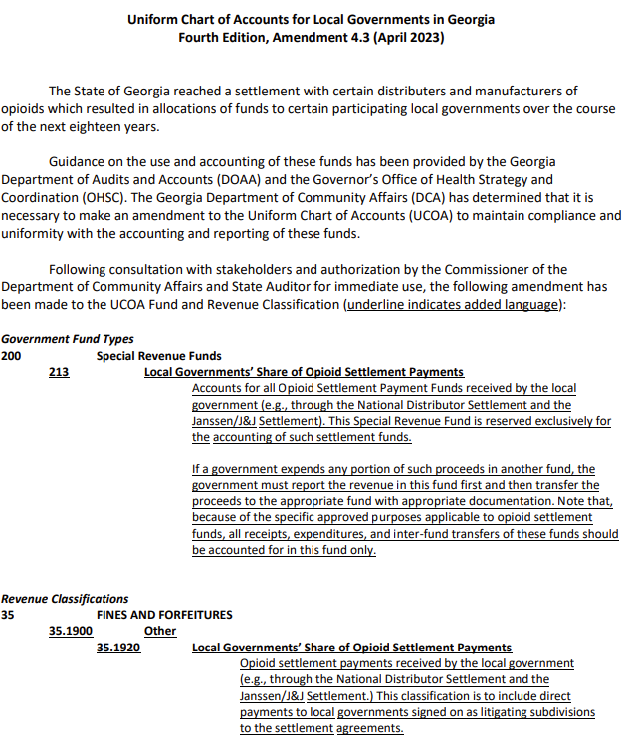
Updating the Uniform Chart of Accounts
The process was just carried out for the accounting of Opioid Settlement Funds.
Amendment became effective July 1, 2023.
Requires use of a special revenue fund for the Local Governments’ Share of Opioid Settlement Payments.
Creates a new revenue classification under Fines and Forfeitures.

Slide 39
Thanks!
John ‘Jack’ Brock
John.Brock@dca.ga.gov
Research@dca.ga.gov
Direct: 404.679.3105
Research and Data Analyst
dca.ga.gov

